Slide 1
Fluorescence in situ hybridization (FISH)
Fluorescence in situ hybridization (FISH) is a molecular cytogenetic technique that uses fluorescent probes that bind to only particular parts of a nucleic acid sequence with a high degree of sequence complementarity.
FISH is used to detect and localize the presence or absence of specific DNA sequences on
chromosomes.
Fluorescence microscopy can be used to find out where the fluorescent probe is bound to the chromosomes.
FISH can also be used to detect and localize specific RNA targets (mRNA, lncRNA and
miRNA) in cells, circulating tumor cells, and tissue samples.
In this context, it can help define the spatial-temporal patterns of gene expression
within cells and tissues.

Slide 2
The nuclear DNA of interphase or metaphase is considered as the most suitable target.
Hybridization of fluorescent-labeled DNA probe to denatured DNA of metaphase
Chromosome
Labeling: Direct or Indirect
If two probes: Relative position of two markers can be identified on a chromosomes
DNA must be made single stranded without destroying the morphology of the
Chromosome…………..with Formamide treatment.

Slide 3
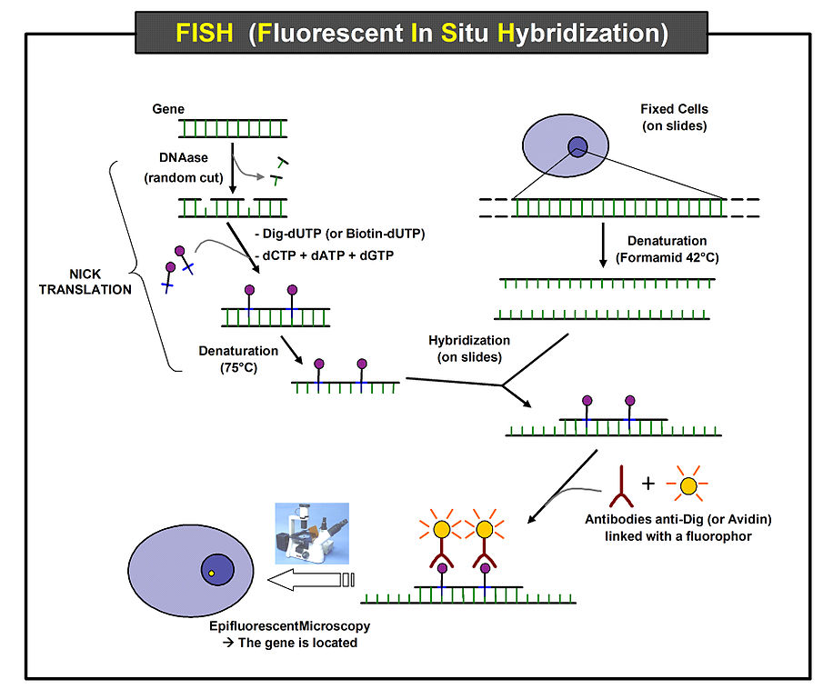

Slide 4
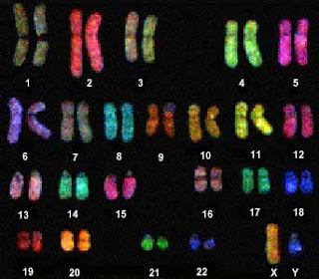
Whole chromosome painting probes
Repetitive sequence probes
Locus specific probes
Albert PS, Zhang T, Semrau K, Rouillard JM, Kao YH, Wang CR, Danilova TV, Jiang J, Birchler JA. Whole-chromosome paints in maize reveal rearrangements, nuclear domains, and chromosomal relationships. Proc Natl Acad Sci U S A. 2019 Jan 29;116(5):1679-1685.

Slide 5
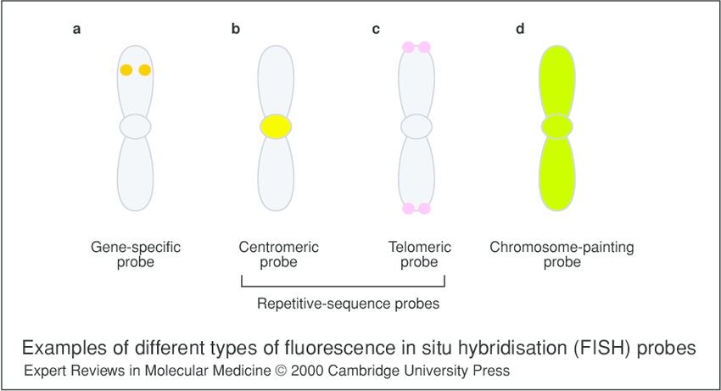

Slide 6
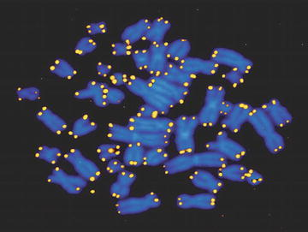
Repetitive sequence probes
(Quantitative) Q-FISH has become an important tool in studying the role of telomeres in aging and cancer.

Slide 7
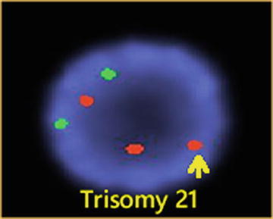
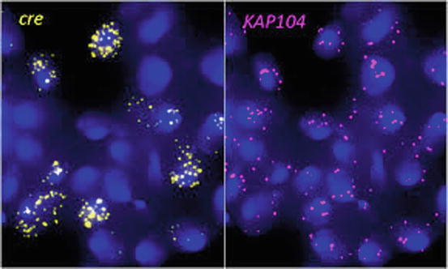
RNA
FISH

Slide 8
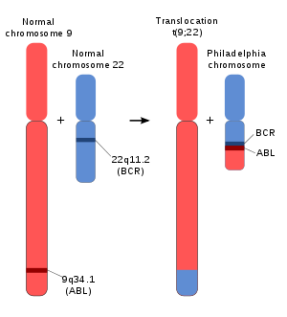
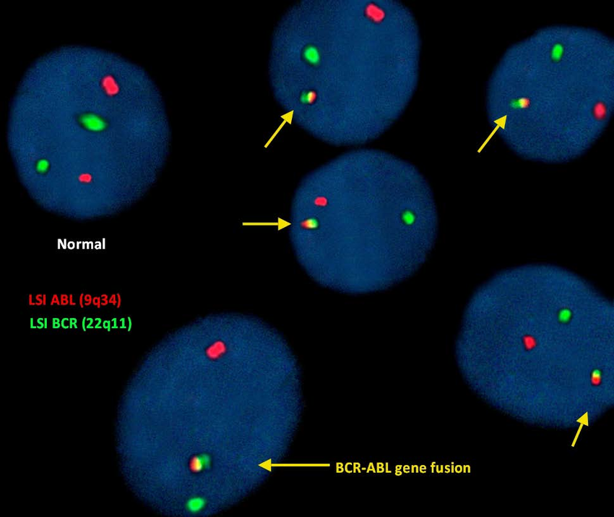
Chronic myeloid leukemia

Slide 9
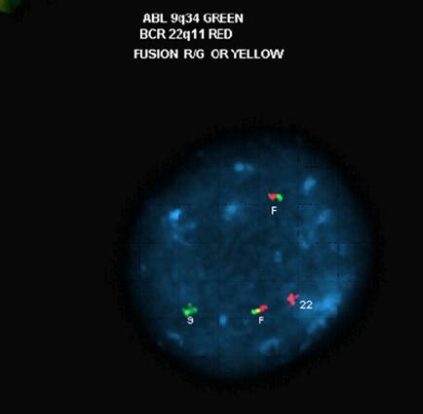

Slide 10
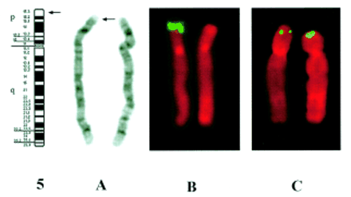
Cri du chat syndrome: (5p minus) syndrome

Slide 11
Applications of FISH
Fluorescence in situ hybridization (FISH) provides researchers with a way to visualize and map the genetic material in an individual's cells, including specific genes or portions of genes. This may be used for understanding a variety of chromosomal abnormalities and other genetic mutations.
FISH has become an essential tool for gene mapping and characterization of
chromosome aberrations. Since the target DNA remains intact, unlike in molecular
genetic analysis, information is obtained directly about the positions of probes in
relation to chromosome bands or to other hybridized probes. Using differentially
labeled probes, chromosome aberrations on particular chromosomes or chromosomal
regions can be easily defined. The diseases that have been diagnosed using
FISH include Prader-Willi syndrome, Angelman syndrome, 22q13 deletion syndrome,
chronic myelogenous leukemia, acute lymphoblastic leukemia, Cri-du-Chat
syndrome, velocardiofacial syndrome, and Down syndrome. The analysis of chromosomes 21, X, and Y can identify oligozoospermic individuals at risk

Slide 12
Applications of FISH
In medicine, FISH can be used for diagnosis, evaluation of prognosis, and evaluation of remission of a disease such as cancer. FISH can be used to detect diseased cells more easily than standard cytogenetic methods.
Targeting nuclear RNA and the corresponding genes within cells or within a single cell or from a single allele can provide important information about gene expression, processing, and transport of transcripts in normal and mutant cells.

Slide 13
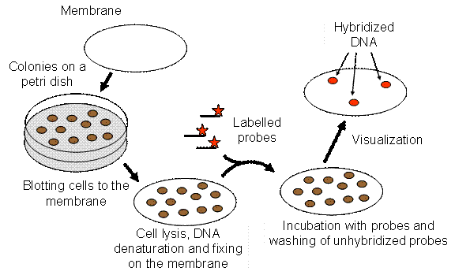
Colony Hybridization
Colonies of bacteria which contain specific DNA can be selected or identified by colony
Hybridization.

Slide 14
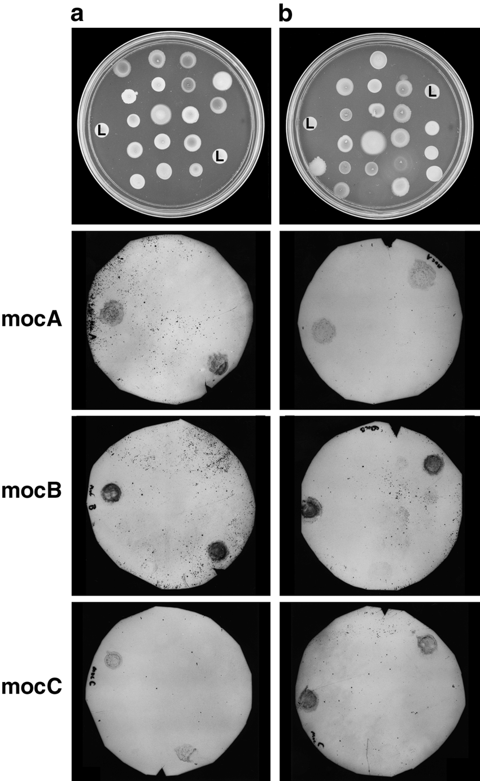
Digoxigenin labeled DNA probe

Slide 15
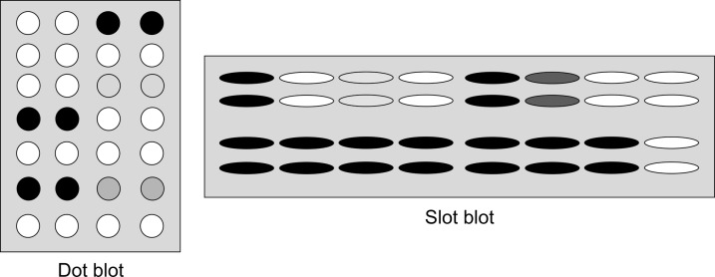
DOT BLOT ASSAY

Slide 17
Electrophoretic Mobility Shift Assay (EMSA)
The electrophoretic mobility shift assay (EMSA) is a rapid and sensitive method to detect protein-nucleic acid interactions.
It is based on the observation that the electrophoretic mobility of a protein-nucleic acid complex is typically less than that of the free nucleic acid.
Also referred as,
Gel shift assay
Gel mobility shift assay
Band shift assay
Gel retardation assay
Titration of a 214 bp lac promoter DNA fragment with E. coli CAP protein

Slide 18
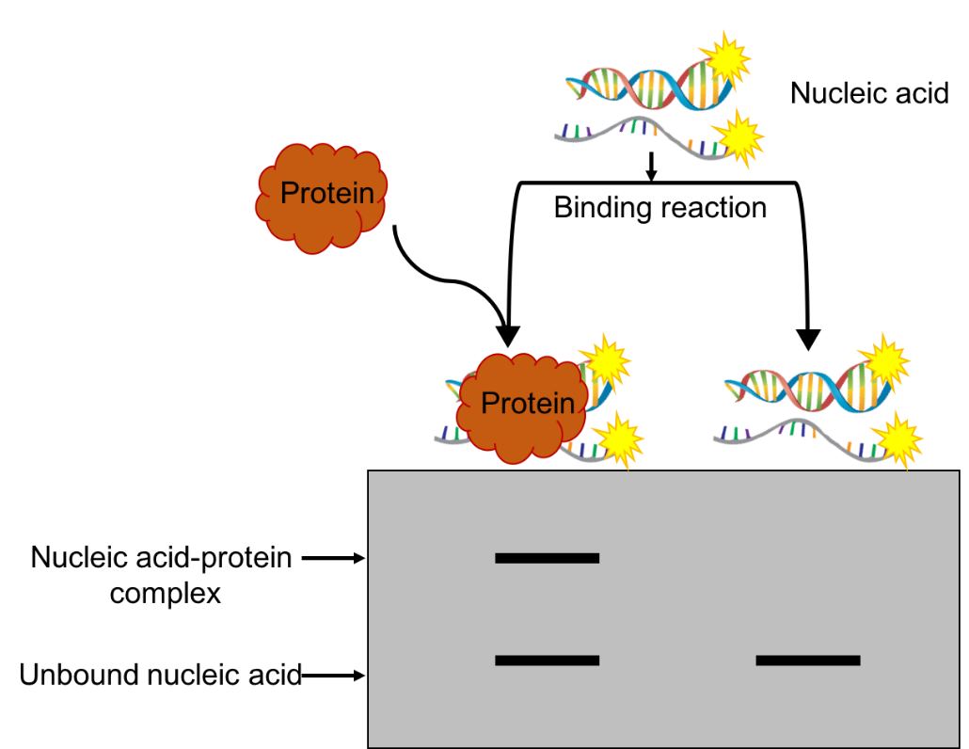

Slide 19
Once the length of the nucleotides is sufficient for the binding of two or more proteins, the protein–DNA complexes migrate as distinct bands, usually referred to as a super shift.

Slide 20
RNA electrophoretic mobility shift:
To get ides about the RNA binding protein
Limitation:
Electrophoretic mobility of a complex provides little direct information about the location of the nucleic acid sequences that are occupied by protein.

Slide 21
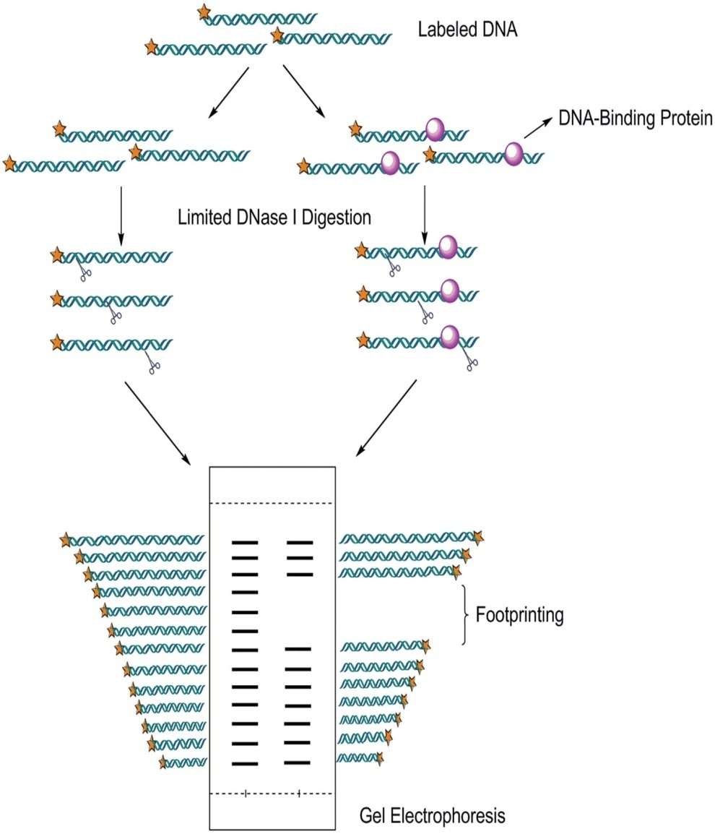
Footprinting Assay
This assay allows us to identify the sites, where protein binds.
DNase I footprinting assay: Identification of the DNA sequence to which protein binds.

Slide 22
Methylation Interference Assay
Methylation interference assay is a method of identifying which regions of DNA strands bind to specific proteins by methylation modification of nucleotides.
The rationale is that dimethyl sulfate (DMS) methylates the exposed guanine residue (G) in DNA, the piperidine in turn chemically cleaves methylated guanine residues.
Methylation interference assay can be used to study the relationship between transcription factors and guanine residues in DNA binding sites.
It is also an effective complement to DNase I footprinting assay to identify the precise location of DNA-protein interactions.

Slide 23
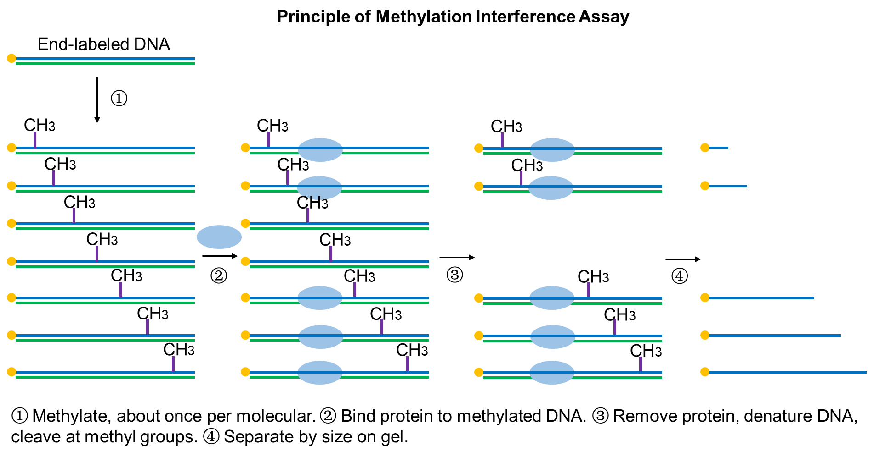

Slide 24
