Slide 1
A bacterial artificial chromosome (BAC) is a DNA construct, based on a functional fertility plasmid (or F-plasmid), used for transforming and cloning in bacteria, usually E. coli.
F-plasmids play a crucial role because they contain partition genes that promote the even distribution of plasmids after bacterial cell division.
The bacterial artificial chromosome's usual insert size is 50–350 kb.
A similar cloning vector called a PAC has also been produced from the DNA of P1 bacteriophage.
BACs are capable of maintaining human and plant genomic fragments of little greater than 300 kb for over 100 generations with a high degree of stability (Woo et al. 1994) and have been used to construct genome libraries with an average insert size of 125 kb (Wang et al. 1995a).

Slide 2
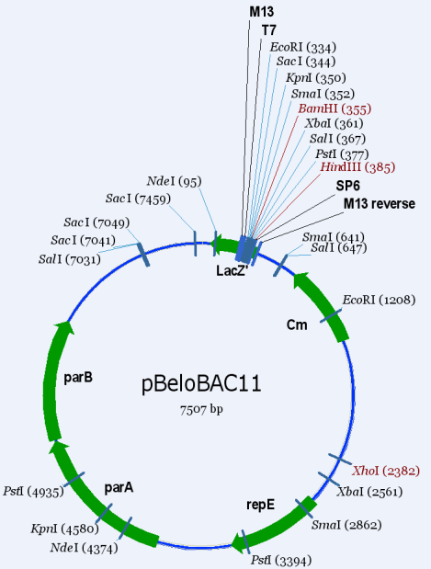
A BAC Vector

Slide 3
Cloning vectors and their insert capacities
Vector system | Host cell | Insert capacity (kb)
Plasmid | E. coli | 0.1-10
Bacteriophage λ | E. coli | 5-25
Cosmid | E. coli | 35-45
Bacteriophage P1 | E. coli | 70-100
BAC (bacterial artificial chromosome) | E. coli | 50-300
P1 bacteriophage-derived AC (PAC) | E. coli | 100-300

