Slide 1
Signal Flow Graphs

Slide 4
Signal Flow Graphs

Slide 16
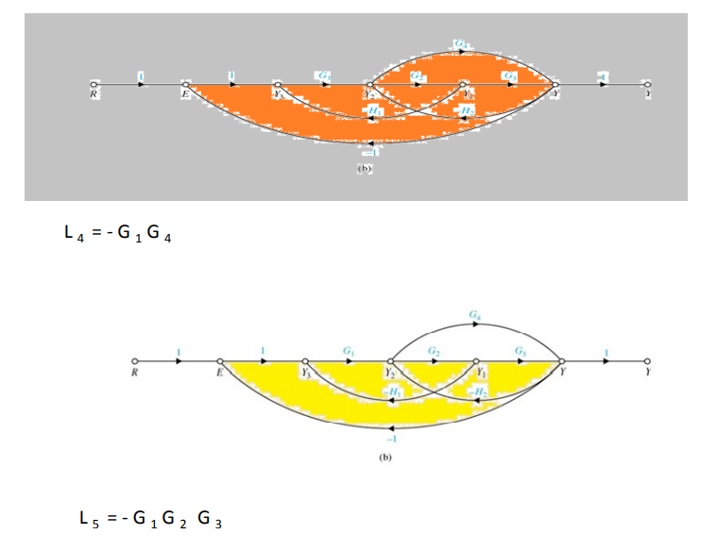

Slide 18
Thank You

