Slide 1
B.Pharm. 5th Semester PHARMACOGNOSY AND PHYTOCHEMISTRY II BP504 T
Anju Singh
School of Pharmaceutical Sciences,
CSJM University, Kanpur

Slide 2
UNIT-II
General introduction, composition, chemistry & chemical classes, biosources, therapeutic uses and commercial applications of following secondary metabolites:
Alkaloids: Vinca, Rauwolfia, Belladonna, Opium,
Phenylpropanoids and Flavonoids: Lignans, Tea, Ruta
Steroids, Cardiac Glycosides & Triterpenoids: Liquorice, Dioscorea, Digitalis
Volatile oils : Mentha, Clove, Cinnamon, Fennel, Coriander,
Tannins: Catechu, Pterocarpus
Resins: Benzoin, Guggul, Ginger, Asafoetida, Myrrh, Colophony
Glycosides: Senna, Aloes, Bitter Almond
Iridoids, Other terpenoids & Naphthaquinones: Gentian, Artemisia, taxus, carotenoids

Slide 3
RUTA
Ruta is known by the name Rue
herb of grace or common rue is grown as an ornamental plant
Herb is used for Medicinal prop. used as condiment & as a insect repellent also
It has strong smelling leaves
It was known to ancient Romans, natural pedanius dioscorides & pliny the elder.
They recommended that the rue in combination with poisonous shrub oleander can be taken as an antidote to poisonous snake bites
In Southern India, Rue is grown in home gardens to repel snakes

Slide 4
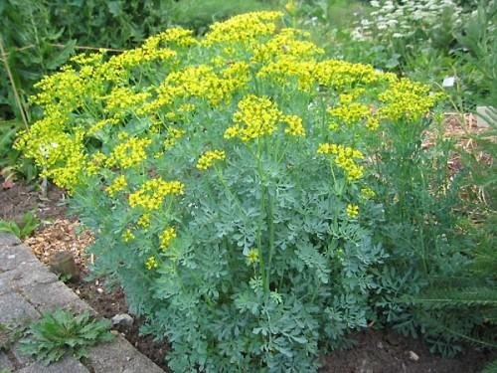
Biological source: consist of entire plant, Ruta graveolens Family: Rutaceae
Garden Rue (Ruta graveolens L.)
It is commonly known as –
Rue/Common Rue/Garden Rue/ Herb of Grace
Rutaceae , genus –Ruta in Latin, means “Bitter” and species graveolens –means “strong smelling”
Indigenous to Mediterranean region and distributed in South America, China, India, Middle East and South Africa

Slide 5
Description
Herbaceous perennial evergreen medicinal shrub with blue-green foliage and grows up to 75 cm heigh
Leaves are compound, shortly petiolate with ultimate segments obovate-oblong
Flowers are yellow in colour with 4-5 petals
Fruits are capsules and shortly pedicelled contains numerous seeds
Organoleptic characters
color: bluish green leaves,
odour: strongly aromatic & characteristic ,
Taste: pungent ,
Flower: greenish yellow

Slide 6
Rue contains about 0.5% of volatile oil, flavonoids, coumarins, and furoquinoline alkaloids which are valued in pharmaceutical industry
Responsible for the bitter taste is Rutin (7 to 8% in the dried leaves)
Chemical constituent:
Flavanoid glycoside: Rutin pale yellow color cyrstalline compound
Alkaloids: Rutalinium, dictamine, rutamin etc.
Fixed oil: linoleic acid, stearic, palimitic, acid
Volatile oil: limonene, cineole, ethyl valerate, methyl salicylate, caryophylline, myrecine
Others: Psoralin, bergaptin, graveoline, rutarin

Slide 7
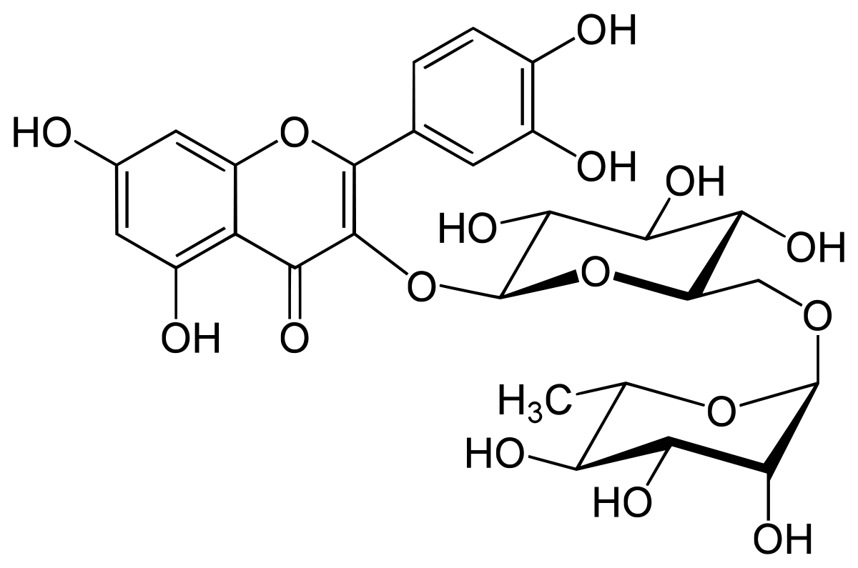
RUTIN
also called rutoside, quercetin-3-O-rutinoside and sophorin, is the glycoside combining the flavonol quercetin and the disaccharide rutinose
(α-L-rhamnopyranosyl-(1→6)-β-D-glucopyranose). It is a citrus flavonoid found in a wide variety of plants including citrus.
Rutin on hydrolysis give quercetin and Rhamnose plus glucose
2-(3,4-dihydroxyphenyl)-5,7-dihydroxy-3-[α-L-rhamnopyranosyl-(1→6)-β-D-glucopyranosyloxy]-4H-chromen-4-one

Slide 8
Uses
Capillary protectant , antitussive, Spasmolytic, Emmenagoggue (to stimulate menstrual flow) (infusion or liq. extract),
Rutin used in combination with ascorbic acid to treat capillary bleeding, blood vessel protectant
pharmacological activities including contraceptive, anti-inflammatory, antimicrobial, antipyretic, antioxidant, analgesic, antihyperglycemic, free radical scavenging, hypotensive, antiviral, and antiplasmodial effects.

Slide 9
Tea Thea Sinensis or Camellia thea
Biological Source
It contains the prepared leaves and leaf buds of Thea sinensis (Linne) kuntz., belonging to family Theaceae.
Geographical Source
It is mainly cultivated in India (Assam), Ceylon, Japan and Java.
Organoleptic characters:
Taste: Bitter, astringent
Color: Dark green, Odour agreeable
CC.: Condensed tannins, derivatives of

Slide 10
Leaves are dark green in colour, lanceolate or elliptical, on short stalks, blunt at apex, base tapering, margins shortly serrate, young leaves hairy, older leaves glabrous.

Slide 11
Tea Thea Sinensis or Camellia thea
Trace compounds: Amino acids, proteins, yellow volatile oil (responsible for odor)
Purine Alkaloids: Xanthine bases- caffeine 1-3 %, Theobromine, Theophylline in mior amts., enzymatic mixture called thease
Color of leaves : because of gallotannic acid
Caffeine: 1,3,7, tri methyl xanthine
Chemical Test: For caffeine, purine alkaloids

Slide 12
TEA
Flavanol: Catechin, epicatechin, epigallocatechin, Gallotannic acid (15-20%), epicatechin gallate
Potentiates the action of ergotamine tartarate & enhances the analgesic activity in migraine
Natural phenol & antioxidant
2 benzene rings, dihydropyran heterocycle with hydroxyl group on C 3, A ring similar to resorcinol, B is similar to catechol moiety
4 diastereoisomers, 2 are catechin, 2 are epicatechin

Slide 13
Chemical Tests
1. Caffeine and other purine alkaloids, gives murexide colour reaction. Caffeine is taken in a petridish to which hydrochloric acid and potassium chlorate are added and heated to dryness. A purple colour is obtained by exposing the residue to vapours of dilute ammonia. In addition of fixed alkali the purple colour disappears.
2. Caffeine also produces white precipitate with tannic acid solution.
Uses
CNS stimulantdue to cerebral vasoconstrictor, In diabetes as diuretic, astringent, antioxidant, beverages, green tea- obesity, weight loss,

