Slide 1
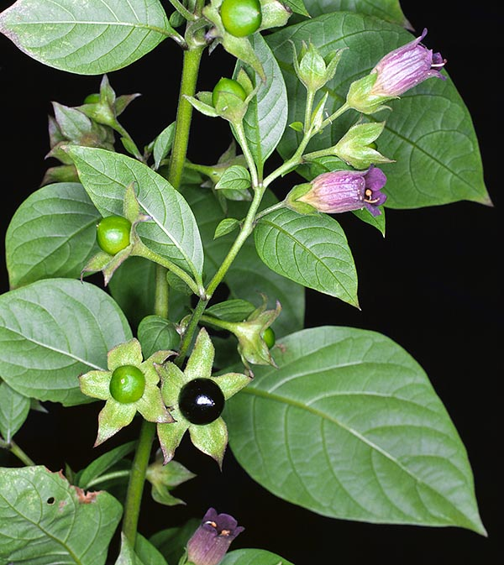
BP504 T. PHARMACOGNOSY AND PHYTOCHEMISTRY II (Theory)
Topic:- Atropa Belladonna
Dr. Anju Singh
Asst Professor
School of Pharmaceutical Sciences CSJM University Kanpur

Slide 2
TROPANE ALKALOIDS
More than 200 different tropane alkaloids are known, for ex. atropine and scopolamine.
Tropane alkaloids: 2 category
1st cocaine alkaloid
2nd Atropine alkaloid: genus Solanum
Atropa belladona: 0.4-1%
Datura stramonium: 0.2%
Hyoscyamus niger: 0.05%
Other solanaceous alkaloids:Hyoscyamine, Hyoscine or scopolamine, apoatropine, belladonine

Slide 3
Tropane alkaloids
They are class of bicyclic amine – pyrrolidine & piperidine ring sharimg a common N atom & 2 C atoms. alkaloids.
Contains 8 aza bicyclo octane nucleus
TAs are either esters of 3α-tropanole (tropine) or,
To a lesser extent, 3β-tropanole (pseudotropine)

Slide 4
Atropa Belladonna
SYNONYMS : Belladonna Leaf, Belladonna Folium.
Biological Source : Belladonna herb consists of dried leaves and other aerial parts of Atropa belladonna (Europian belladona)and Atropa acuminate (Indian belladona).
It belongs to family Solanaceae.
Geographical Source : It is indigenous to and cultivated in England and other European countries.
In India, it is found in the Western Himalayas from Shimla to Kashmir and adjoining areas of Himachal Pradesh.

Slide 5
Morphology
COLOUR : LEAVES – Green to brownish green.
FLOWERS – Purple to yellowish brown.
FRUITS – Green to brown.
ODOUR : Slight and characteristics.
TASTE : Bitter and acrid.
SIZE : LEAVES – 5 to 25 cm long and 2.5 to 12 cm wide.
FLOWERS – Corolla 2.5 cm long and 1.5 cm wide.
FRUITS – About 10 cm in diameter.
SHAPE : LEAVES – Ovate, lanceolate, with acute apex, decurrent lamina, entire margin.
FLOWERS – Campanulate and small reflexed lobes of corolla.
FRUITS – Sub-globular in shape with numerous flat seeds.

Slide 6
Morphology of Flower Fruit and leaves
Epidermal cellswith slightly, sinuousanticlinal wall
Striated cuticle
Anisocyticstomata
Uniseriate multicellularcovering trichomes
Glandular trichomes which are uniseriate and with unicellularheads
The palisaderatio is 5 to 7

Slide 7
T. S of Belladonna

Slide 8
Belladona herb
Deadly night shade leaf (European belladonna).
consists of dried leaves & other aerial parts of Atropa belladonna Linn. (European belladonna) or Atropa acuminata Royle ex-Lindley (Indian belladonna), family Solanaceae. contains not less than 0.3 % of the alkaloids of belladonna herb, calculated as l-hyoscyamine.
In ancient times, the juice of this plant was used as a cosmetic, because of its dilatory effect on the pupil of the eye. This drug was first introduced in the London Pharmacopoeia in 1809.

Slide 9
Belladona herb
Chemical Constituents:
The total alkaloidal content of drug is 0.4 – 1% & varies in different parts of plant, roots (0.6 %), stems (0.05 %), leaves (0.4 %), unripe and ripe berries (0.19 - 0.21 %) and seeds (0.33 %).
The main alkaloids are l-hyoscyamine and its racemic form is atropine.
The drug also contains belladonine, scopoletin (I - methyl aesculetin), hyoscine, pyridine and N - methyl pyrroline. The later two are the volatile bases. Homotropine is a synthetic compound and is preferred in the medical profesion as the synthetic process of atropine and hyoscyamine is very costly.

Slide 11
Tests
Vitali Morin reaction: alkaloid+drops of sulphuric acid , evaporate to dryness, add 0.3ml of 3% meth. , produces purple color, KOH
Hyoscine HBr + AgNO₃ sol. – yelowish white ppt. – insol. In HNO₃, soluble in dil. NH₃
Gerrard’s test: Alkaloid+ 2%HgCl2 in 50% ethanol – Red color by atropine,
Red after warming- Hyoscyamine, Hyoscine- White ppt

Slide 12
Uses/ Applications
Uses It is the parasympatholytic drug with anticholinergic properties. It is used to reduce the secretions such as sweat, saliva and gastric juice and also to reduce spasm in cases of intestinal gripping due to strong purgatives. It is also used as an antidote in opium and chloral hydrate poisoning.
Dose 0.6 to 1 ml in the form of belladonna tincture - 4 times a day.

