Slide 1
Brady’s Volleyball Skill Test
by
Dr. Ashish Kumar Dubey
Head
Department of Physical Education
C.S.J.M University, Kanpur

Slide 2
Brady’s Volleyball Skill Test
Brady constructed a volleyball skill test on 537 college men volleyballers. It was constructed by Brady in 1945. The test-retest reliability coefficient reported is 0.92 while the validity coefficient has been reported to be 0.86. The test was constructed to measure general volleyball playing ability of college men.
Purpose
The test was constructed to measure general volleyball playing ability of college men.
Equipment
Standard inflated volleyballs, wall marking chalk, tape, stopwatch and pair of staircases for support to mark the target
Test Target Dimensions
A target is marked on the wall with a good quality marking chalk, The target is bounded by a horizontal line of 5 feet length at a height of 11.5 feet from the floor/ground. The two ends of the horizontal line are extended upward toward the ceiling up to 3 to 4 feet high

Slide 3
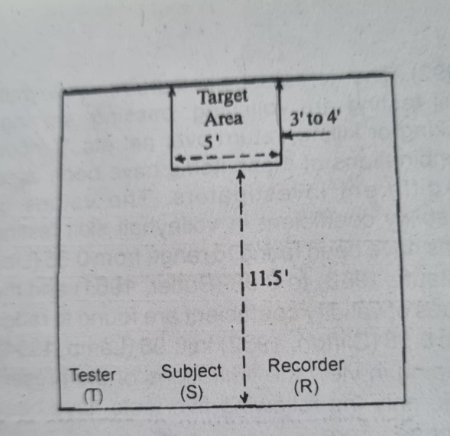
Test Administration
The subject/performer is asked to make a maximum number of volleys standing at any point/points in front of the target in one minute. He is specifically instructed that only legal volleys will be counted, that is, the subject should perform real volleys and not the thrown balls, and the volleys must hit the wall within the boundaries of the target. If the ball is caught or gets out of control, the subject is to be asked to repeat from the start. Two trials may be given and the best be considered. On the signal ‘Go’ the ball is tossed against the wall at the target area and the stopwatch is started. On rebound, the ball is volleyed into the marked target consecutively for one minute till the stop signal is given.
Scoring
The number of real volleys in one minute gives the score of the test.

