Slide 1
Enzyme Technology

Slide 2
Enzymes
biological catalysts
proteinaceous
specific catalytic site (active centre).
some enzymes contain → “cofactor”( nonprotein organic compound) → catalytically active
“apoenzyme” → protein portion
holoenzyme → fully intact enzyme.

Slide 3
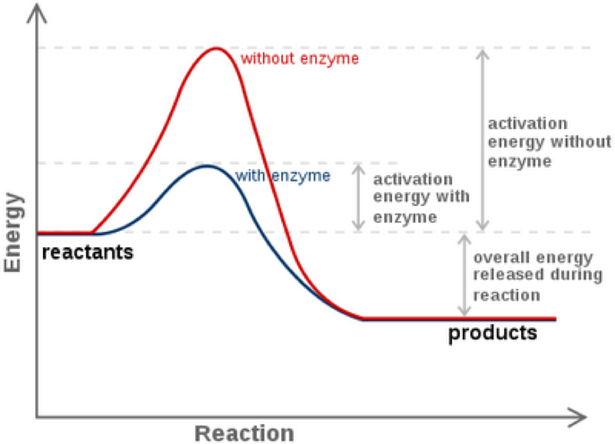
How does enzyme work

Slide 4
Cofactor + apoenzyme ® Holoenzyme (or enzyme)
Cofactors → simple divalent metallic ion (e.g. Ca2+, Co2+, Mg2+ , Mn2+ or Zn2+ ).
Cofactors → firmly bound to apoenzyme → prosthetic group.
Cofactors → loosely bound to apoenzyme → coenzyme.
Cofactors → stable to heat.
most enzyme → lose activity on heating.

Slide 5
Proenzyme or zymogen :
inactive form of enzymes → converted → active form.
Proenzyme – Pepsinogen → Enzyme - Pepsin
Proenzyme – Trypsinogen → Enzyme - Trypsin

Slide 6
PROPERTIES OF ENZYMES
protein in nature
larger than substrate molecules
substrate binds → active site or active centre of enzyme
active site → bear a specific complementary relationship → structure of the substrate (s) → w/c allows → an almost precise fit b/w them.

Slide 7
active site → made up of :
a) a binding site , and
b) a catalytic site.
only a few of the amino acids → take part in the catalytic mechanism,
others → determine the specificity of enzyme.
active site → amino acids → have reactive side-chain grouping e.g., cysteine , histidine and serine.

Slide 8
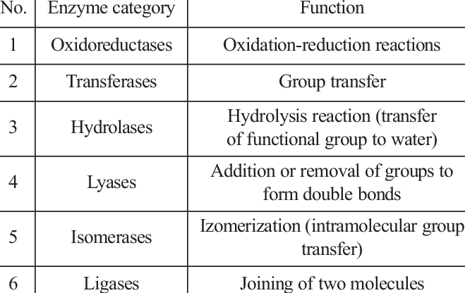
Classes of enzyme

Slide 9
Sources of food enzymes
Industrial enzymes have traditionally been derived from:
Plants: α-amylase, β-amylase, bromelain, β-glucanase, ficin, papain, chymopapain, and lipoxygenase
Animals: trypsins, pepsins, chymotrypsins, catalase, pancreatic amylase, pancreatic lipase, and rennin (chymosin)
Microorganisms: α-amylase, β-amylase, glucose isomerase,
pullulanase, cellulase, catalase, lactase, pectinases, pectin lyase, invertase, raffinose, microbial lipases, and proteases.

