Slide 1
Health Problems
Presented By:
Rajesh Pratap Singh
Associate Professor

Slide 3
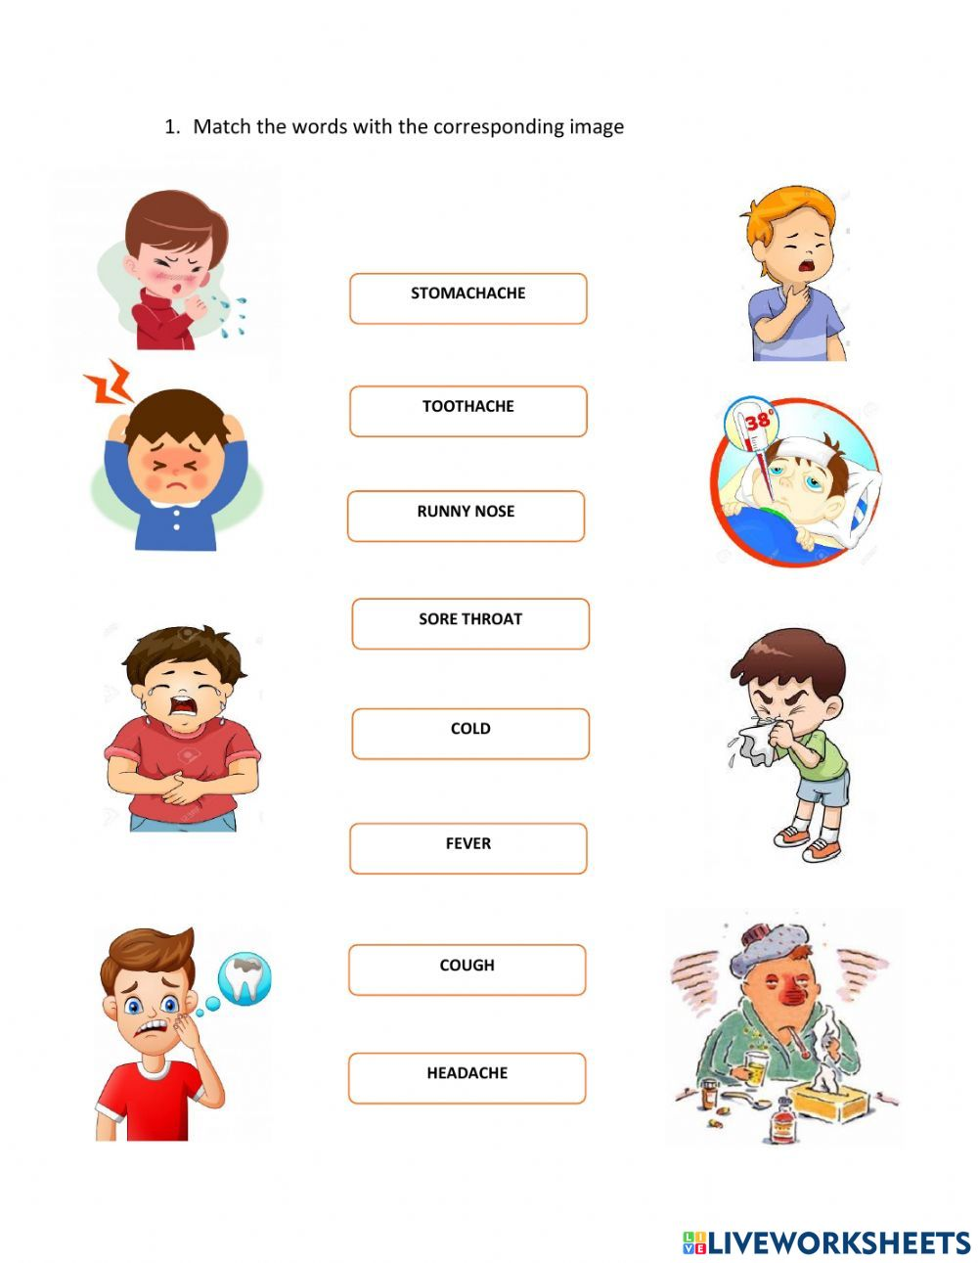

Slide 5
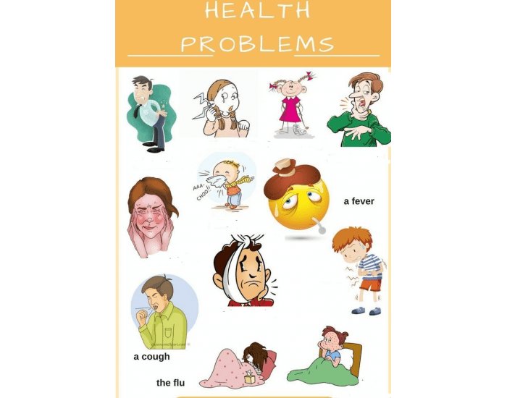

Slide 6
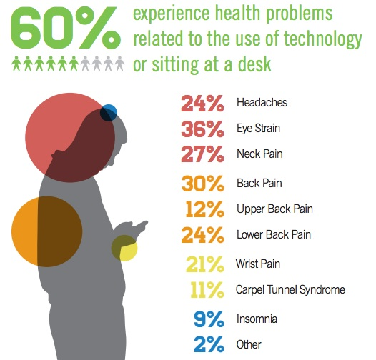

Slide 7
Health problems
There are many health problems in India but the main health problem which we are facing every day are as follows:
(i) Communicable disease संचारी रोग
(ii) Nutritional problem पोषण संबंधी समस्या
(iii) Environmental पर्यावरण स्वच्छता समस्या
Sanitation problem
(iv) Medical care problem चिकित्सा देखभाल समस्या
(v) Population Problem जनसंख्या समस्या

Slide 9
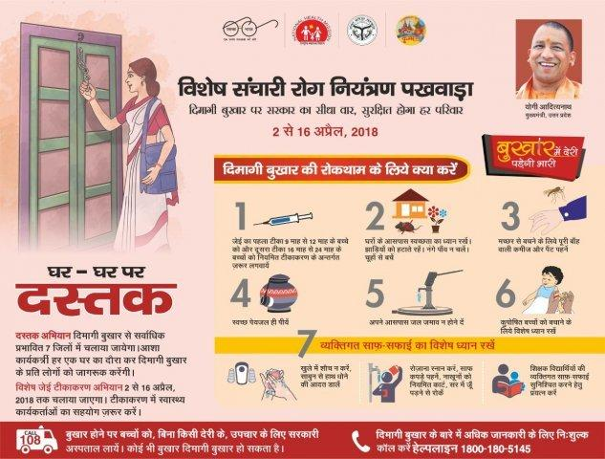

Slide 11
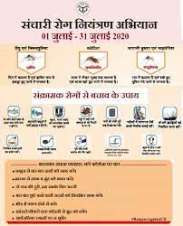

Slide 14
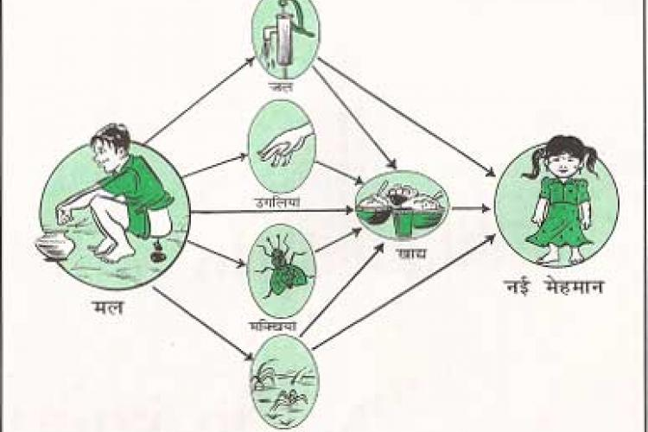

Slide 16
