Slide 1
History & Foundation of Physical Education

Slide 2
What is Education?
Education
“Educare”
“to lead out”
Notes:
1. First education is derived from the Latin word ''Educare'' which means ''to lead out'' or ''to draw out''. It meaning is a carbon copy of the previous one.
2. According to another view, the term is derived from the Latin word ''educare'' which means to bring up'' ''to raise'' or to nourish''. It means that education is an external imposition on the child and man.

Slide 3
“to draw out” Latin word ''educare‘
'to raise'‘ “means to bring up''

Slide 4
According to Indian thinkers the word ''Shiksha'' is especially used for education. The term ''Shiksha'' is derived from the Sanskrit verbal root ''Shas'' which means to discipline, ''to control'', ''to instant'' or ''to teach''. The term ''Vidya'' is derived from the Sanskrit verbal root ''Vid'' which means to know.

Slide 5
Definition of Education
Rig-Veda: Education has been defined as something ''Which makes a man self-reliant and self-less”
Upanishad : ''Education is that whose end product is salvation”
Panini : ''Human education means the training which one gets from nature.''

Slide 6
Kautilya : ''Education means training for the country and love for the nation.'‘
Vivekananda : “Education means the manifestation of divine perfection already existing in man. He further says, ''We want that education by which character has formed the strength of mind is increased, the intellect is expanded and by which one can stand on one‘s own feet”

Slide 7
Gandhi : "According to Mahatma Gandhi ''By education, I mean an all-round drawing out of the best in child and man-body, mind and spirit.'‘
APJ Abdul Kalam : ''Education is the most powerful weapon which you can use to change the world"

Slide 8
Task?
Construct your own definition ?
Notes:
Today education system not merely deals with mental enhancement of an individual, but also a source of physical activities that’s leads to all-round development of an individual. The best individual is one who is physically fit, mentally sound and sharp, emotionally balanced and socially well adjusted. It is therefore, physical education said to be an integral part of “Total Education’.

Slide 9
Physical Education is as old as the history of mankind because the very basis of human existence is physical activity. Whether in an unorganized form or organized one, physical education as such has been a part and parcel of human life right from pre-historic period.

Slide 10
Definition of Physical Education
Physical education is the phase of the whole field of education that deals with big muscles activity and their related response.
J.B. Nash
Physical education is education through physical activities for the development of total personality the personality of the child and its fulfillment and perfection in the body, mind and sprit. J.P. Thomas

Slide 11
“Physical education is the sum of man’s physical activities. Selected as to kind and conducted as to outcomes.”
J.F. William
Physical education is the way of education through physical activities which are selected and carried on with full regard to values in human growth, development of behavior.”
J.B. Nash

Slide 12
Discussion over the misconception about Education & Physical Education
How the system of education has changed in recent years in India
What do you think about the origin of Sports and Physical education in India
Difference between old and new system of education

Slide 13
Study Question
Name ten Physical Activities done in pre - historic period
What are the economic type games, and give two examples?
In your opinion has television reduced social-interaction games?

Slide 14
Aim & objective of Physical Education

Slide 16
AIMS OF PHYSICAL EDUCATION
Aim of physical education, like general education, is to develop human personality in its totally well planned activity programs.
All round development of an individual or wholesome development of human personality and moral aspects to make an individual a good citizen who is able to make contribution in growth process of his / her nation in own way.

Slide 17
Objectives of Physical Education
Objectives of physical education are steps considered towards the attainment of the AIM. They are the particular and precise means employed to realize an aim.
The movement an aim is achieved it become an objective in the action that goal on continuing.

Slide 18
According to Charles A. Bucher
Physical Development Objective
Motor and Movement Development
Cognitive and Mental Development
Social Development Objective
Culture Development Objective
Spiritual Development Objective

Slide 19
According to COAPEA (1934)
Physical Fitness
Mental health & efficiency
Social Moral Character
Emotional expression & control
Appreciation
Notes:
COAPEA- THE COMMITTEE ON OBJECTIVES OF THE AMERICAN PHYSICAL EDUCATION ASSOCIATION (1934)

Slide 20
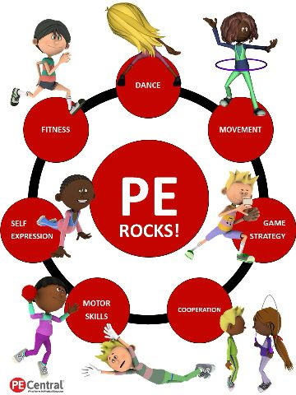

Slide 21
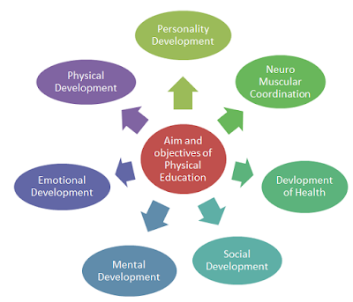

Slide 22
Some other Objectives of Physical Education

Slide 23
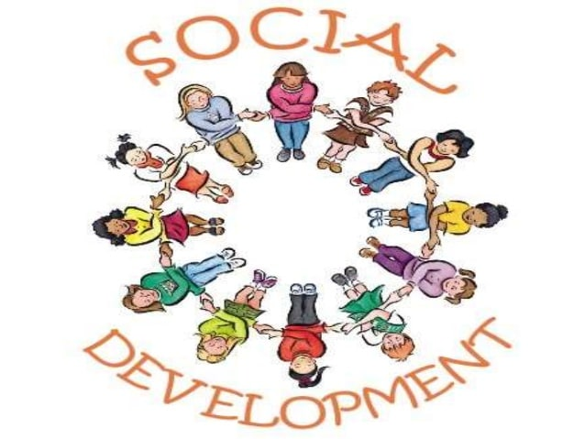

Slide 24
