Slide 1
Inoculum Preparation

Slide 2
Inoculum Preparation
Inoculum is starter culture required initially to start fermentation.
Inoculum is the mixture of cultured microbes along with media in which it is growing.
An inoculum can be defined as
“The population of microorganisms or cells that is introduced in the fermentation medium or any other suitable medium.”

Slide 3
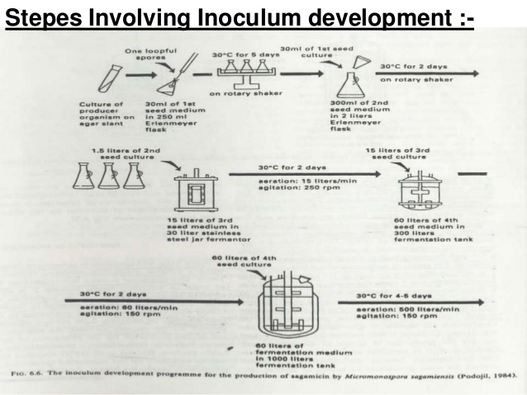
Inoculum Preparation

