Slide 1
Isolation and Purification of microorganism

Slide 2
Introduction

Slide 3
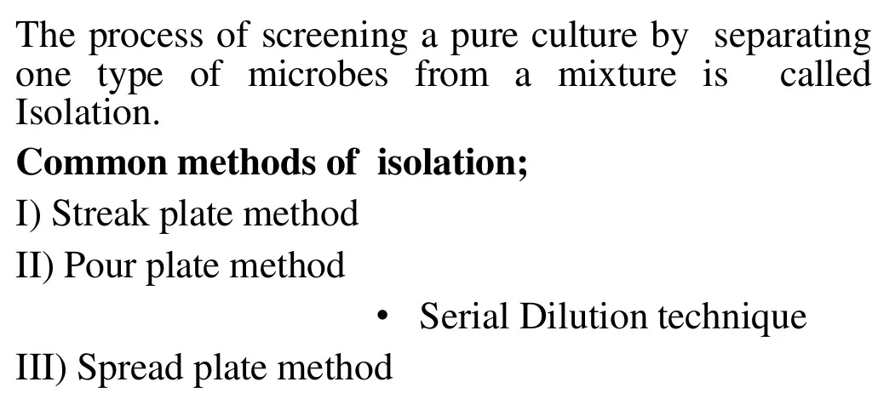
Methods of isolation

Slide 4
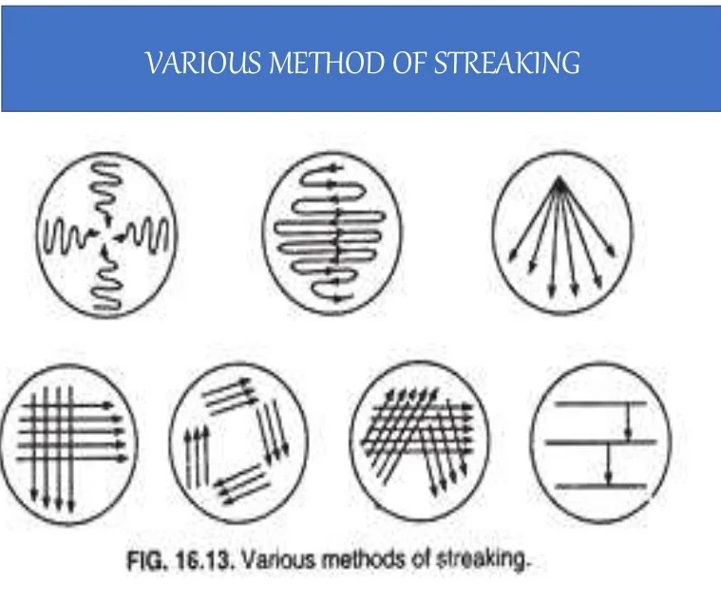
1. Streak Plate Method

Slide 5
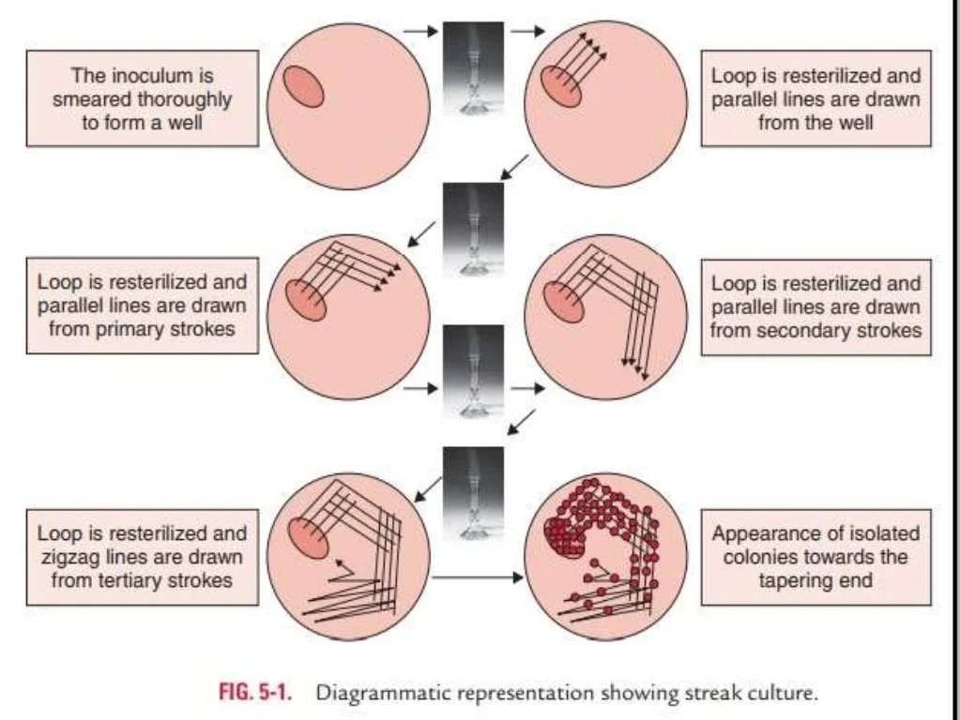
1. Streak Plate Method

Slide 6
2. Pour Plate Method

Slide 7
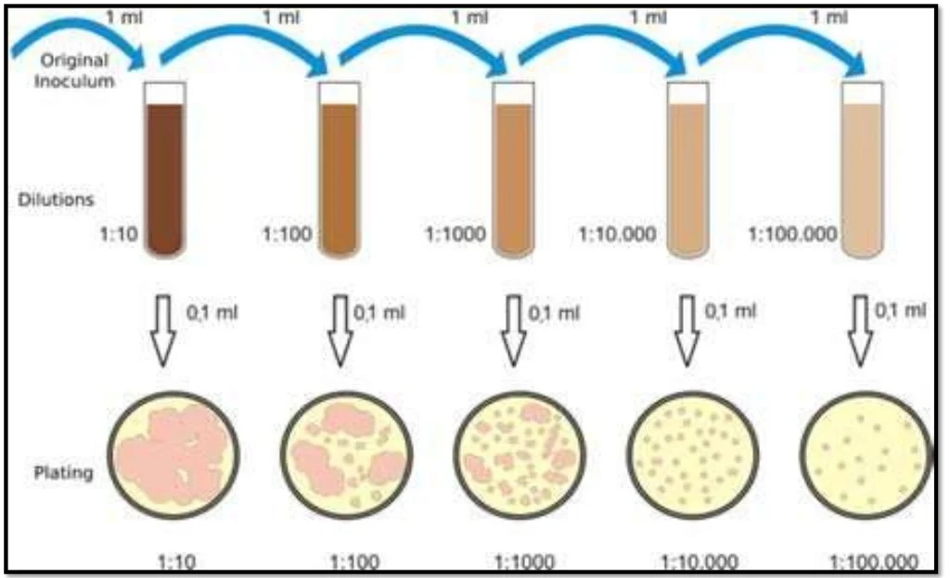
2. Pour Plate Method

Slide 8
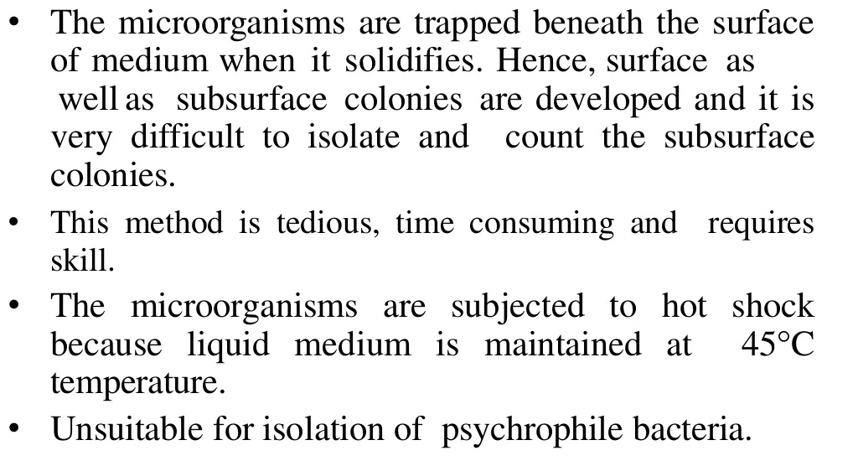
2. Pour Plate Method
Disadvantages

Slide 9
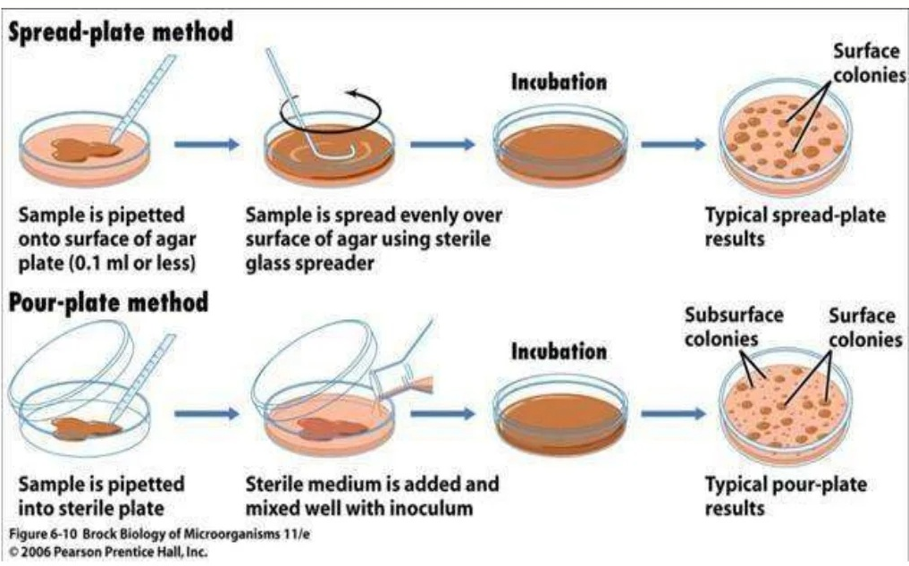
Procedure for spread plate and Pour Plate Method

Slide 10
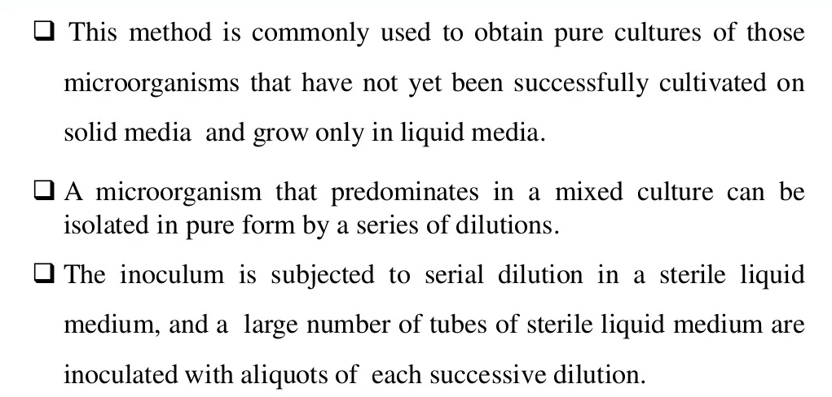
2 A. Serial dilution

Slide 11
2 A. Serial dilution

Slide 12
3. Spread Plate Method

Slide 13
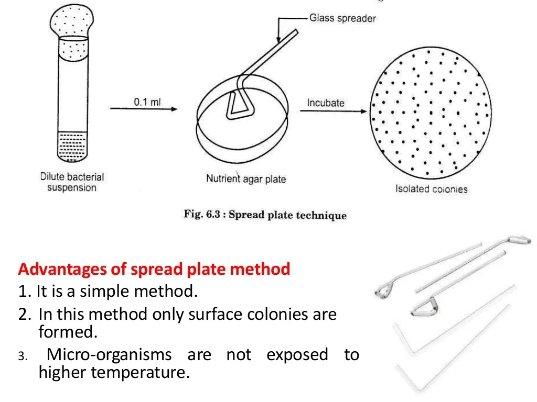
3. Spread Plate Method

