Slide 1
Microbial Genetics
LT10

Slide 2
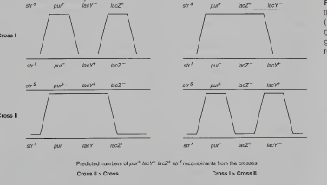
Hfr Mapping

Slide 3
Isolation of Hfr Strains
Isolation of F' Plasmids

Slide 4
