Slide 1
Microbial Genetics
Lecture-8
Dr Manishi Tripathi

Slide 2
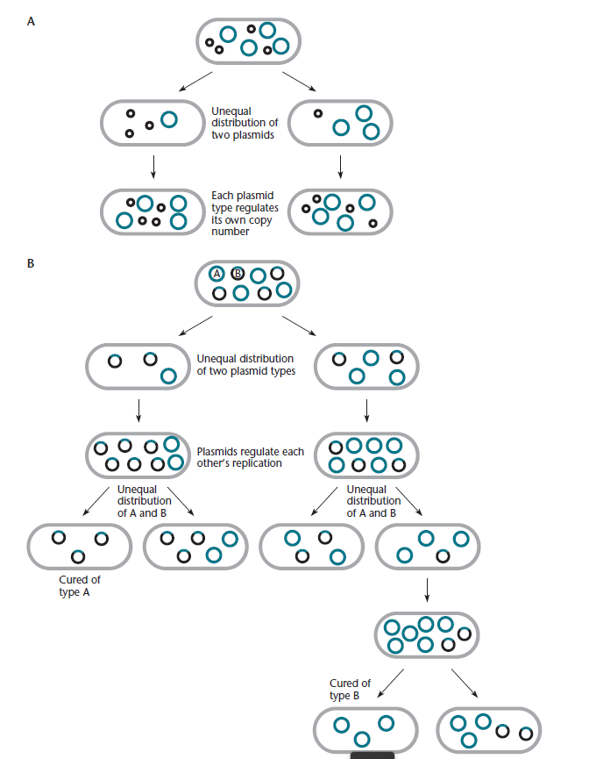
INCOMPATIBILITY

Slide 3
Examples of Plasmid Cloning Vectors
A number of plasmid cloning vectors have been engineered for special purposes. Almost all of these plasmids
have at least some of the features mentioned above for adesirable cloning vector.
1. They are small, so that the plasmid can be easily isolated and introduced into various bacteria.
2. They have relatively high copy numbers, so that the plasmid DNA can be easily purified in sufficient quantities.
3. They carry easily selectable traits, such as a gene conferring resistance to an antibiotic, which can be used to select cells that contain the plasmid.
4. They have one or a few sites for specific restriction endonucleases, which cut DNA and allow the insertion
of foreign DNA segments. Also, these sites usually occur in genes that can be easily screened for to facilitate the detection of plasmids with foreign DNA inserts by insertional inactivation

