Slide 1
Microbial genetics
LT-12
TRANSFORMATION

Slide 2
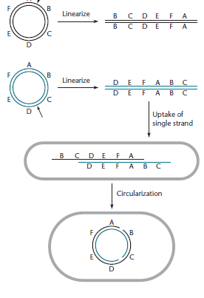
Transformation by plasmid DNA

Slide 3
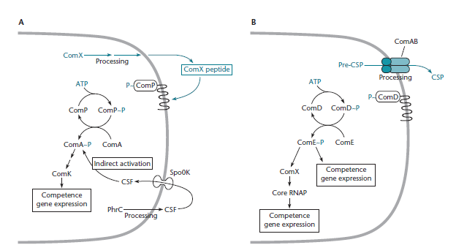
Regulation of competence development by quorum sensing. (A) In B. subtilis(B) In S. pneumoniae

Slide 4
Role of Natural Transformation
NUTRITION
REPAIR
RECOMBINATION

Slide 5
Artificially Induced Competence
Chemical Induction
TRANSFORMATION BY PLASMIDS
TRANSFORMATION OF CELLS WITH CHROMOSOMAL GENES
TRANSFECTION BY PHAGE DNA
Electroporation
Protoplast Transformation

