Slide 1
Microbial genetics
LT-13

Slide 2
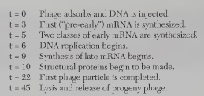
Lytic Growth of Phage ג

Slide 3
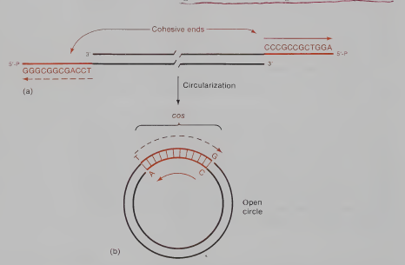

Slide 4
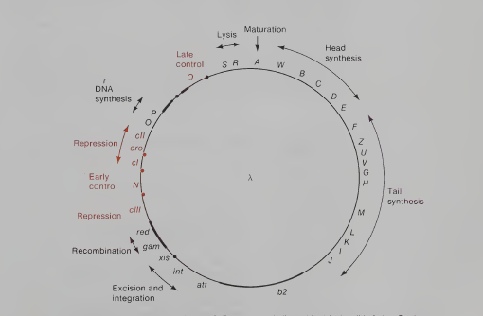
Genetic map of phage ג

Slide 6
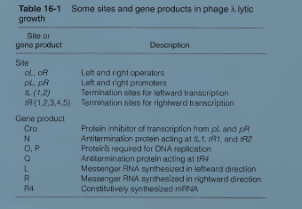

Slide 7
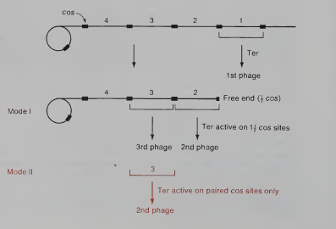
Two rules of packaging

