Slide 1
Microbial genetics
LT-8

Slide 2
Bacterial Conjugation
INSERTION OF F INTO THE E. c
Homologous recombination. If the recombinational event is physically reciprocal, homologous recombination between two identical IS elements, one in the chromosome and one in F, would yield flanking IS elements. Homologous recombination requires either the bacterial Rec system (described later) or a transposon gene product
2. Replicon fusion. An Hfr cell could arise by formation of a cointegrate mediated by an IS element in F, resulting in the duplication of a target sequence in the chromosome coli CHROMOSOME

Slide 3
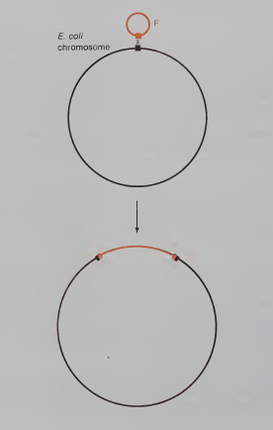
Integration of F by a reciprocal exchange between an IS element in F and a homologous sequence in the bacterial chromosome

Slide 4
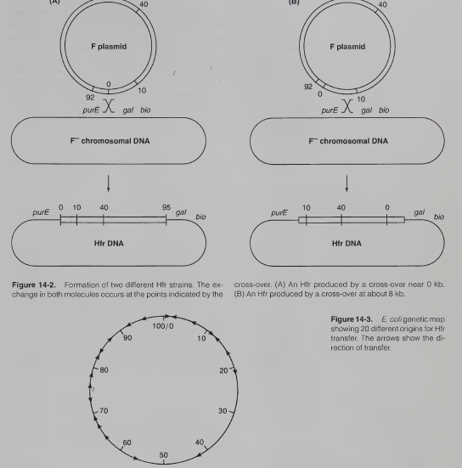

Slide 5
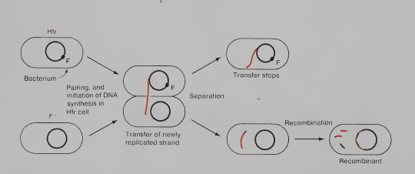
Hfr TRANSFER

Slide 6
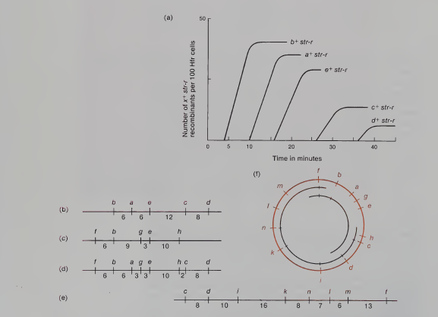
Interrupted Mating and Time-of-Entry Mapping

