Slide 1
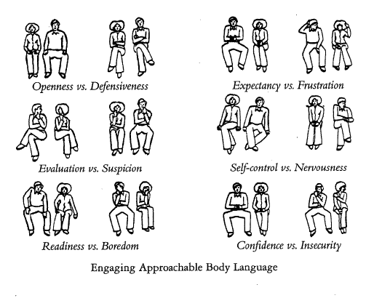
Non-verbal Communication
It refers to all communication that happens with the use of words, spoken or written.
Non-verbal communication is concerned with body movements (kinesics), space (proxemics), and vocal (paralinguistic) features.
It includes all unwritten and unspoken messages, both intentional an unintentional.

Slide 2
Types of non-verbal Communication:
Kinesics- is the study of body’s physical movements. It is the way the body communicates without words, i.e. through the various movements of its parts.
Personal appearance- It plays an important role. Appearance includes, clothes, hair, accessories, cosmetics, and so on.
Posture- Posture generally refers to the way we hold ourselves when we stand, sit, or walk. One’s postures changes according to the situation.
Gesture- Gesture is the movement made by the hands, head or face. Skillful and appropriate gesture can add to the impact of verbal communication.

