Slide 1
Maintenance and Preservation
of pure culture

Slide 2
Introduction

Slide 3
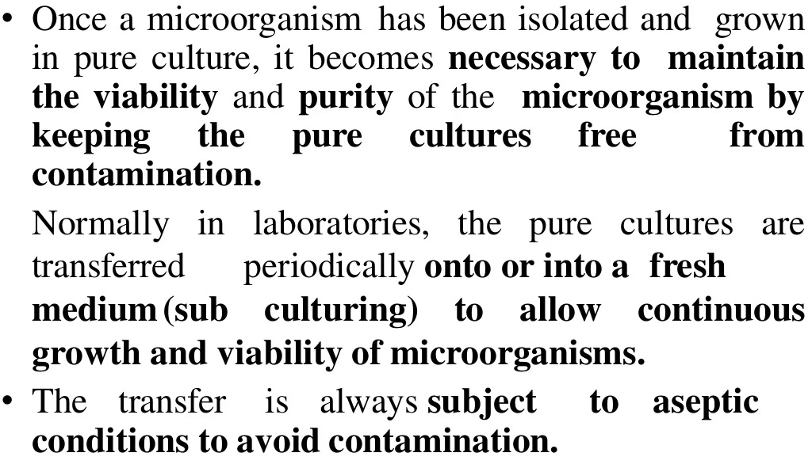
Introduction

Slide 4
Objectives of preservation

Slide 5
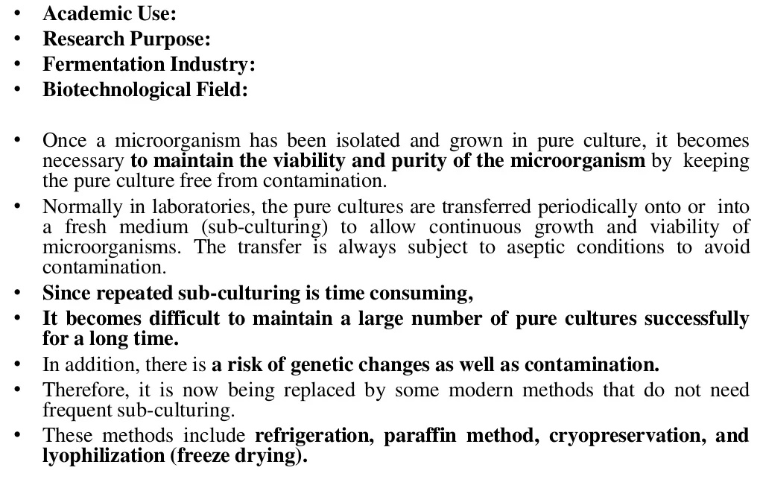
Applications of preservation

Slide 6
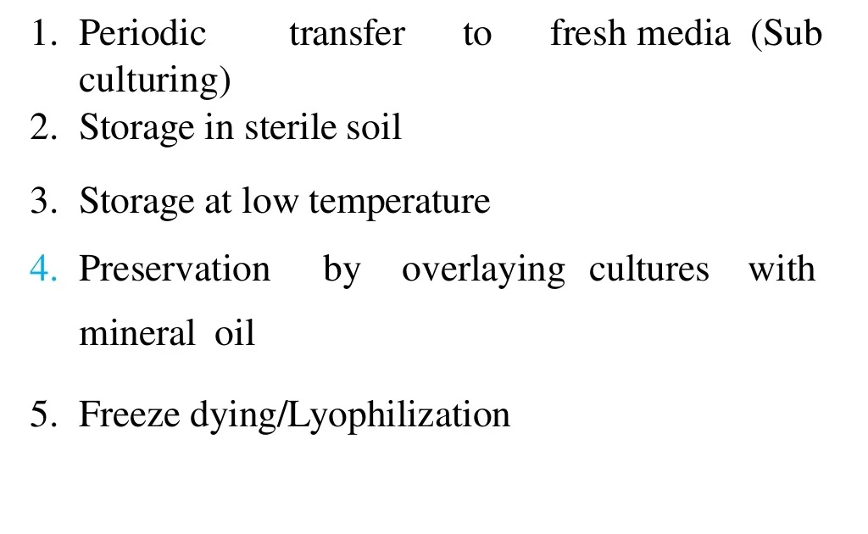
Methods of preservation

Slide 7
1. Periodic transfer to fresh media

Slide 8
1. Periodic transfer to fresh media

Slide 9
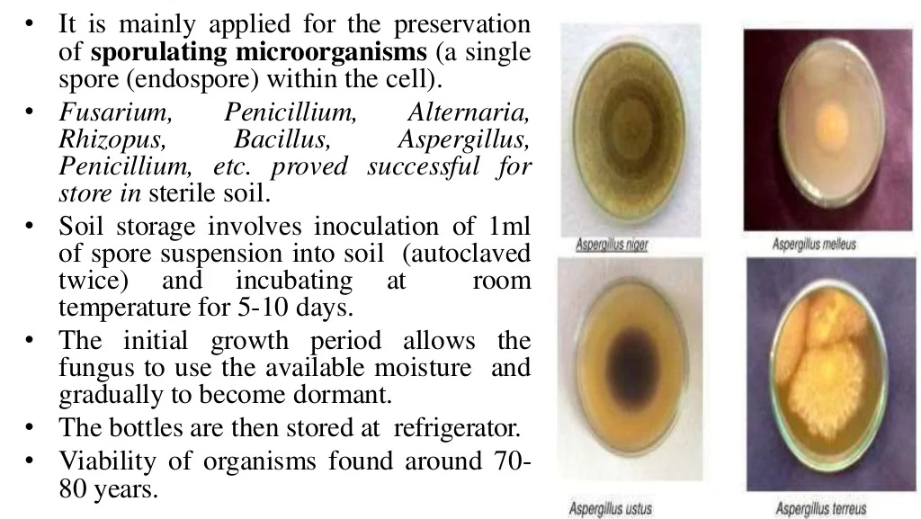
2. Storage in sterile soil

Slide 10
3. Storage at low temperature

Slide 11
3. Storage at low temperature
Glycerol Stock
Glycerol stock is a type of suspension used in laboratory settings to store bacterial cultures for extended periods of time. When liquid bacteria cultures are added to a 50% glycerol solution, the glycerol infuses into the bacterial cells, making them structurally stable and allowing them to be stored safely. After mixing your samples, freeze them at −80 °C (−112 °F) to ensure that they remain viable for as long as possible.

Slide 12
3. Storage at low temperature
Glycerol Stock: Procedure
After you have bacterial growth, add 500 μL of the overnight culture to 500 μL of 50% glycerol in a 2 mL screw top tube or cryovial and gently mix.
Note: Make the 50% glycerol solution by diluting 100% glycerol in dH20.
Note: Snap top tubes are not recommended as they can open unexpectedly at -80°C.
Freeze the glycerol stock tube at -80°C. The stock is now stable for years, as long as it is kept at -80°C. Subsequent freeze and thaw cycles reduce shelf life.
To recover bacteria from your glycerol stock, open the tube and use a sterile loop, toothpick or pipette tip to scrape some of the frozen bacteria off of the top. Do not let the glycerol stock unthaw! Streak the bacteria onto an LB agar plate.
Grow your bacteria overnight at the appropriate temperature.

Slide 13
4. Preservation by overlaying culture with mineral oil or
liquid paraffin storage

Slide 14
5. Lyophilization

Slide 15
5. Lyophilization
Procedure

Slide 16
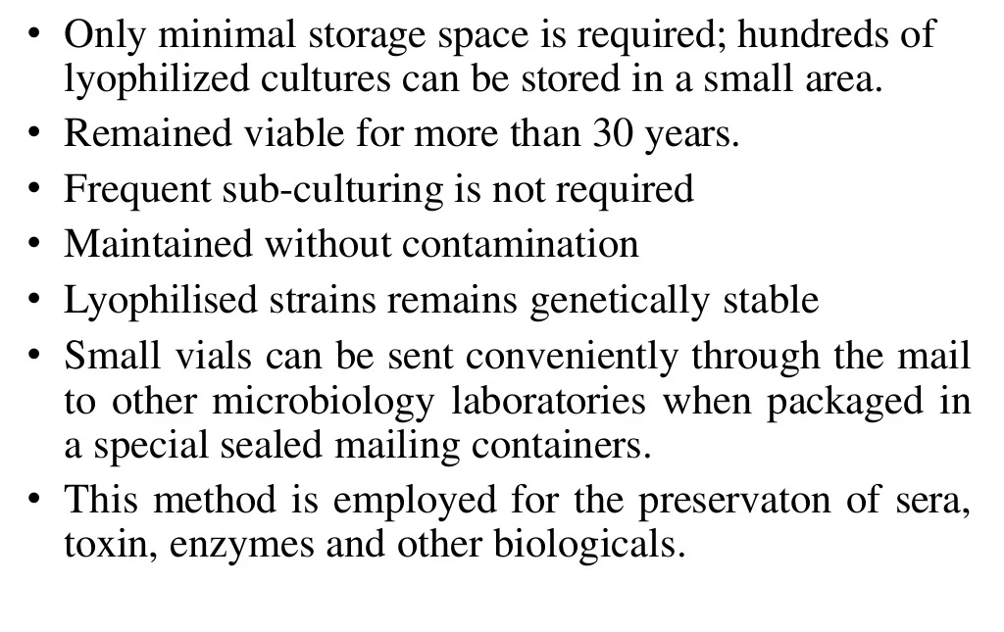
5. Lyophilization
Advantages

