Slide 1
B. PHARM. 5th semESTER PHARMACOGNOSY AND PHYTOCHEMISTRY II BP-504 T
ANJU SINGH
School Of Pharmaceutical Sciences
CSJM University, Kanpur.

Slide 2
UNIT-II
General introduction, composition, chemistry & chemical classes, biosources, therapeutic uses and commercial applications of following secondary metabolites:
Alkaloids: Vinca, Rauwolfia, Belladonna, Opium,
Phenylpropanoids and Flavonoids: Lignans, Tea, Ruta
Steroids, Cardiac Glycosides & Triterpenoids: Liquorice, Dioscorea, Digitalis
Volatile oils : Mentha, Clove, Cinnamon, Fennel, Coriander,
Tannins: Catechu, Pterocarpus
Resins: Benzoin, Guggul, Ginger, Asafoetida, Myrrh, Colophony
Glycosides: Senna, Aloes, Bitter Almond
Iridoids, Other terpenoids & Naphthaquinones: Gentian, Artemisia, taxus, carotenoids
RAUWOLFIA

Slide 3
RAUWOLFIA
Synonyms
1. Rauwolfia root,
2.Serpentina root,
3.Chhotachand,
4.Sarpgandha
Biological Source –
Rauwolfia consists of dried roots of the plant known as
Rauwolfia serpentina Benth, belonging to family Apocynaceae.
Serpgandha contains not less than 0.15 per cent of reserpine and ajmalcine, calculated on dried basis.

Slide 4
Geographical Source –
Several species of Rauwolfia are found distributed in the tropical regions of Asia, America and Africa:
Commercially, it is produced in India, Sri Lanka, Myanmar, Thailand and America. In India, it is cultivated in Uttar Pradesh, Bihar, Orissa, Tamil Nadu, West Bengal, Karnataka, Maharashtra, and Gujarat.

Slide 5
History
This drug is known to Indian System of Medicine since last many centuries.
Because of snake like shape of the drug, it has been known as 'Sarpagandha'.
It has found its place as an important drug in treatment of insanity and snake bite since traditional times. But the drug came into limelight only after the isolation of reserpine, its most significant alkaloid, in 1952 by Mueller.

Slide 6
Morphological Characters
Colour - Root bark is greyish yellow to brown and wood, pale yellow.
Odour - Odourless
Taste – Bitter
Size - About 10 to 18 cm long and from 1 to 3 cm in diameter.
Shape - Roots are sub-cylindrical, slightly tapering and tortuous.
NOTE:- Fracture is short and irregular. The transversely cut surface is white, dense with finely radiating xylem.
Roots are rough with longitudinal marking and Sightly wrinkled surface. Rootlets are usually absent ,but few small circular root scars with tetrastichous arrangements are seen.

Slide 7
Microscopic characters
The cork is made up of stratified cells followed by phelloderm of few rows of parenchyma.
Phloem is narrow, parenchymatous with small scattered sieve tissue.
Parenchyma contains starch grains and few latex cells, with brown resinous matter.
Secondary phloem contains calcium oxalate crystals.
Xylem is about 4/5 of the diameter of the root and consists of vessels, tracheids, wood parenchyma and wood fibres.
Xylem vessels are elongated up to 350 p in length and 50 u in width and contain simple or bordered pits.
Stone cells and phloem fibres are absent.

Slide 8
Chemical Constituents
About 30 indole alkaloids have been reported in drug and total alkaloidal content of rauwolfia roots ranges from 0.7-3 per cent, depending upon the source.
Alkaloids are concentrated mostly in the bark of the roots.
The alkaloids of rauwolfia are broadly classified into the following types:
(a) indole alkaloids
(b) indoline alkaloids
(c) indolenine alkaloids
(d) oxyindole alkaloids and
(e) pseudo indoxyl alkaloids.
The important alkaloid of rauwolfia is reserpine.
Apart from the alkaloids, it also contains oleo-resin, phytosterol, fatty acids, alcohol and sugars.

Slide 9
The other alkaloids present in the drug are ajmaline, ajmalicine, rauwolfinine, rescinnamine, reserpinine, yohimbine, serpentine and serpentinine.
The major alkaloids reserpine and rescinnamine are esters derived from methyl reserpate and trimethoxybenzoic acid in reserpine and trimethoxycinnamic acid in case of rescinnamine.
Syrosingopine is methyl carbethoxy syringoyl reserpate.
reserpine contains six asymmetric carbon atoms thus allowing for 64 stereoisomers. Reserpine occurs in nature as the laevorotatory substance

Slide 10
Rauwolfia
Reserpine:
Molecular formula: C₃₃H₄₀N₂O₉
The indole and dihydroindole bases divided into three groups according to their structural types :
(a) Alkaloids with the yohimbine skeleton, including diesters of the reserpine type.
(b) Ajmalicine-like indoles , whose distinguishing feature is the oxygen-heterocyclic E ring.
(c) Dihydroindoles of the ajmaline type and biogenetically related indoles and indolenines.

Slide 11
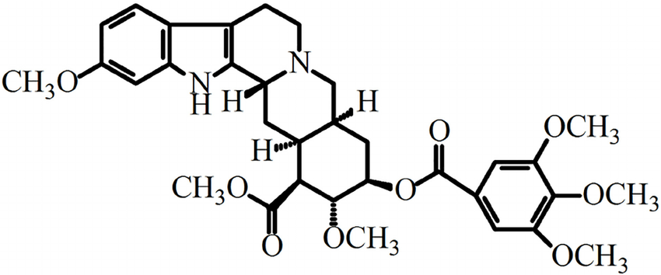
Chemistry of Reserpine Rauwolfia
Reserpine:
Reserpine (methyl 18-O-(3,4,5 trimethoxybenzoyl) reserpate or 11, 17α dimethoxy-16β -methoxy- carbonyl-18β -3’,4’,5’-trimethoxybenzoyloxy-3β,20α -yohimbane.
R=3,4,5-trimethoxybenzoic acid – Reserpine
R= 3,4,5- trimethoxycinnamic acid- Recinnamine

Slide 12
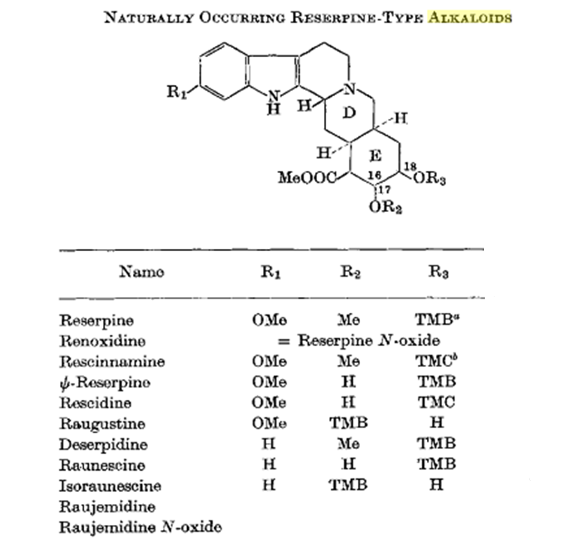

Slide 13
NOTE: Reserpine like alkaloids is colorimetrically determined by reaction between acidic solution of aloids and sodium nitrite.
Chemical Tests
1. A red coloration along the medullary rays is observed when the freshly fractured surface is and with concentrated nitric acid.
2. Reserpine shows violet red colour when treated with solution of vanillin in acetic acid.
3. Powdered ranwolfia when treated with sulphuric acidand p-di-methyl aminodehyde, develops violet to red colour. (Test is for modle alkaloids).

Slide 14
Uses
Rauwolfia is antihypertensive in activity.
Among the various alkaloids of rauwolfia, reserpine rescinnamine and ajmalicine are clinically important.
Reserpine lowers the blood pressure by depleting stores of catecholamines at nerve endings. It prevents re-uptake of nor epinephrine at storage sites, allowing enzymatic destruction of neuronal transmitter. It is used to treat mild essential hypertension and may be an effective adjunct to the treatment of more severe hypertension.
Because of the tranquillising effects, the drug is used in mild anxiety conditions and reserpine in some of the neuropsychiatric disorders.
Rescinnamine is also used as antihypertensive, but it causes mental depression in higher doses.

Slide 15
Deserpidine is used as antihypertensive and tranquilliser. It shows very less side effects.
Ajmalicine, though less in quantity, has the uses in treatment of circulatory diseases, in relief of obstruction of normal cerebral blood flow.
Syrosingopine shows peripheral effects similar to reserpine.It has less sedative actions and it isused for the treatment of mild or moderate hypertension.

Slide 16
THANK YOU

