Slide 1
SPORTS TRAINING
By
Dr. Ashish kumar Dubey
ASSISTANT PROFESSOR
(Department of Physical Education)

Slide 3
MEANING AND DEFINITION OF SPORTS TRAINING.
Sports training is a process of sports perfection directed by scientific and pedagogic principles and aims at leading a sportsperson to high and top level performance in a sport or an event by means of planned and systematic improvement of performance capacity and readiness of performance.

Slide 5
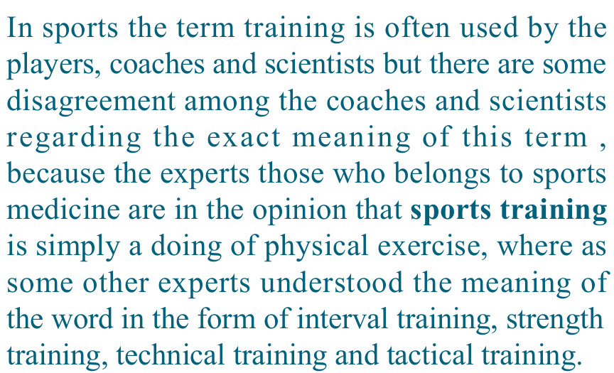

Slide 7
Aims and tasks of sports training
The aim of sports training is to prepare a sportsperson physically , physiologically and psychologically for a possible highest sports performance at the time of main competition, in a specific or an event.
to be continue……

Slide 9
1. Physical preparation
Complete physical preparation of a sportsperson is ensured as a result of development of essential motor qualities . Through training , these motor qualities can be developed separately as well as in combination with each other.
the requirement of these abilities differ from sport to sport. To train these motor qualities, the sportspersons have to regularly participate in general, specific and competitive exercise schedules, which are specific to a sport.
to be continue……

Slide 10
2. Technical preparation
Higher the level of skill, higher will be the performance. In order to acquire skill mastery , one has to undergo technical training.
complete technical mastery also ensures economic application of motor abilities during competition thus reducing effort which in turn saves energy .
To be continue……

Slide 11
3) Tactical preparation
Tactics means intelligent or creative application of skills during a competition. Knowledge of competition rules, training of tactical concepts and acquiring of tactical preparation. Importance of tactics varies from sport to sport. Tactics players more important role in the team games and in individual sports its role is limited.

Slide 12
4. Intellectual preparation.
Intellectual preparation of a sportsperson is done through imparting scientific knowledge of theory of sports training. The sportsperson is to encouraged to study literature on modern training means and methods and also modern techniques.
to be continue…..

Slide 13
Three steps for talent identification and their development are –
The first step is to locate children who are suitable for sports
The second step, which comes after 3 and 4 years of training aims at finding out children who are talented for a group of sports.
The third step, which comes again after 3 and 4 years of training, aims at identifying talent for a single or for one or two events.

Slide 14
Principles of sports training
Principles of continuity
Principles of overload
Principles of individual differences
Principles of progression
Principles of warm-up and cooling down

Slide 15
Cont…..
Principles of variety
Principles of specificity
Principles of individual load
Principles of rest and recovery

Slide 21
SYSTEMATIZATION OF SPORTS TRAINING PROCESS
The systematization of training process of a sports person being with the basic training and ends with the attainment of high performance in view of the above the following three levels of sports persons are covered under this process.
1.Beginner
2.Advanced (Intermediate) level
3.High performance
This process beings at the age of 10 to 12 years and continues until the achievement of performance comparable to National and international standards. Actual duration of training differs from sport to sport and depends upon the nature of the activity.
1.Basic Training
2.Advanced (Intermediate) level
3.High performance

Slide 22
Basic Training
Aim : It is a generally long term preparation of sports person and in addition it also Aims to development of qualities of character and will.
Task to be fulfilled
• Consolidation of health
• Development of basic physical abilities by means of
many sided physical training all the motor qualities
are to be equal developed.
• To develop rough from pertaining to skill of sport or
an event.
• To provide competitive experience so as to enable a
sports person to learn how to react and behave in a
competition.

Slide 23
To be cont..
Content of training :
• Variety of training method and means should be adopted so as to ensure all around general development of Athletic ability of a sports person.
• To select and perform exercises from other games and sports. A Javelin thrower may participate and volleyball and handball in view of similarity in the motor action and motor components to be developed.
• Equal selection and application of exercises for development of different motor abilities.
• The ratio between general and specific training means should 70 : 30.
Beginning and end of this stage: basic training started at the age of 10 to 12 years and the duration of the stage is 3 to 4 years

Slide 24
Advanced Training
Aim : The qualities, which the sports person has out developed during the basic training, are to be further developed and consolidated. The level of motor qualities and motor skills is to be improved. The qualities of character and will are to be adapted to higher motor abilities and skills.

Slide 25
Cont..
Tasks to be fulfilled:
• Further consolidation and strengthening of health. In view of increased training load the health is likely to be affected.
• Further development of motor abilities by adopting
training means of a specialized sport.
• Development of technique up to final form.
• Readiness of Undertake risk.
• Development of self Reliance.

Slide 26
Cont….
Content of training :
• Generally and specify training means and method
are applied.
• Training means supplementary sports are applied in order to improve the motor qualities of specialized sport.
• The ratio between the general and specific training
means should be60:40 or 50:50

Slide 27
Cont.
Beginning and end of this stage:
The beginning of Advanced training depends upon the performance reached by the sports person at the end of basic training and also on the rate of development of the physical and psychic qualities of the sports person the duration of this phase of training is 2 to 4 years.

Slide 28
High performance Training
Aim :
To the optimal performance standard in the chosen Sports which is comparable National and international standards. The sports person should attain high performance efficiency at the time of National and International Championship.

Slide 29
Cont….
Task to be Fulfilled :
• The motor qualities specific to the chosen sport are to be developed to optimal level.
• The general condition is to be developed in accordance with the specific requirements of the choosing spot the level specific qualities to a great extent depends upon the general condition of the sportsperson
• The sports from should be developed in a way that it remains stable under the stress of competition
• The qualities of character and will must be accomplished under high competitive requirements.

Slide 30
cont.
Content of Training:
• The selection and application of training method and means depend upon the aim of high performance training and also on the individual characteristics of this sports person
• The ratio of general and specific training depends upon the chosen sport and also on the strong and weak point of this sports person the ratio of 70:30 or 80:20 or 90:10 in favour of specific training is found suitable.

Slide 31
Cont.
Beginning of end of this stage:
The beginning of the training period depends upon the performance reached in the Chosen Sports at the end of advance training the duration of this phase depends upon the rate at which the sports person develop and attain performance comparable to National and international Standards

Slide 32
.

