Slide 1
The track & field
Dr. Ashish Kumar Dubey
H.o.d., Dept. of Physical Education

Slide 2
Dr. Ashish Kumar Dubey
Assistant Professor, Dept. of Physical Education

Slide 3
Dr. Ashish Kumar Dubey
Assistant Professor, Dept. of Physical Education

Slide 4
Dr. Ashish Kumar Dubey
Assistant Professor, Dept. of Physical Education

Slide 5
Dr. Ashish Kumar Dubey
Assistant Professor, Dept. of Physical Education

Slide 6
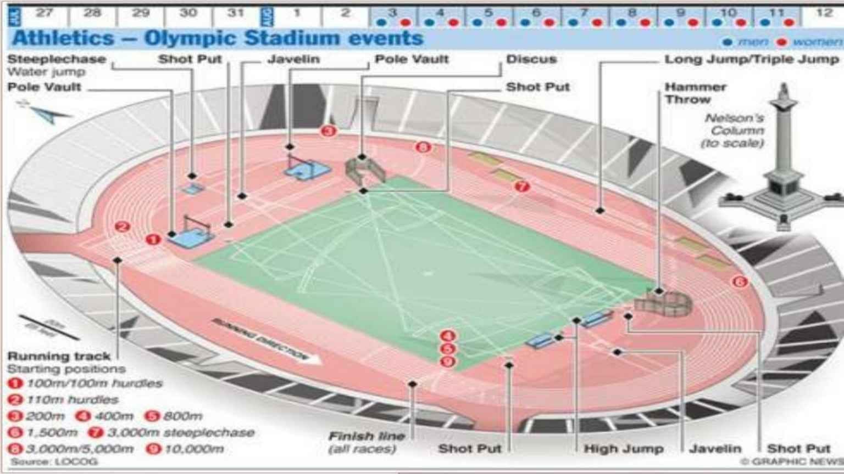
Dr. Ashish Kumar Dubey
Assistant Professor,
Dept. of Physical Education

Slide 7
To be continued…
Thank you!

