Slide 1
Control Systems - Time Domain Specifications
School of Engineering,
Department of Electronics & Communication Engg.,
C S J M University, Kanpur.

Slide 2
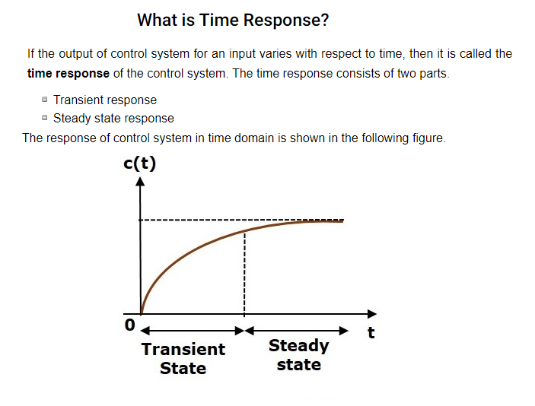

Slide 3
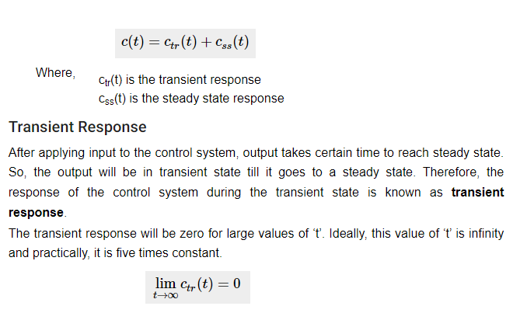

Slide 5
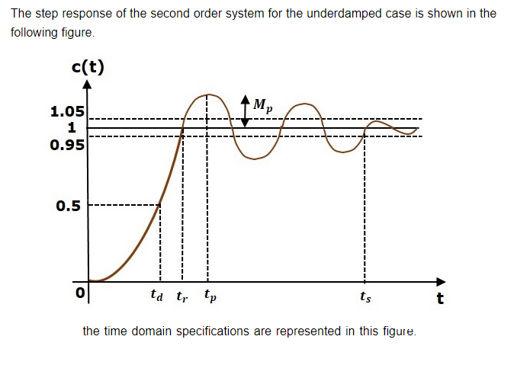

Slide 6
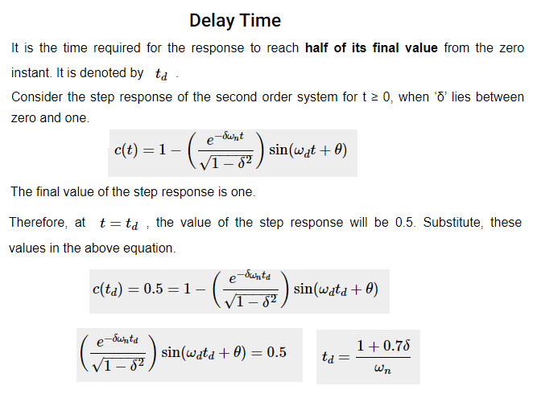

Slide 11
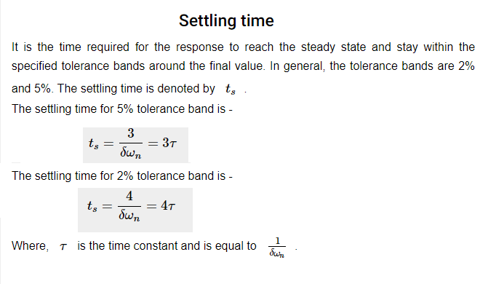

Slide 12
