Slide 1
Transformation

Slide 2
Natural Transformation
Discovery of Transformation
Competence

Slide 3
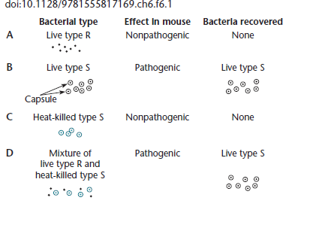

Slide 4
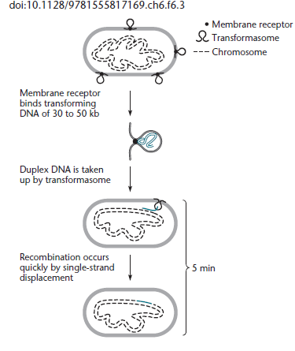
DNA uptake in H. influenzae

Slide 5
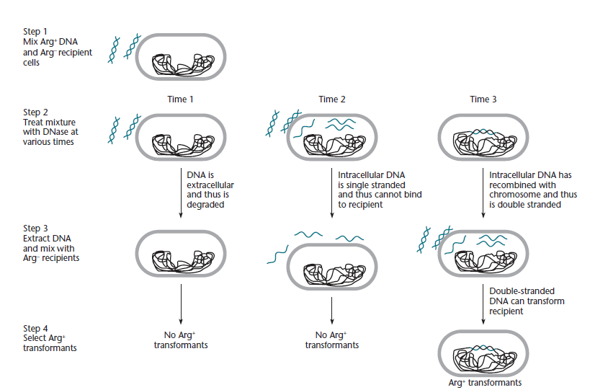
Genetic assay for the state of DNA during transformation

