Slide 1
Transposable Elements
Microbial Genetics
MIC 302
Dr Manishi Tripathi

Slide 2
Transposons
Transposable elements or transposons are common in both prokaryotes and eukaryotes, where they influence the variation of phenotypic expression over the short term and evolutionary development over the long term.
Each transposon codes for the enzymes that specifically insert it into the recipient DNA.
This process has been described as illegitimate recombination because it requires no homology between donor and recipient DNAs
Insertion site is chosen largely at random, transposition is a potentially dangerous process; the insertion of a transposon into an essential gene will kill a cell together with its resident transposons. Hence transposition is tightly regulated; it occurs at a rate of only 10-5 to 10-7 events per element per generation.

Slide 3
Many bacterial transposons contain easily recognizable genes, which may or may not exist elsewhere in the genome. For example, antibiotic-resistance genes are commonly carried on transposons.
The transposons first discovered did not contain any known host genes, and for historical reasons, they were called insertion sequences, or IS elements, designated ISI, IS2.
Transposons have occasionally been designated in nonstandard ways—for example, the transposon TnlOOO (an element contained in the F plasmid) is often called γδ.
A transposon is frequently located within a particular gene; this creates a mutation in that gene, which is assigned an allele number. lacZ87::Tn3
The antibiotic-resistance genes of most R plasmids are carried by transposons present in the plasmid DNA

Slide 4
Prokaryotic transposons with three levels of complexity
1. The simplest transposons, and the first to be characterized, are named insertion sequences or IS elements. They are designated by “IS” followed by an identifying number.
IS elements are normal constituents of bacterial chromosomes and plasmids.
For example, a common E. coli strain has eight copies of IS1 and five copies of IS2. IS elements generally consist of 2000 bp.
These comprise a so-called transposase gene, and in some cases a regulatory gene, flanked by short inverted (having opposite orientation) terminal repeats The inverted repeats are essential for transposition; their genetic alteration invariably prevents this process.
An inserted IS element is flanked by a directly (having the same orientation) repeated segment of host DNA . This suggests that an IS element is inserted in the host DNA at a staggered cut that is later filled in . The length of this target sequence (most commonly 5 to 9 bp)

Slide 5
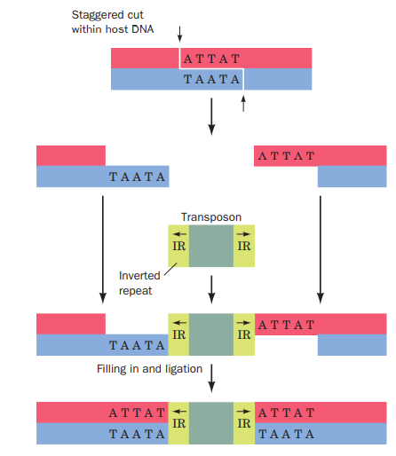

Slide 6
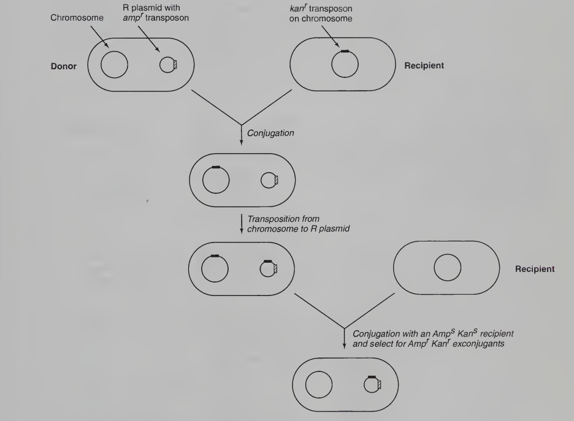
An experiment to demonstrate transposition

Slide 7
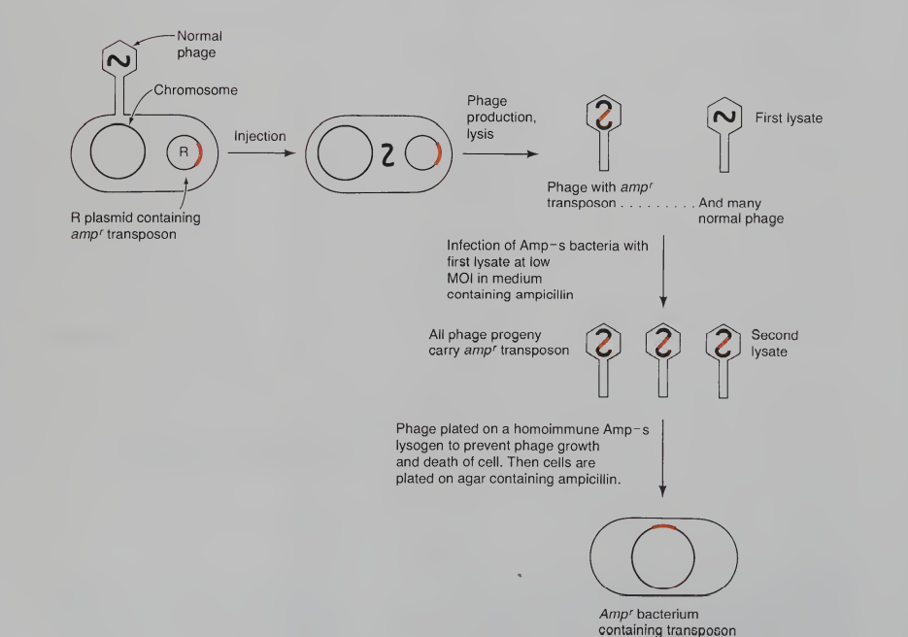
An experiment demonstrating transposition

Slide 8
2.Complex transposons
. More complex transposons carry genes not involved in the transposition process, for example, antibiotic resistance genes. Such transposons are designated “Tn” followed by an identifying number. For example, Tn3 consists of 4957 bp and has inverted terminal repeats of 38 bp each. The central region of Tn3 codes for three proteins:
(1) a 1015-residue transposase named TnpA
(2) a 185-residue protein known as TnpR, which mediates the site-specific recombination reaction necessary to complete the transposition process and also functions as a repressor for the expression of both tnpA and tnpR; (3) a -lactamase that inactivates ampicillin. The site-specific recombination occurs in an AT-rich region known as the internal resolution site that is located between tnpA and tnpR.

Slide 9
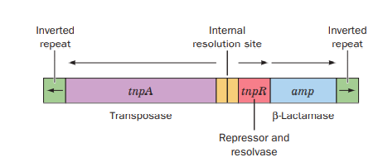
Tn3

Slide 10
3.Composite transposons
The so-called composite transposons consist of a gene-containing central region flanked by two identical or nearly identical IS-like modules that have either the same or an inverted relative orientation. It therefore seems that composite transposons arose by the association of two originally independent IS elements. Since the IS-like modules are themselves flanked by inverted repeats, the ends of either type of composite transposon must also be inverted repeats. Experiments demonstrate that composite transposons can transpose any sequence of DNA in their central region

Slide 11
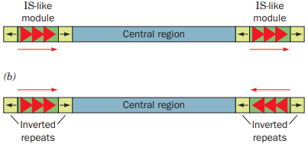
composite transposon

Slide 12
There are two modes of transposition
(1) direct or simple transposition, in which the transposon, as the name implies, physically moves from one DNA site to another
(2) replicative transposition, in which the transposon remains at its original site and a copy of it is inserted at a target site.

Slide 13
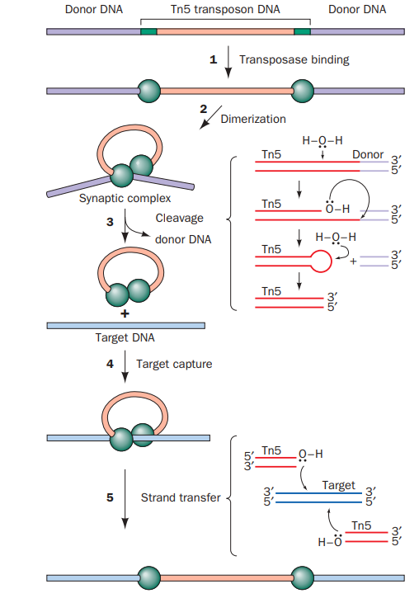
Direct Transposition of Tn5 Occurs by a Cut-and-Paste Mechanism
Tn5 is a 5.8-kb composite transposon that contains the gene encoding the 476-residue Tn5 transposase together with three antibiotic resistance genes. It is flanked by inverted IS-like modules ending in 19-bp sequences called outside end (OE) sequences. Tn5 undergoes direct transposition via a “cut-and-paste” mechanism

Slide 14
Replicative Transposition
Replicative Transposition Occurs via Cointegrates If a plasmid carrying a transposon resembling Tn3 is introduced into a bacterial cell carrying a plasmid that lacks the transposon, in some of the progeny cells both types of plasmid will contain the transposon.
Such transposition involves the replication of the transposon into the recipient plasmid rather than its transfer from donor to recipient.
Two plasmids, one containing a replicative transposon, will occasionally fuse to form a so-called cointegrate containing like-oriented copies of the transposon at both junctions of the original plasmids .
Some of the progeny of a cointegrate-containing cell lack the cointegrate and instead contain both original plasmids, each with one copy of the transposon

Slide 15
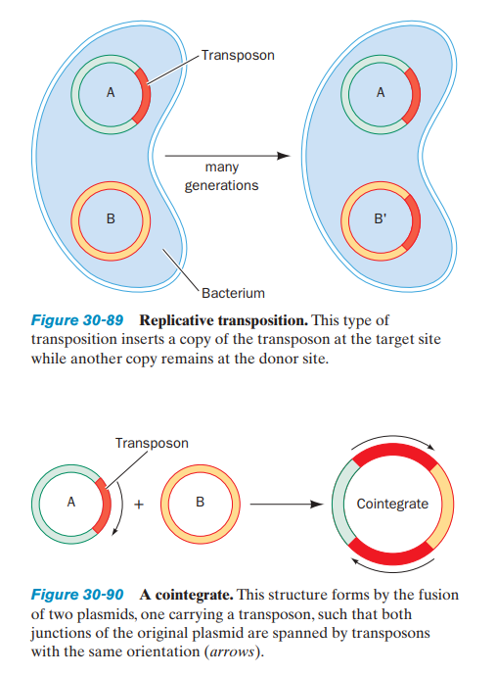

Slide 16
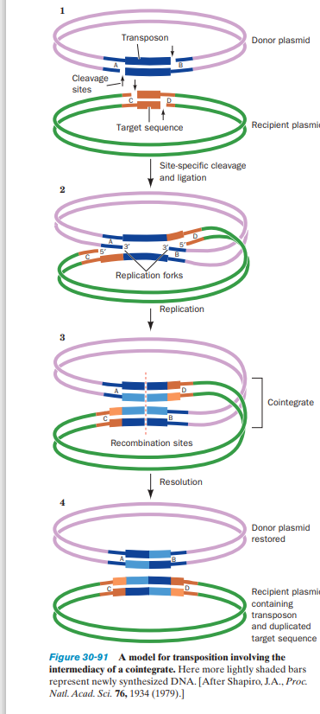

Slide 17
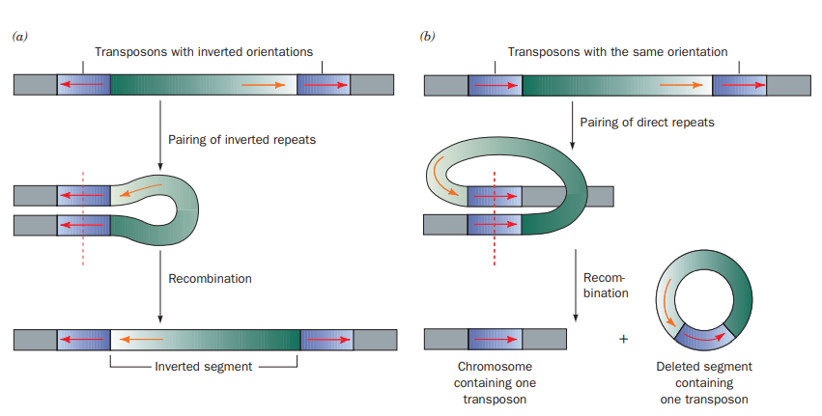
Chromosomal rearrangement via recombination. (a) The inversion of a DNA segment between two identical transposons with inverted orientations. (b) The deletion of DNA segment between two identical transposons with the same orientation. This process parcels one transposon each to the resulting two DNA segments

Slide 18
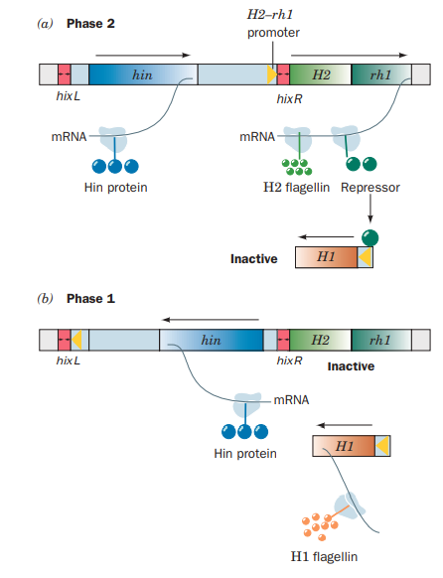
The mechanism of phase variation in Salmonella
(a) In Phase 2 bacteria, the H2–rh1 promoter is oriented so that H2 flagellin and repressor are synthesized. Repressor binds to the H1 gene, thereby preventing its expression.
(b) In Phase 1 bacteria, the segment preceding the H2–rh1 transcription unit has been inverted relative to its orientation in Phase 2 bacteria. Hence this transcription unit cannot be expressed because it lacks a promoter. This releases H1 from repression and results in the synthesis of H1 flagellin. The inversion of the segment preceding the H2–rh1 transcription unit is mediated by the Hin protein, which is expressed in either orientation by the hin gene

