Slide 1
Effective Technical Communication
Dr. Ankit Trivedi

Slide 2
Course Outline B.Tech 286 IInd year
Module 1- Principles of Communication, levels of communication, formal
vs. informal, horizontal, vertical and diagonal.
Interpersonal communication: need, motivation, perception, improving interpersonal communication.
Nonverbal communication: body language, appearance, symbols, cues, space and environment.
Verbal communication in small groups.
Module 2- Technical writing: Technical writing objectives, Grammar and editing, forms of discourse, Basics of Grammar, correction based on parts of speech, uses of articles, editing strategies, proposal writing, creating C.V., writing notice, agenda and minutes.
Module 3- Self Assessment- Self assessment, managing time, rapid reading, taking notes.
Module 4- Communication: Public Speaking, Group discussion, Oral presentation Aids, Interviews, meeting.
Module 5- Ethics- Business ethics, Etiquettes in social and office settings, Email etiquettes, Telephone Etiquettes, Engineering ethics, managing time.

Slide 3
What is Communication?
Communication is derived from the Latin word ‘communico’ or ‘communicare’ which mean “to Share; to Impart”.
It stands for a natural activity of human beings, to share or convey opinions, feelings, information and ideas to others through words, body language or signs.
Some Definitions of Effective Communication
George Vardman in his book Effective Communication of Ideas defines effective communication as “purposive interchange, resulting in workable understanding and agreement between the sender and receiver of the message.”
Robert Anderson, in his concept of communication, adds the element of medium. In Professional Selling, he observes, “Communication is interchange of thoughts, opinions, or information, by speech, writing or signs.”

Slide 4
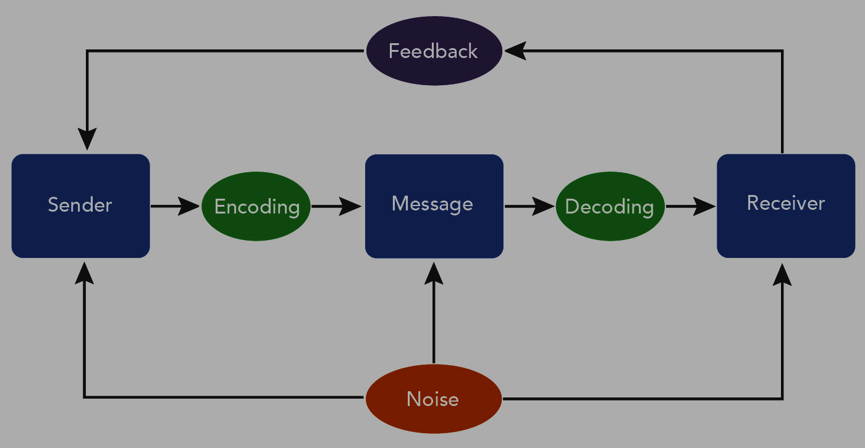

Slide 5
Emphasizing the various processes of communication, Allen Louis says, “Communication is the sum of all the things one person does when he wants to create understanding in the mind of another; it involves a systematic and continuous process of telling, listening and understanding
In Human Behaviour at Work, Keith Davis defines communication as “The transfer of information and understanding from one person to another person. It is a way of reaching other with facts, ideas, thoughts and values. It is a bridge of meanings among people so that they can share what they feel and know. By using this bridge, a person can cross safely the river of misunderstanding that sometimes separates people.”
Koontz and O’ Donell defines communication as “the transfer of information from one person to another whether or not it elicits confidence.”
George Terry defines “Communication is an exchange of facts, ideas, opinions or emotions by two or more persons.”

Slide 6
Features of Effective Communication
Communication is a two way process by which information is transmitted between individuals and/or organizations so that an understanding may develop among them.
It is a continuous process of meaningful interactions among persons in an organization that results in meanings being perceived and understood in a desired way.
The role of the receiver and the sender keeps changing in the entire communication activity.
Communication broadly includes both the verbal and non-verbal forms. Therefore, it also includes sign languages and body language used in face-to-face communication.
Communication skills are generally understood to be an art or technique of persuasion through the use of oral, written and non-verbal features.

Slide 7
Purpose or Objectives of Communication
Public relations: communication helps the people to build the relation. In an organization public relation helps in building the contact of the organization with other organization or investor. It also help organization in building relation with the buyers and also with the employers.
Technological advancements: due to scientific and technological advancements, the world is changing and to convey these technological advancements among the employers and the users an effective communication is needed.
Holistic development: communication helps in inspiring and motivating people. It helps in maintain goodwill and harmony in the society.
To persuade: all communication is a deliberate and intentional act of persuasion. A persuasive communicator wants the reader to understand the message and to be influenced, as intended by the sender.
To inform: when communication is directed towards the information it is actually directed by the desire to expose, develop and explain the subject. It focusses on the subject and how to make it effective and understandable.
To develop managerial skills: communication is the process of learning. Communication of facts, ideas, opinions, information etc. add value to the knowledge of managers about various happenings, in the organization and behavior of people.

Slide 8
Principles of Communication
For the Effective Communication there are 7C’s and 4S’s of Communication
7Cs
Correctness
Credibility
Conciseness
Courtesy
Clarity
Consistency
Concreteness
Some include
CREATIVITY
CONSIDERATION
COMPLETENESS
CONCISENESS
COURTESY
CORRECTNESS
CREDIBILITY
As the part of 7C’s

Slide 9
4Cs
Shortness
Strength
Sincerity
Simplicity

Slide 10
Types of Communication
Means of Communication are broadly of two types
Types of communication based on number of receivers addressed
Non- Verbal
Verbal
Group Communication
Mass
Communication
Intrapersonal
Communication
Intrapersonal
Communication

Slide 11
Communication Network in an Organization
Based on organization structure
Formal
Informal
NOTE: Verbal and non-verbal communication come in an organization also but it will be the last classification. First two will be based on organization structure and based on channel. These are primary classification.
Based on channel
Upward
Downward
Diagonal
Or
Spiral
Lateral
or
Horizontal

Slide 12
Levels of Communication
Extrapersonal Communication : Communication between human being and non-human entities is extrapersonal.
Intrapersonal Communication : Intrapersonal communication takes place within individual.
Interpersonl Communication : Communication at this level refers to the sharing of information among people.
Organizational Communication : Communication is an organization takes place at different hierarchical levels.
Mass Communication: Mass communication is meant for large audiences and requires a medium to transmit information.

Slide 13
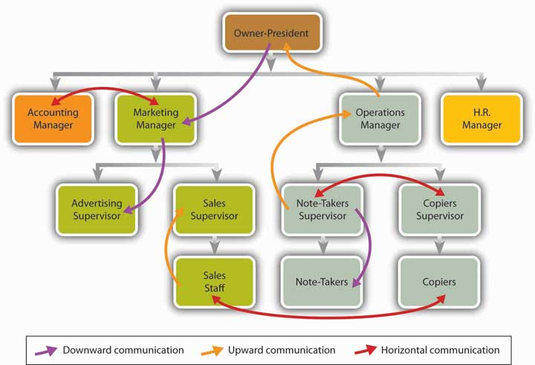
Flow of Communication

Slide 14
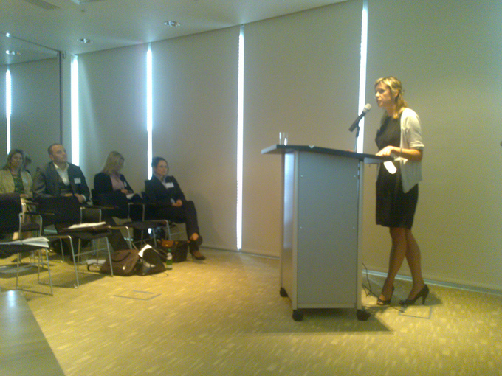
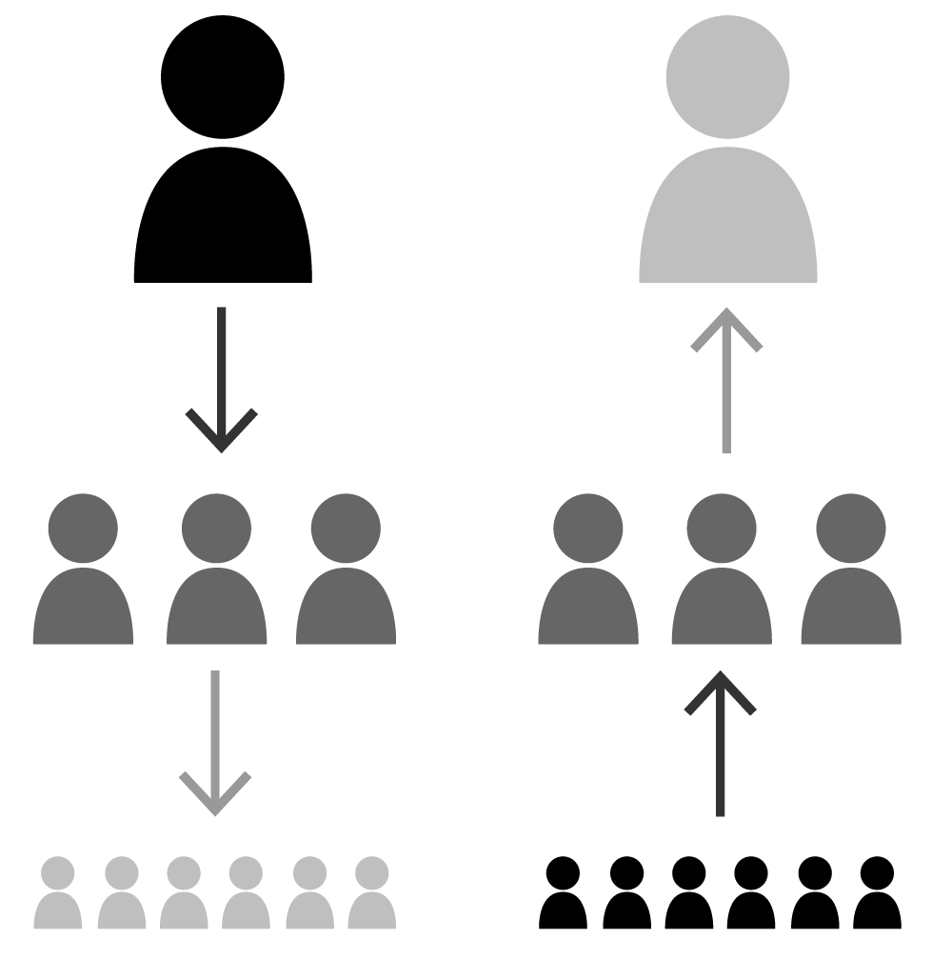
Downward Communication :

Slide 15
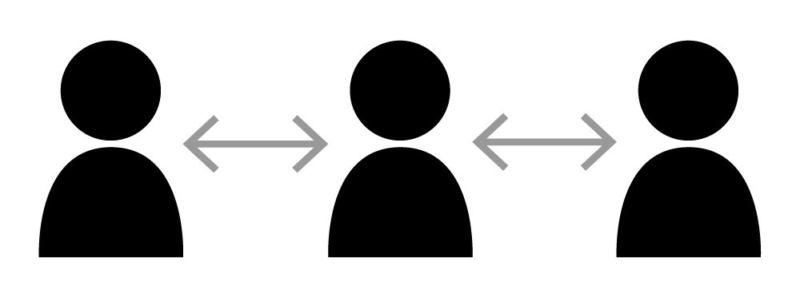
Horizontal Communication:

Slide 16
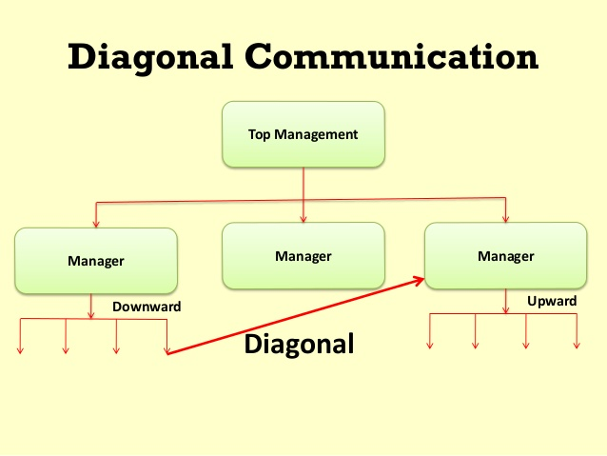
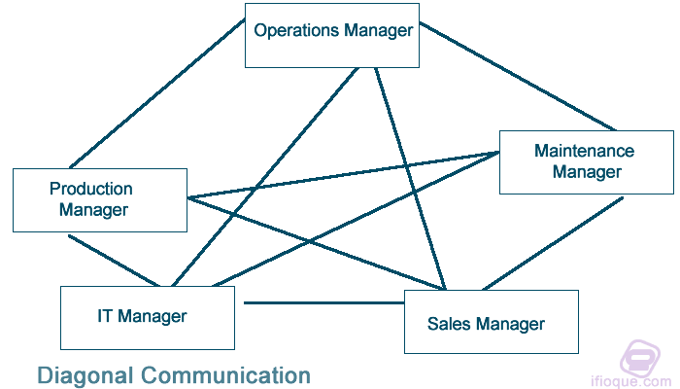
Diagonal Communication

Slide 17
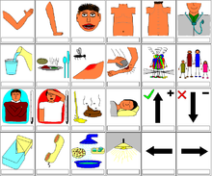
Nonverbal communication:
It refers to all communication that occurs without the use of words, spoken or written.
It includes all unwritten and unspoken messages, both intentional and unintentional. Non-verbal cues, however, our action speaks louder than words.

