Slide 1
B.PHARM. 5th SEMESTER BP504 T. PHARMACOGNOSY AND PHYTOCHEMISTRY II (Theory)
UNIT-I
BRIEF STUDY OF BASIC METABOLIC PATHWAYS
DR. ANJU SINGH
ASSISTANT PROFESSOR
SCHOOL OF PHARAMACEUTICAL SCIENCES
CSJMU, KANPUR

Slide 2
WHAT IS BIOSYNTHESIS?
Process of forming large molecules from smaller subunits within living organism, done by mainly enzymes
Also known as anabolism- simple molecules join to form macromolecules
Ex: Photosynthesis in chloroplast
Conversion of light energy into chemical energy
Synthesis of glucose from H₂O+CO₂

Slide 3
METABOLISM
What is Metabolism?
Metabole: Greek word: Means Change
Controls total chemical reactions
Metabolic pathway: is a series of steps in biochemical reactions that help to convert molecules or substrates like sugar into different usable materials
All these reactions take place inside cell, enzymes which are protein molecules break down or build up molecules
Enzymes are catalyst to these metabolic reactions

Slide 4
Anabolism: synthesis of larger/ complex mol. – requires energy, Glucose → glycogen
Catabolism: Met. Reac. in cell that degrade substrate into smaller/ simpler products- release energy- Glucose→CO₂
Anabolic: Small molecules join into larger ones. Hence, Energy is required
+ Energy
+ Energy
Catabolic: Large Molecules are broken down into the smaller one and hence energy is released

Slide 5
METABOLIC PATHWAYS
Two types:
Anabolic Pathway: Utilization of energy for biosynthetic reactions. Utilizes NADH, FADH2, ATP
Metabolites: intermediates, small mol. products of metabolism
Primary metabolites- responsible for primary fnc. Like- photosynthesis, respiration, reproduction etc.
Catabolic Pathway: release energy by breaking down molecules into simpler molecules. Ex. Cellular respiration: Sugar is taken in by cells and broken down to release energy.
Ex: Citric or krebs cycle- acetate from macronutrients like protein, fat, carbohydrate molecules under oxidation produces NADH, FADH2, ATP

Slide 6
METABOLIC PATHWAYS
Primary metabolites: carbohydrates, lipids, proteins, amino acids, nucleic acids, cellulose etc
Not responsible for therapeutic activity
Primary metabolic pathway: pathways followed for production of primary metabolites
Secondary metabolites: not responsible for growth
Secondary metabolites: synthesized for adaptation by plants under stress conditions, toxic subs, for attracting pollination, for defense etc
They are therapeutically active
Ex: Alkaloids, glycosides etc.
They are the derivatives of primary metabolites
Synthesis of secondary metabolites: pathway known Secondary metabolic pathway

Slide 7
METABOLIC PATHWAYS
Primary Metabolic pathways:
Glycolysis
TCA/ Kreb’s / Citrate pathway
Pentose phosphate pathway/ Hexose monophosphate P
Primary metabolic pathway of carbon
1st step is photosynthesis
Energy
O₂
Photosynthesis
Water
6CO₂ + 6H₂O C₆H₁₂O₆ +6O₂
CO₂
Sugar

Slide 8
METABOLIC PATHWAYS
Sugar or Glucose enters Glycolysis cycle & finally converted to 2 pyruvate + 2 NADH + 4 ATP with many intermediates
After glycolysis, Pyruvate in presence of O₂ (aerobic) is converted to Acetyl CoA
In TCA cycle- Oxidation of Acetyl CoA, derived from carbohydrates, fats, proteins
Oxidation of nutrients to produce usable chemical energy in the form of ATP.

Slide 9
GLYCOLYSIS CYCLE
Glucose
ATP
Hexose Kinase
ADP
Glucose 6 Phosphate
Phospho glucose isomerase
Fructose 6 Phosphate
ATP
Phospho Fructose kinase
ADP
Fructose 1, 6 Bis Phosphate
aldolase
GLAP
DHAP
2 NAD⁺ + 2Pi
Trios PO4 isomerase
2 NADH
GLAP hydrogenase
GLAP: Glyceraldehyde 3 Phospahte
1,3 Bisphospho Glycerate
2 ADP
Phospho glycerate kinase
2 ATP
DHAP: di hydroxy acetone phosphate
3 Phosphate Glycerate
Phospho glycerate mutase
2 ADP
2 ATP
2 Phosphate Glycerate
Phospho enol pyruvate
Pyruvate
enolase
Pyruvate kinase

Slide 10
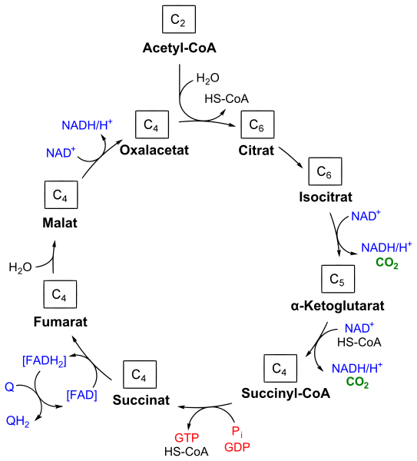
CITRIC ACID CYCLE
https://commons.wikimedia.org/wiki/File:TCA_cycle.svg

Slide 11
METABOLIC PATHWAYS
Sugar or glucose alternatively enters pentose phosphate pathway (HMP)
HMP SHUNT PATHWAY
It helps in formation of NADPH from fatty acids, synthesis of ribose for nucleotide & nucleic acid (oxidative pathway)
Helps in formation of erthyrose 4
phosphate, used in synthesis of
aromatic amino acids
(non oxidative)
↓ precursor for
lignin,
& other biosynthetic pathways
Glucose 6 Phosphate
NADP⁺
Mg⁺²
Glucose 6 P dehydrogenase
NADPH + H⁺
6 Phosphoglucanolactone
Glucanolactone hydrolase
6 Phosphogluconate
NADP⁺
Mg⁺²
Phosphogluconate dehydrogenase
CO₂, NADPH + H⁺
Ribulose 5 phosphate

Slide 12
References
Medicinal Natural Products: A Biosynthetic Approach, Paul M. Dewick, 3rd Ed. 2009, John Wiley & Sons, Ltd. England .
The Biosynthesis of secondary metabolites, R.B. Herbert, 1st Ed. 1981, Chapman & hall, London.
Pharmacognosy, C.K. Kokate, A.P. Purohit, S.B. Gokhale, 54th Ed. 2017, Nirali Publication, New Delhi
Trease and Evans Pharmacognosy, W.C. Evans, 15th Ed. Elsevier, 2002.
https://www.slideshare.net

