Slide 1
BP504 T. PHARMACOGNOSY AND PHYTOCHEMISTRY II (Theory)
UNIT-II
General introduction, composition, chemistry & chemical classes, biosources, therapeutic uses and commercial applications of following secondary metabolites:
Alkaloids: Vinca, Rauwolfia, Belladonna, Opium,
Phenylpropanoids and Flavonoids: Lignans, Tea, Ruta
Steroids, Cardiac Glycosides & Triterpenoids: Liquorice, Dioscorea, Digitalis
Volatile oils : Mentha, Clove, Cinnamon, Fennel, Coriander,
Tannins: Catechu, Pterocarpus
Resins: Benzoin, Guggul, Ginger, Asafoetida, Myrrh, Colophony
Glycosides: Senna, Aloes, Bitter Almond
Iridoids, Other terpenoids & Naphthaquinones: Gentian, Artemisia, taxus, carotenoids

Slide 2
OPIUM ALKALOIDS
Isoquinoline is a heterocyclic aromatic organic compound. It is a structural isomer of quinoline. Isoquinoline and quinoline are benzopyridines, which are composed of a benzene ring fused to a pyridine ring
1-Benzylisoquinoline is the structural backbone in naturally occurring alkaloids including papaverine. The isoquinoline ring in these natural compound derives from the aromatic amino acid tyrosine
Being an analog of pyridine,
isoquinoline is a weak base,

Slide 3
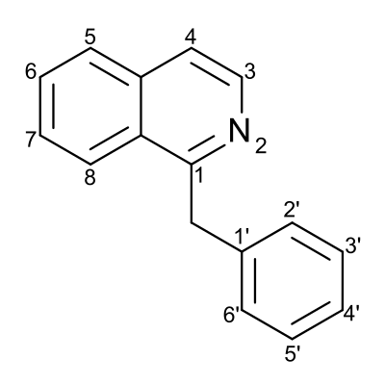
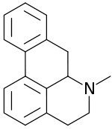
OPIUM ALKALOIDS
Isoquinoline was first isolated from coal tar in 1885 by Hoogewerf and van Dorp
Isoquinoline alkaloids are natural products of the group of alkaloids, which are chemically derived from isoquinoline. They form the largest group among the alkaloids
isoquinoline alkaloids can be further classified based on their different chemical basic structures. The most common structural types are the benzylisoquinolines and the aporphines

Slide 4
OPIUM ALKALOIDS
a total of about 2500 isoquinoline alkaloids are known nowadays, which are mainly formed by plants
The isoquinoline alkaloids are primarily formed in the plant families
Papaveraceae, Berberidaceae, Menispermaceae,
Fumariaceae and Ranunculaceae.
The opium poppy, which belongs to the Papavaraceae family, is of great interest, since the isoquinoline alkaloids morphine, codeine, papaverine, noscapine and thebaine can be found in its latex
4

Slide 5
OPIUM ALKALOIDS
a total of about 2500 isoquinoline alkaloids are he opium alkaloids may have sedative, psychotropic or analgesic properties
Morphine and codeine are indeed used as analgesics
5

Slide 6
OPIUM ALKALOIDS
Opium- air-dried milky exudate/ latex, obtained by incising unripe capsules- opium poppy Papaver somniferum (Papaveraceae).
Opium production- ripening capsules, just changing color from blue- green to yellow, carefully incised - knife to open the latex tubes.
Although the ripe poppy capsule can contain up to 0.5% total alkaloids, opium represents a much concentrated form and up to 25% of its mass is composed of alkaloids ( more than 40 alkaloids were identified).
Plant-known-Europe-4000 years ago, as evidenced by fossil remains of poppy seed cake and poppy pods found in the Swiss lake dwellings of the Neolithic Age. Opium was probably consumed by the ancient Egyptians and was known to the Greeks as well.
6

Slide 7
OPIUM ALKALOIDS
Opium wars:
The continuing illegal export of opium
to China by the British triggered a two-phase war, aptly called the Opium Wars, between 1839 and 1842. They concluded with China being forced to accept opium and endure a growing addiction rate.
Opium alkaloids usually occur naturally combined with a specific acid: (Meconic acid).
Meconic acid present only in Opium with morphine.
Meconic acid gives a deep purplish red-colored complex with FeCl₃
7

Slide 8
TESTS FOR IDENTIFICATION
Papaverine
1- Warren’s test: Papaverine + crystal of KMnO₄ + Marqui’s reagent (HCHO/ H2SO4) → Green color → Blue
2- Papaverine + Conc H2SO4 → Violet color on heating
Narcotine
1- Alkaloid + conc. H2SO4 → violet. (This test is –ve with Morphine)
2- Alkaloid + sucrose + conc. H2SO4 → green-yellow → blue- violet
8

Slide 9
PROPERTIES OF NARCEINE
Narceine occurs as white silky crystals.
Very hygroscopic, Optically inactive.
It is slightly soluble in water soluble in ethanol, insoluble in CHCI, and ether.
It is a weak monoacidic tertiary base. Can be extracted from an aqueous solution of its salts with CHCI3.
Contain C=O and COOH groups, thus it forms:
Oxime
Salt with NaHCO₃
Ester with alcohol
9

Slide 10
TEST FOR IDENTIFICATION
10

Slide 11
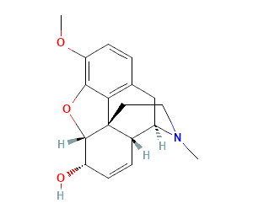
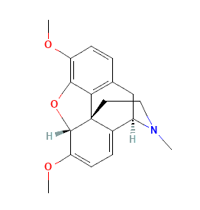
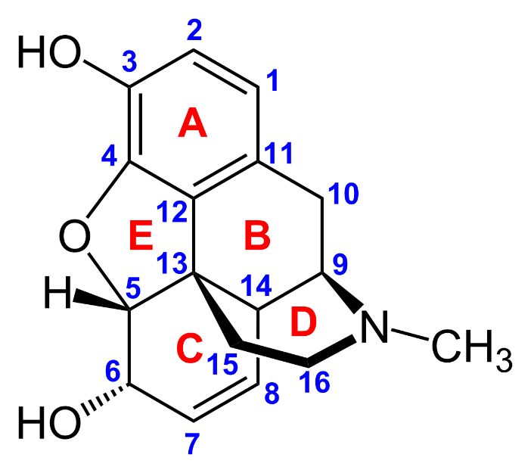
OPIUM ALKALOID OF PHENANTHRENE GROUP
MORPHINE CODIENE THEBAINE
Thebaine is a Tetrahydro-Phenanthrene type that differs structurally from morphine/codeine mainly by its possession of a conjugated diene ring system.
Morphine and Codeine are Hexahydro-Phenanthrene type
11

Slide 13
MORPHINE | CODEINE | THEBAINE
1. Phenolic | 1. Non-phenolic | 1. Non-phenolic
2. Solid, crystalline. | 2. Solid crystalline. | 2. Solid crystalline.
3. Insoluble in ether, benzene, CHCl₃ water and ammonia. | 3. Soluble in ether, benzene, CHCl₃ and water. | 3. Soluble in benzene, CHCl₃ .
4. Salicylate salt is soluble in water | 4. Soluble in ammonia as Complex. 5. Salicylate salt is H₂0 soluble. | 4. Insoluble in ammonia. 5. Salicylate salt is H₂0 insoluble.
13

Slide 14
14

Slide 15
CHEMICAL TESTS MORPHINE
Morphine
Tests due to Phenolic properties
Morphine Blue color
Nitrous acid test:
Morphine solution in HCl + NaNO₂+ NaOH Red color
B) Tests due to Reducing properties
1) lodic acid test
Morphine solution in H2SO4 reduces iodic acid or KIO₃ (K-iodate) to lodine,
upon shaking with CHCl₃ Violet color in the CHCl₃, layer
2) Morphine + Sucrose + Conc. H₂SO₄ Purple red color
FeCl₃
15

Slide 16
16

Slide 17
MORPHINE is a powerful analgesic and narcotic, It also induces a state of euphoria and mental detachment, together with nausea, vomiting, constipation, tolerance, and addiction.
CODEINE
Its action is dependent on partial demethylation in the liver to produce morphine, so it produces morphine-like analgesic effects.
Codeine is always taken orally and is a component of many compound analgesic preparations.
Codeine is a relatively safe non-addictive medium analgesic.
Codeine also has valuable anti-tussive action, helping to relieve and prevent coughing.
THEBAINE
It is almost devoid of analgesic activity.
Its main value is as a substrate for the semi-synthesis of other drugs
17

