Slide 1
B.PHARM. 5th SEMESTER BP504 T. PHARMACOGNOSY AND PHYTOCHEMISTRY II (Theory)
UNIT-III
Isolation, Identification, and Analysis of Phytoconstituents
D) Resins
Podophyllotoxins
Curcumin
DR. ANJU SINGH
ASSISTANT PROFESSOR
SCHOOL OF PHARAMACEUTICAL SCIENCES
CSJMU, KANPUR

Slide 2
RESINS: EXTRACTION AND ISOLATION:
Pharmaceutical resins are obtained from the plants and animals by following methods.
Method 1: A Powdered drug is extracted with alcohol, filtered and concentrated.
Then concentrated extract is shacked with excess of water to get precipitated.
This method is used for extraction of Jalap, Podophyllum, ipomoea, etc.
Method 2: By distillation for separation of oil, e.g. Colophony, copaiba, etc.
Method 3: By heating the plant part, e.g. Guaiacum etc.
Method 4: As plant exudates by incision, e.g. Myrrh, Balsam, etc.

Slide 3
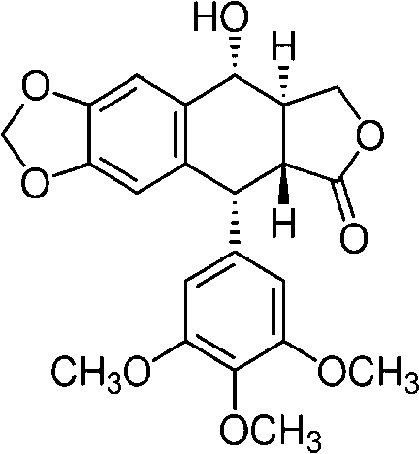
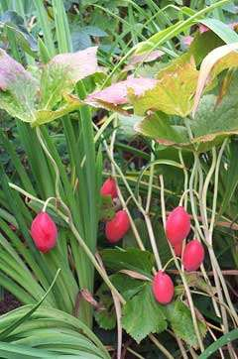
PODOPHYLLOTOXIN
Biological source:
Podophylotoxin is the lactone resin present in the root and rhizome of Podophyllum hexandrum and P. emodi, belongs to family – Berberidaceae. Podophyllum resin contains not less than 40% and not more than 50% of podophyllotoxin

Slide 4
PODOPHYLLOTOXIN
Isolation:
Required quantity of rhizomes or roots of P. emodi is taken with methanol, filtered it and evaporated to semisolid mass.
Semisolid mass is dissolved into acidic water.
Precipitate is formed which should be allowed for at least for 2hrs., filtered it and the filtrate is washedwith cold water.
The residue is collected, washed with acidified water and dry to obtain dark brown amorphous powder.
Then the residue is extract with hot alcohol, filtered and
evaporated to dryness.
Finally residue is re- crystallise in benzene to yield podophyllotoxin

Slide 5
PODOPHYLLOTOXIN
Properties:
Appearance: White to off-white solid
Odour: Characteristic
Taste: Bitter
Solubility: It is soluble in acetone, benzene; very soluble in ethanol, chloroform; slightly soluble in water; insoluble in ethyl ether
Identification by chemical test:
Sample drug + 50% H₂SO₄ → violet-blue color

Slide 6
PODOPHYLLOTOXIN
Analysis by TLC
Sample preparation : 1mg of Podophyllotoxin is dissolved in 1ml of methanol
Standard sample : Podophyllotoxin Stationary phase : Silica gel-G
Mobile phase :Chloroform: Methanol (90:10) for about 6cm (Only glycosides are separated but aglycone like podophyllotoxin remains in the region of the front. (TOULENE :ETOAC::5:7)
The same plate is again eluted with more weakly polar Solvent Chloroform: Acetone (65:35) upto 12cm.
Detecting agent : Spray with methanol H₂SO_{4 .} heat 10 min at 110° C
RF Value : 0.65 Color spot : Yellow spot
Analysis by HPLC Method : Isocratic
Stationary phase : C18 column
Mobile phase : Methanol: water (6:4) at flow rate 0.8ml/min.
Detection : Photodiode detector at 283nm

Slide 7
PODOPHYLLOTOXIN
Utilization:
Podophyllotoxin and its derivatives are used as cathartic, purgative, antiviral agent, vesicant, antihelminthic, and antitumor agents (antiproliferative agent).
Storage condition:
It should be store in well closed and air-tight containers protected from light and in cool place.

Slide 8
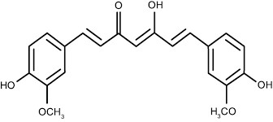
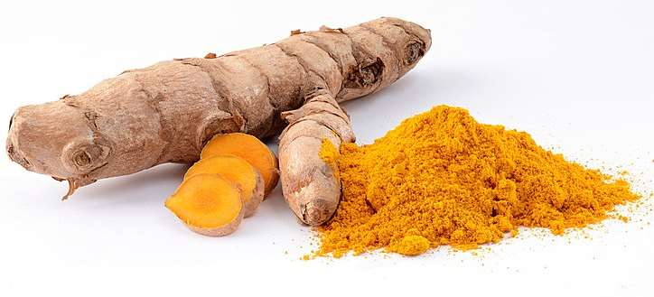
CURCUMIN: BRIGHT YELLOW
Biological source:
Curcumin or Curcuminoids are the diaryl hepnoid compounds obtained from the dried rhizomes of Turmeric, Curcuma longa, belongs to family – Zingiberaceae. Curcumin is the major colouring principle present upto 5% in the rhizomes. It is a mixture of curcumin, monodesmethoxycurcumin and bisdesmethoxycurcumin

Slide 9
CURCUMIN
Curcumin can be obtained by different processes.
Method 1: Turmeric powder is extracted with n-hexane for 2hrs., filtered it and discarded n-hexane extract. Then marc is extracted with acetone for 2hrs.
The acetone extract is distilled off and dried the crystals of curcumin. It is recrystallized from hot ethanol to yield orange red needles.
Method 2:
Turmeric powder is extracted with pure alcohol by Soxhlet extractor until coloring matter is removed.

Slide 10
CURCUMIN
Alcoholic extract is filtered and concentrated under reduced pressure to semisolid residue.
This residue is dissolved in sufficient quantity of benzene.
Benzene portion is transferred to separating funnel and 0.1% NaOH solution is added, shacked slowly.
The alkali layer is separated and repeated it twice.
Combined alkali layer and acidify with HCl, yellow colour precipitate is formed.
The extract is concentrated with continious stirring; lumpy mass of resin will be separated out.
The extract is filtered and evaporated the filtrate to get crystal of pure curcumin

Slide 11
CURCUMIN
Properties:
Appearance: Orange yellow crystalline powder
Odour: Characteristic
Taste: Slightly pungent bitter
Solubility: Insoluble in water and ether, but soluble in alcohol
Identification by chemical test:
Sample is treated with acetic anhydride and conc. H₂SO₄, it gives violet color. When this test is observed under UV light, red fluorescence is seen

Slide 12
CURCUMIN
Analysis by TLC:
Sample preparation : 1mg of Curcumin is dissolved in 1ml of methanol
Standard sample : Curcumin
Stationary phase : Silica gel-G
Mobile phase : Chloroform: Ethanol: Glacial acetic acid (94:5:1)
Detecting agent : Observed under U.V light at 366nm
RF Value : 0.79
Analysis by HPLC
Method : Isocratic
Stationary phase : C18 column
Mobile phase : Methanol: 2% Acetic acid and Acetonitrile
Detection : UV-Visible detection 425nm

Slide 13
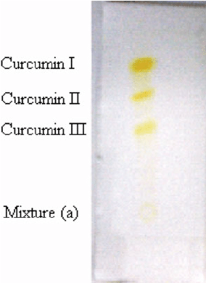

Slide 14
HPLC

Slide 15
CURCUMIN
Utilization:
It is used as ant-inflammatory, anti arthritic, antimicrobial and antioxidant.
It is also used against peptic ulcer, wound healing.
Storage condition:
It should be store in well closed and air-tight containers protected from light and in cool place.

Slide 16
REFERENCES
Lecture notes by Mr. Ashutosh Meher, Associate professor, Barpali, Bargarh, Odisha
16

