Slide 1
B.PHARM. 5th SEM. 504T UNIT V- BASICS OF PHYTOCHEMISTRY
Modern Methods of Extraction
Application of latest techniques
Chromatography
Spectroscopy
Electrophoresis
in
Isolation, Purification & Identification of crude drugs

Slide 2
ELECTROPHORESIS
Electrophoresis is the migration of charged particles or molecules in a medium under the influence of an applied electric field.
The comprehensive term refers to the migration of charged particles of any size in a liquid medium under the influence of an electric field.
Depending on the kind of charge the molecule carry, they move toward either
To cathode
or to Anode
An ampholyte become positively charged in acidic condition and migrate to the cathode, in the alkaline condition they become negatively charged and migrate to the anode.
Commonly used for the isolation of amino acids and proteins
2

Slide 3
The rate of migration of an ion in an electrical field depends on factors,
Net charge of the molecule
Size and shape of the particle
Strength of electrical field
Properties of supporting medium
Temperature of operation
3

Slide 4
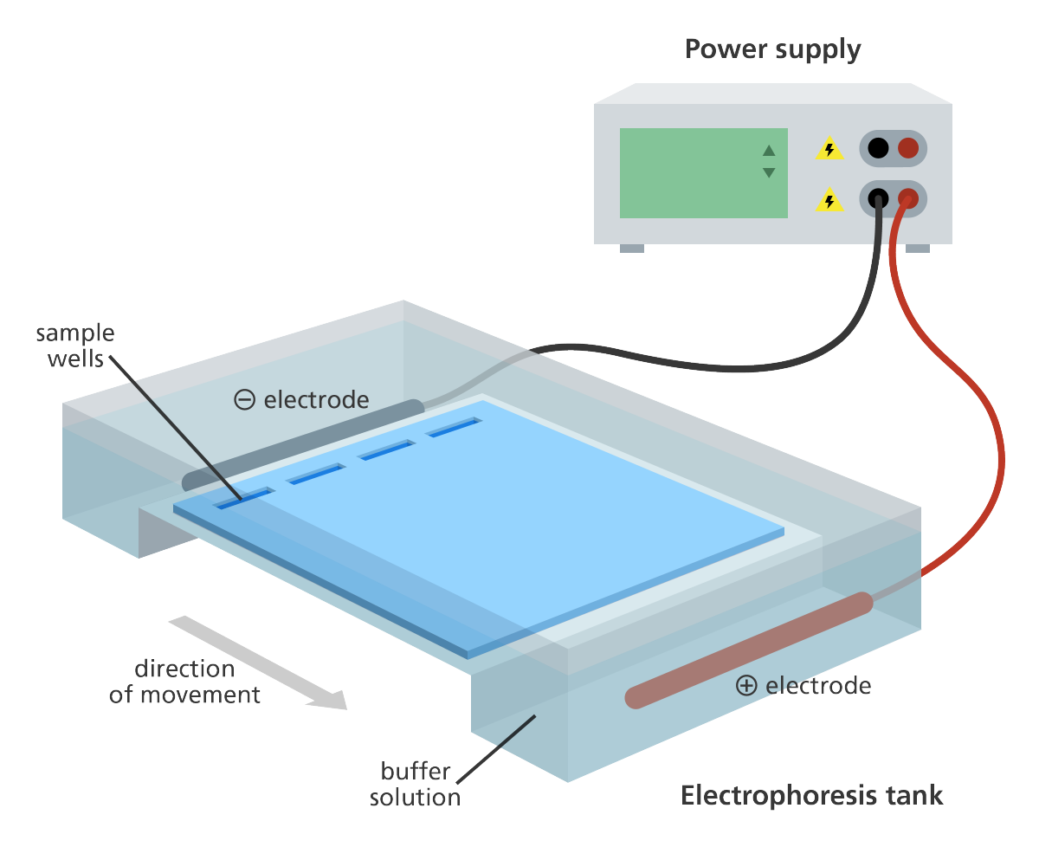
4

Slide 5
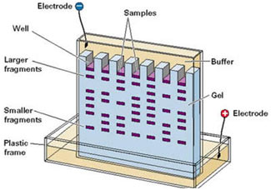
5

Slide 6
6

Slide 7
REFERENCES
https://www.slideshare.net/wadekarpradnyap/basics-of-phytochemistry
By Mrs Pradnya Wadekar Bapat, Asst. Prof., ABCP, Sangli

