Slide 1
B.PHARM. 5TH SEM. 504T UNIT V- BASICS OF PHYTOCHEMISTRY
Modern Methods of Extraction
Application of latest techniques
Chromatography
Spectroscopy
Electrophoresis
in
Isolation, Purification & Identification of crude drugs
1

Slide 2
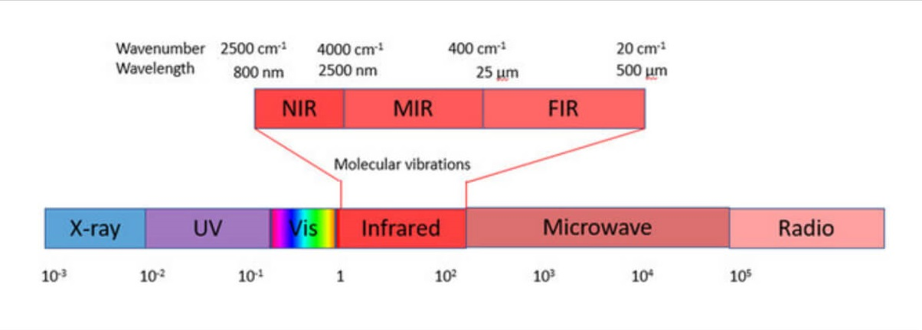
IR SPECTROSCOPY
IR spectroscopy (which is short for infrared spectroscopy) deals with the infrared region of the electromagnetic spectrum, i.e. light having a longer wavelength and a lower frequency than visible light.
The IR spectroscopy concept can generally be analyzed in three ways: by measuring reflection, emission, and absorption.
The major use of infrared spectroscopy is to determine the functional groups of molecules, relevant to both organic and inorganic chemistry
2

Slide 3
THEORY OF INFRA RED ABSORPTION
IR radiation does not have enough energy to induce electronic transitions as seen with UV.
Absorption of IR is restricted to compounds with small energy differences in the possible vibrational and rotational states.
For a molecule to absorb IR, the vibrations or rotations within a molecule must cause a net change in the dipole moment of the molecule.
The alternating electrical field of the radiation (remember that electromagnetic radiation consists of an oscillating electrical field and an oscillating magnetic field, perpendicular to each other) interacts with fluctuations in the dipole moment of the molecule.
If the frequency of the radiation matches the vibrational frequency of the molecule then radiation will be absorbed, causing a change in the amplitude of molecular vibration.
3

Slide 4
What is a vibration in a molecule?
"Any change in shape of the molecule- stretching of bonds, bending of bonds, or internal rotation around single bonds".
• Why we study the molecular vibration?
Because whenever the interaction b/w electromagnetic waves & matter occur so change appears in these vibrations.
4

Slide 5
FUNDAMENTAL VIBRATIONS.
Vibrations which appear as band in the spectra.
NON-FUNDAMENTAL VIBRATIONS
Vibrations which appears as a result of fundamental vib. Mol.
https://en.wikipedia.org/wiki/Infrared spectroscopy
5

Slide 6
NON-FUNDAMENTAL
VIBRATIONS
• OVER TONES: These are observed at twice the frequency of strong band. Ex: carbonyl group.
• COMBINATION TONES: Weak bands that appear occasionally at frequencies that are sum/difference of 2 or more fundamental bands.
• FERMI RESONANCE: Interaction b/w fundamental vibration & overtones or combination tones. Ex:CO2
6

Slide 7
FINGERPRINT REGION
In IR, the region below 1500 cm-1 is rich in many absorption bands and the region is known as fingerprint region.
Here the number of bending vibrations are usually more than the number of stretching vibrations.
In this region, small difference in the structure and constitution of a molecule results significant changes in the absorption bands.
Many compounds show unique absorption bands in this region and which is very useful for the identification of the compound.
7

Slide 8
SAMPLINGS
SOLID RUN IN SOLUTION: Dissolve solid sample in non-aqueous solvent (which should be IR inactive) and place a drop of this solution in alkali metal disc and allow to evaporate, leaving a thin film which is then mounted on a sepectrometer.
E.g. of solvents - acetone, cyclohexane, chloroform, carbon tetrachloride etc.
MULL TECHNIQUE :Finely powdered sample + mulling agent (Nujol) and make a thick paste (mull). Transfer the mull to the mull plates and the plates are squeezed together to adjust the thickness it is then mounted in spectrometer.
8

Slide 9
3.Pressed pellet technique :Finely powdered sample is mixed with about 100 times its weight of KBr in a vibrating ball mill and the mixture is then pressed under very high pressure in an evacuable die to form a small pellet( 1-2mm thick and 1cm in diameter).
4. Solid films: Here amorphous solid is dissolved in volatile solvents and this solution is poured on a rock salt plate (NaCl or KBr), then the solvent is evaporated by gentle heating.
9

Slide 10
Sampling of liquids Liquid sample can be sandwiched between two alkali halide plates (NaCl, KBr, CaF2).
Sampling of gases: Here gases sample is introduced into a glass cell made up of NaCl.
Very few organic compounds can be examined as gases. E.g.: 1,4-dioxane.
Sampling of solutions Here 1-5% of solution is placed in a solution cell made up of metal halides and a second cell containing the pure solvent act as a reference.
Important solvents used are:-chloroform, CC14, Carbon disulphide etc.
10

