Slide 1
B.PHARM. 5th SEM. 504T UNIT V- Basics of Phytochemistry
Modern Methods of Extraction
Application of latest techniques
Chromatography
Spectroscopy
Electrophoresis
in
Isolation, Purification & Identification of crude drugs

Slide 2
SPECTROSCOPY
Spectroscopy is the study of the interaction between matter and electromagnetic radiation
Traditionally, spectroscopy involved the visible spectrum of light, but X-ray, gamma, and UV spectroscopy also are valuable analytical techniques.
Spectroscopy can involve any interaction between light and matter, including absorption, emission, scattering, etc.
When a beam of electromagnetic radiation passes through a sample, the photons interact with the sample.
They may be absorbed, reflected, refracted, etc.
Absorbed radiation affects the electrons and chemical bonds in a sample.
In some cases, the absorbed radiation leads to the emission of lower- energy photons.
Spectroscopy looks at how the incident radiation affects the sample.
Emitted and absorbed spectra can be used to gain information about the material.

Slide 3
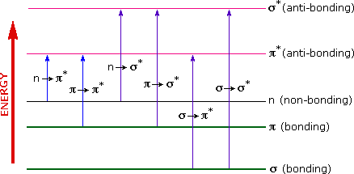
UV/VISIBLE SPECTROSCOPY
UV-Vis spectroscopy is absorption spectroscopy or reflectance spectroscopy in part of the ultraviolet 100-400nm and the full, adjacent visible spectral regions (400-800 nm)
Absorption of the ultra-violet radiations results in the excitation of the electrons from the ground state to higher energy state.

Slide 4
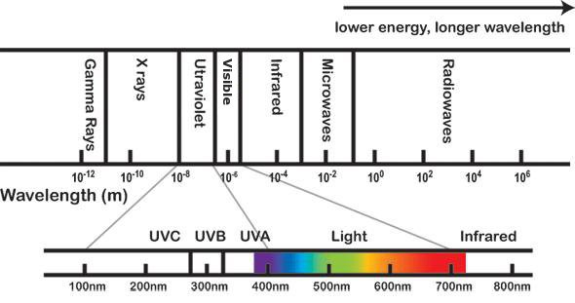

Slide 5
PRINCIPLE
UV spectroscopy obeys the Beer-Lambert law. which states that when a beam of monochromatic light is passed through a solution of an absorbing substance, the rate of decrease of intensity of radiation with thickness of the absorbing solution is proportional to the incident radiation as well as the concentration of the solution.
The expression of Beer-Lambert law is-
A = log (I_{o}/I)= EcL
Where, A = absorbance
I_{o}= intensity of light incident upon sample cell
I= intensity of light leaving sample cell
C = molar concentration of solute
L= length of sample cell (cm.)
E = molar absorptivity

Slide 6
Chromophore- Chromophore is defined as any isolated covalently bonded group that shows a characteristic absorption in the ultraviolet or visible region (200-800 nm).
Chromophores can be divided into two groups-
a) Chromophores which contain p electrons and which undergo pie to pie transitions.
Eg: Ethylenes and acetylenes
b) Chromophores which contain both p and nonbonding electrons. They undergo two types of transitions; pie to pie and nonbonding to pie".
Eg: Carbonyl, nitriles, azo compounds, nitro compounds
Auxochromes- An auxochrome can be defined as any group which does not itself act as a chromophore but whose presence brings about a shift of the absorption band towards the longer wavelength of the spectrum.
Eg:-OH,-OR,-NH2,-NHR, -SH, etc.

Slide 7
BATHOCHROMIC EFFECT- This type of shift is also known as red shift. Bathochromic shift is an effect by virtue of which the absorption maximum is shifted towards the longer wavelength due to the presence of an auxochrome or change in solvents. The nonbonding to pie transition of carbonyl compounds observes bathochromic or red shift.
HYPSOCHROMIC SHIFT- This effect is also known as blue shift. Hypsochromic shift is an effect by virtue of which absorption maximum is shifted towards the shorter wavelength. Generally it is caused due to the removal of conjugation or by changing the polarity of the solvents.
HYPERCHROMIC EFFECT- Hyperchromic shift is an effect by virtue of which absorption maximum increases. The introduction of an auxochrome in the compound generally results in the hyperchromic effect.
HYPOCHROMIC EFFECT- Hyperchromic effect is defined as the effect by virtue of intensity of absorption maximum decreases. Hyperchromic effect occurs due to the distortion of the geometry of the molecule with an introduction of new group.

