Slide 1
Unit-6 Physical Activity and Leadership Training
VISHAL KUMAR
PGT- PHE
AIRFORCE SCHOOL

Slide 2
Leadership Qualities
According to R.M. Snodgill: “Leadership is a process of influencing the activities of an organized group for any goal achievement.
According to P.M. Joseph: “Leadership is the quality which enables the person to take initiative and guide others in performing some required task.”
According to Montgomery: “The capacity to rally people for common purpose.”
Good leadership requires three basic things:
Good leader
Good followers
Common purpose

Slide 3
There are two types of leaders:
Professional
Democratic
Professional Leader: Professional leader is that who earns the quality of leadership by becoming a teacher, officer, administrator or manager, etc.
Democratic Leader: It is of two types. They are chosen by the choice of the people.
Mature leader: Mature leader is like a political leader.
Amateur leader: These are leaders with voluntary service like student leader, game leader, captain, group leader, academic leader, cultural leader and stage leader, etc.

Slide 4
Qualities of a leader or captain
Academically Sound:
God personality:
Good Moral Character:
Intelligent:
Self-Discipline:
Determination:
Inculcate Friendship:
Master of Physical Skill:
Expressive and Optimistic:
Loyal:
Example for Others:
Impartial:

Slide 5
To Create and develop a good leader the following points should be considered such as:
Appointing Leader for Different Activities:
Responsibility for Conducting Event:
Given Authority:
Guidance to Leader:
Assigning Duties:
Recognition and Honour to Leaders:
Special Consideration:
Technical Tips:

Slide 6
Role of leader or Captain
Group Representation:
Opportunity to Direct:
Reduces Stress:
Better Discipline:
Develops Socialization:
Inspire Others:
Close Relationship:
Better Organization:
Good Medium to Convey:
Improves Abilities:
Provides Recognition:
Improves Coordination:

Slide 7
Meaning of Adventure Sports
Adventure sports activities are the risky and dangerous activities which are mostly performed in natural environment. These are the activities which give us exciting or unusual experience with uncertain outcome. These activities are also termed as Extreme Sports.
Objectives of Adventure Sports
Minimize Pollution:
Protection of Wildlife:
Use of Natural Resources:
Understanding Nature:
Healthy Activity:
Information about Area:
Leadership and Togetherness:
Develop physical Fitness:
Gives Thrill and Recreation:
Overcome Problems and Develop Creativity:
Organisational Skills:
Encourage Tourism:
Considering Safety Tools:
Knowledge about Forest Resources:

Slide 8
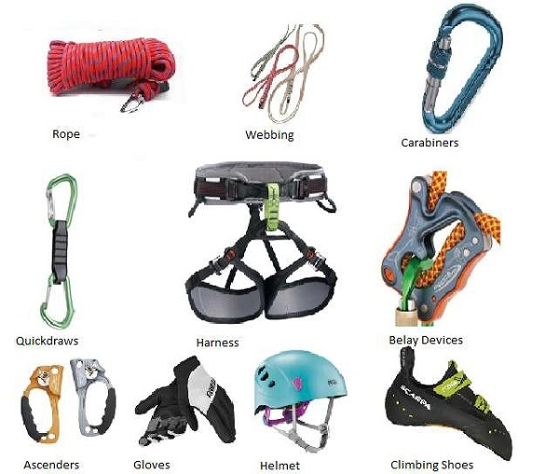
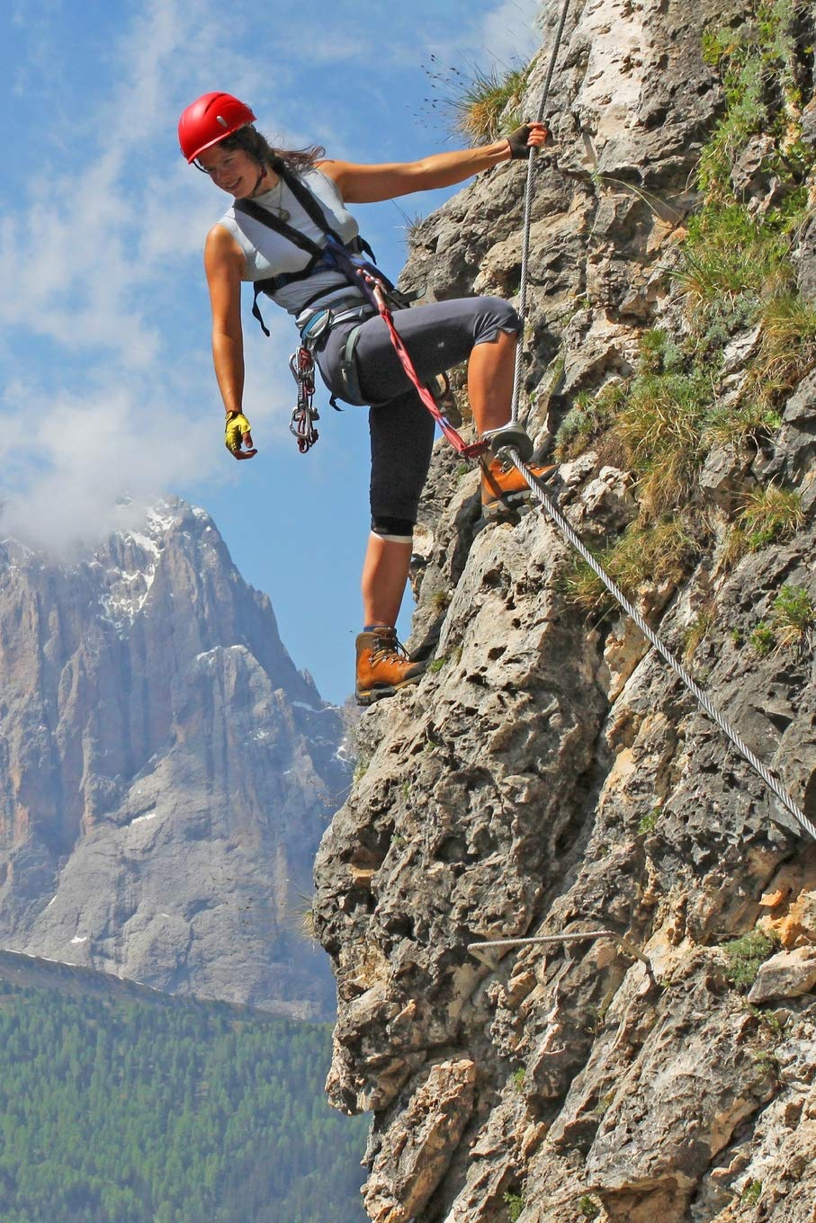
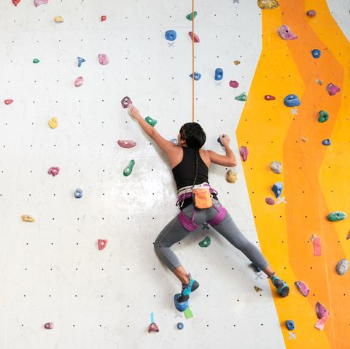
Adventure Activities And their Safety Equipment
Rock Climbing:
Rock climbing is an activity in which participant climbs up or down or across natural rock formation. The goal is to reach the summit or topo of a formation or the end point of a pre-defined route without falling.

Slide 9
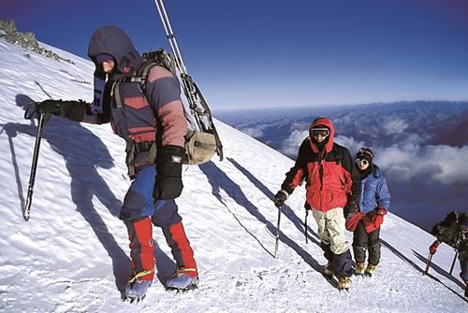
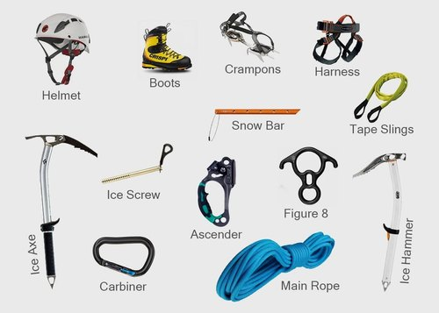
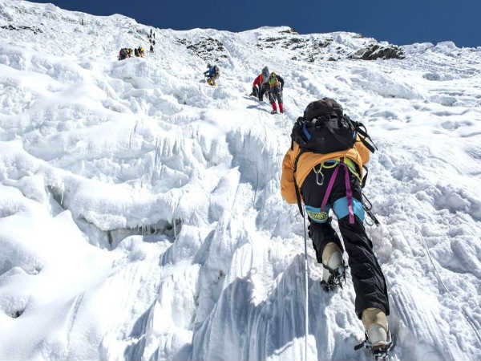
Mountaineering Mountaineering or mountain climbing is an age old activity of climbing up or scaling the steep slopes of a mountain side in hopes of reaching the summit or top.

Slide 10
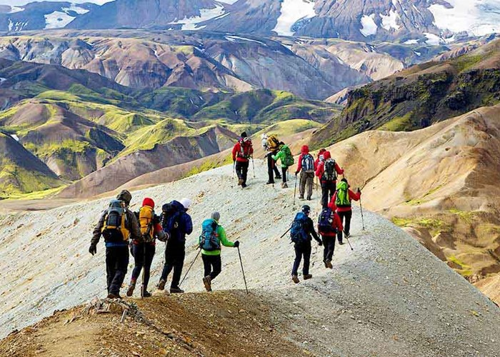
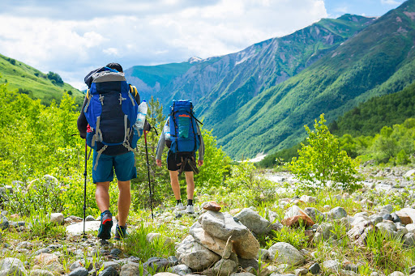
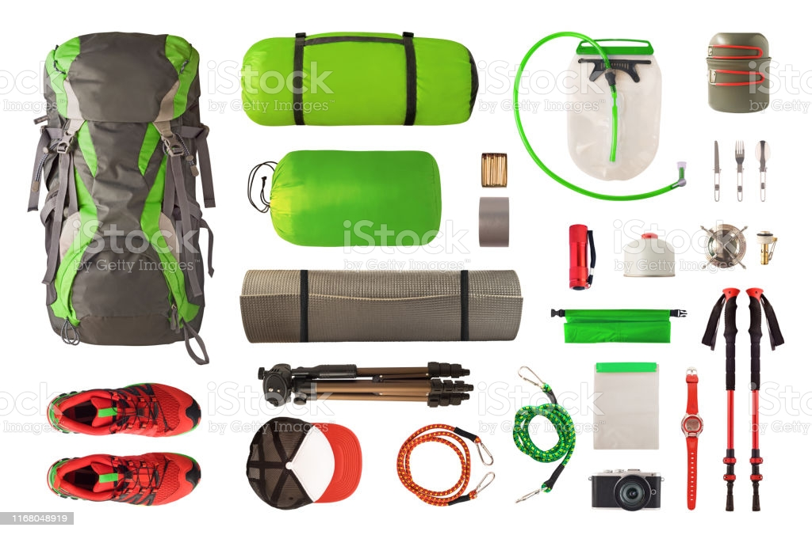
Trekking Trekking is a long adventurous journey undertaken on foot in areas where common means of transport are generally not available.

Slide 11
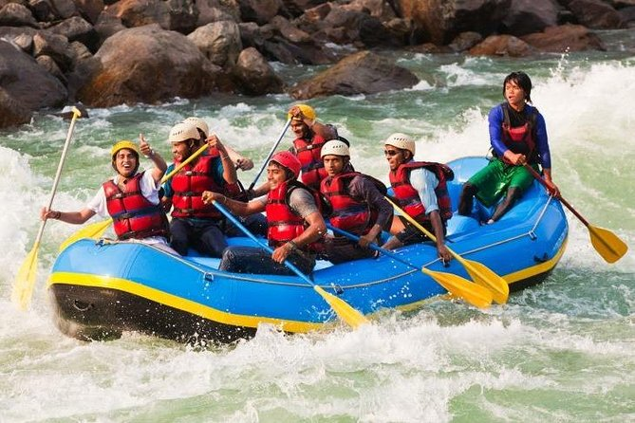
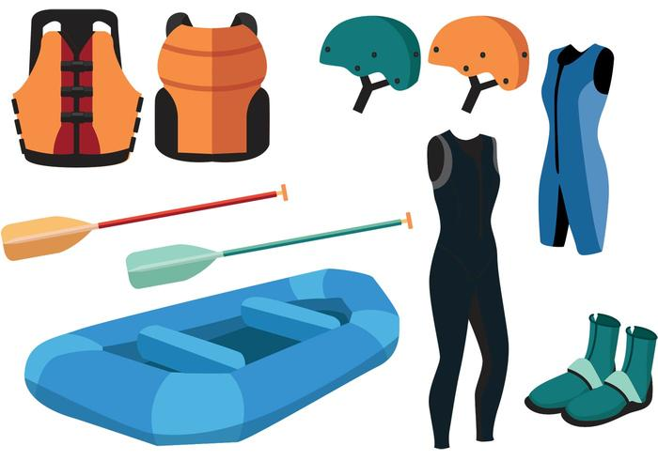
River Rafting River rafting is also named as white-water Rafting. It is a challenging recreational outdoor activity using a boat or raft to navigate over the flow of river.

Slide 12
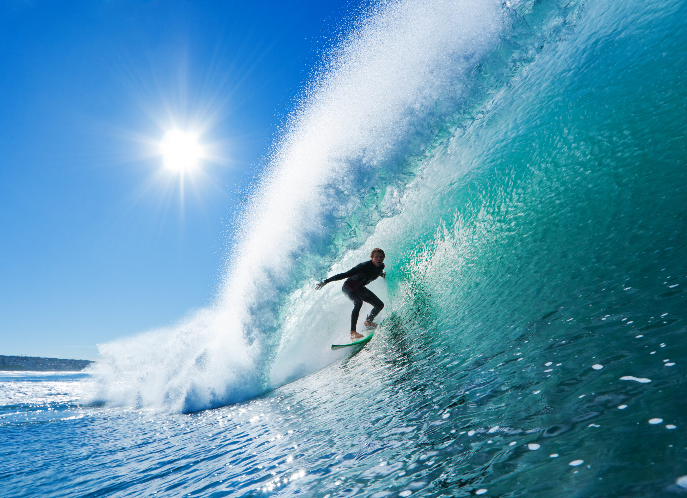
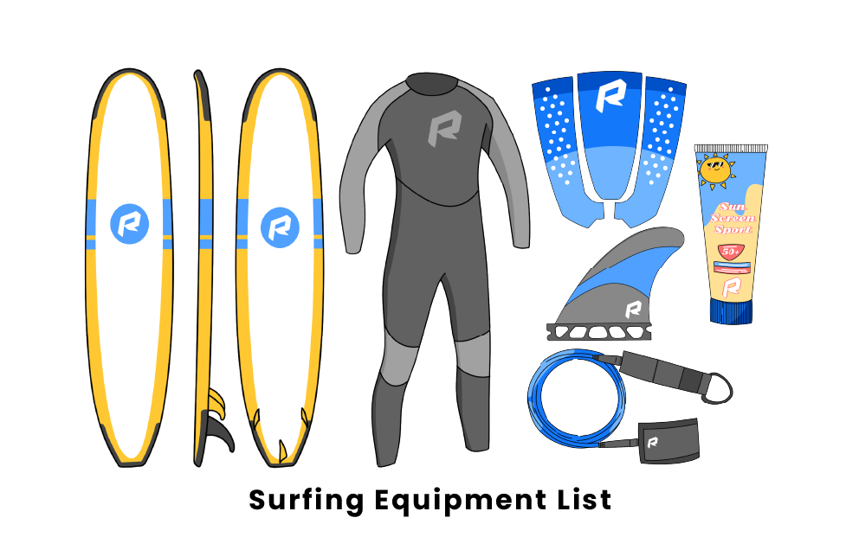
Surfing It is a water sports in which the wave rider referred as ‘Surfer’ rides on moving wave balancing on the surfing board, the wave usually carrying the surfer near the shore.

Slide 13
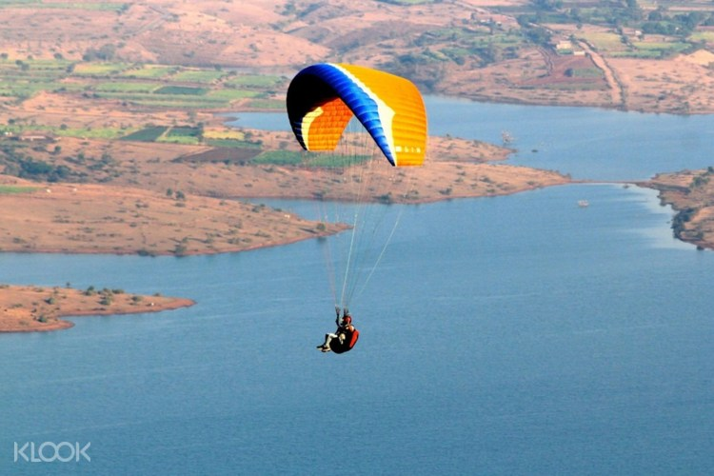
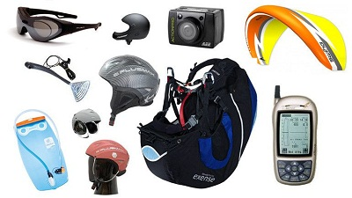
Paragliding It is a recreational, thrilling and competitive adventure sports of flying with paraglider. Paraglider is a lightweight free flying foot launched glider aircraft with no rigid primary structure.

Slide 14
Causes of Sports Injuries
Lack of Fitness:
Poor Concentration:
Overstress or Tension:
Not performing Warming-up
Equipment Failure:
Faulty Skill Actions:
Not Following Rules:
Aggression or Violence:
Poor Playfield:
Not Considering Safety Means:
Not Wearing Protective Guards:
Wrong Training Methods:
Wrong Treatment of Injury:

Slide 15
Safety measures to prevent Sports Injuries
Proper Warming-up:
Medical Check before Activity:
Proper Concentration:
Safety Guards and Check Equipment:
Regular Conditioning and proper Skill:
Sufficient Physical Fitness:
Consider Safety Means:
Proper and Safe Environment:
Activity Under Expert’s Observation:
Good Coaching Skills:
Follow Rules and Regulations:
Consider Sports Ethics and Sportsmanship:
Controlling Aggression and Violence:
Proper Training Methods:
Follow Training Principles:
Balanced Diet and Good Posture:
Knowledge of Health Education and First Aid:
Training Regarding Safe Escape:

