Slide 1

Basics of
Phytochemistry

Slide 2
Contents
Methods of Extraction
Application of latest techniques in isolation, purification, & identification of crude drugs :
1. Spectroscopy
2. Chromatography
3. Electrophoresis

Slide 3
Extraction
The process of isolation of active ingredients or active substances or active medicaments from raw materials of either plants or animals' sources with the help of solvent is called extraction.
Purpose:
The extracts obtained are utilized for the isolation and characterization of
therapeutically active chemical constituents.

Slide 4
Terms
Marc:
The unwanted or insoluble substances left behind after the process of extraction is called marc.
Menstrum
The solvent used in the process of extraction is called solvent. The most commonly used menstrum is water.
Choice of Menstrum
The menstrum should have the following properties
1. Highly selective for the compound to be extracted
2. High capacity of extraction
3. Should not react with the extracted compound or any other compound in the raw material.
4. Should have low price and easily available
5. Should be harmless to man and environment
6. Completely volatile

Slide 5
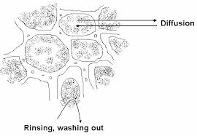
Extraction process
The Entire process of drug extraction can be divided into four steps
1. Penetration of the solvent into the drug.
2. Dissolution of constituents
3. Outward diffusion of the solution from the cells
4. Separation of dissolved portion and the exhausted drug

Slide 6
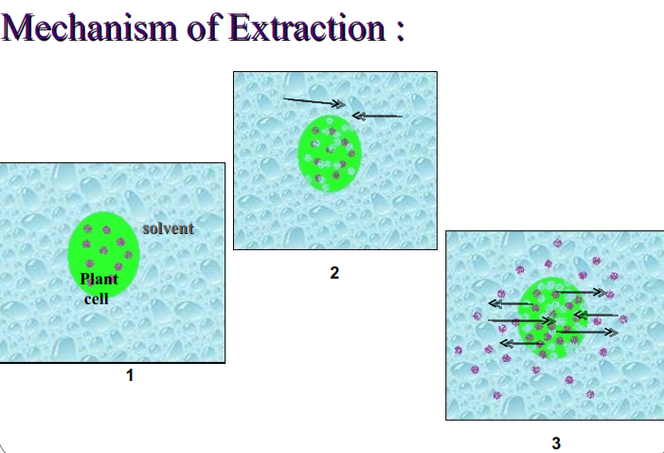

Slide 7
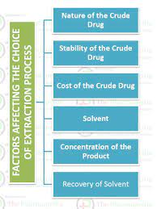

Slide 8
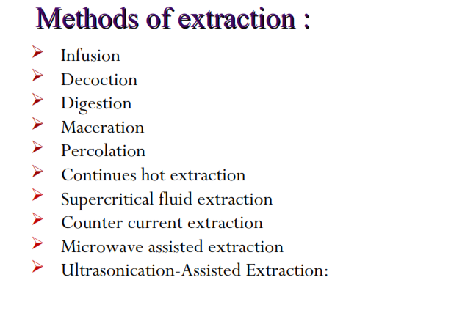

Slide 9
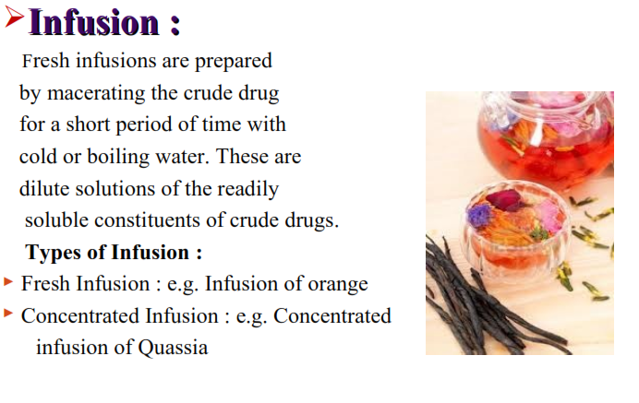

Slide 10
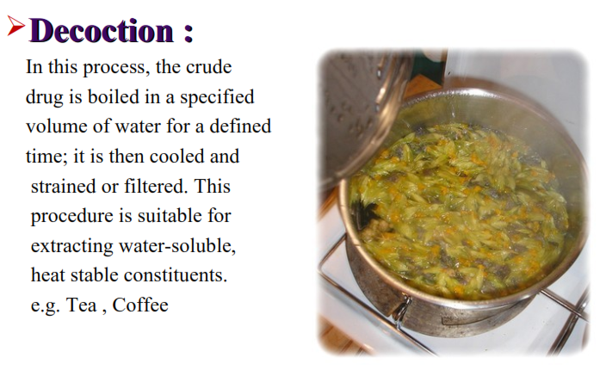

Slide 11
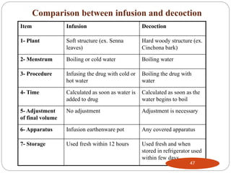

Slide 12
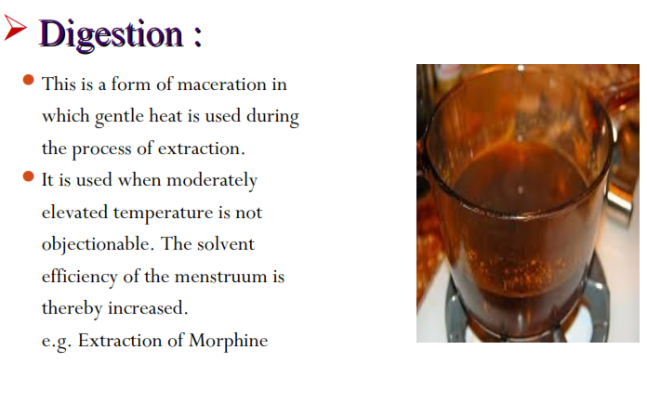

Slide 13
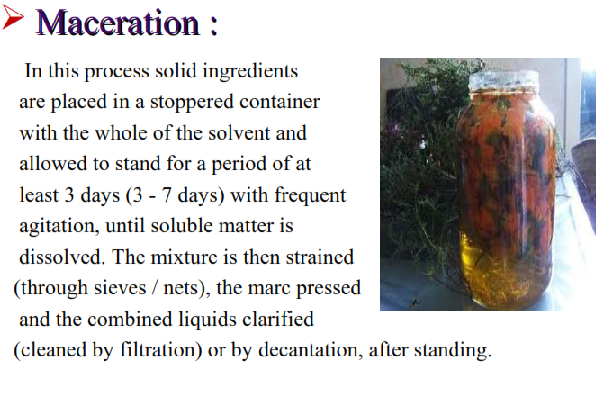

Slide 14
The drug is allowed to stand for few days
i) To help the solvent to penetrate the cells of the drugs
ii) To provide the time for partitioning the active ingredient into the solvent.
iii) To transfer the drug out of the cells into the bulk of the solvent.
The process is normally used for the preparation of tinctures or extracts and menstrum is usually
alcoholic, hydro alcoholic (in case of tinctures) or may be aqueous.
Types of maceration:
A. Simple maceration - a process for tinctures made from organized drugs e.g. roots, stems, leaves etc.
B. Maceration with adjustment - a process for tinctures made from unorganized drugs such as oleo-resins and gum resins.
C. Multiple maceration - a process to prepare concentrated extract. It includes ‘Double maceration’ and ‘Triple maceration’.

Slide 15
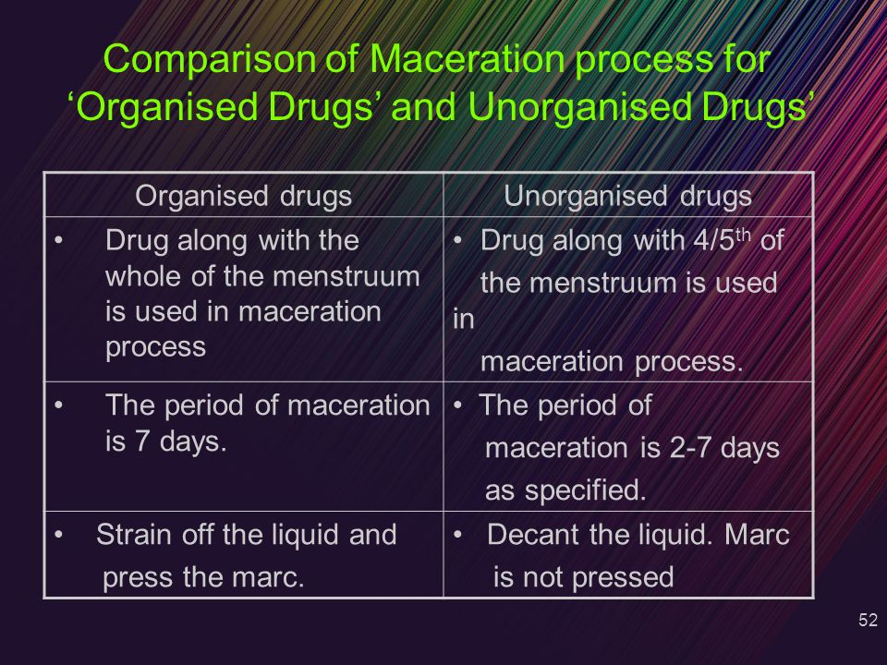
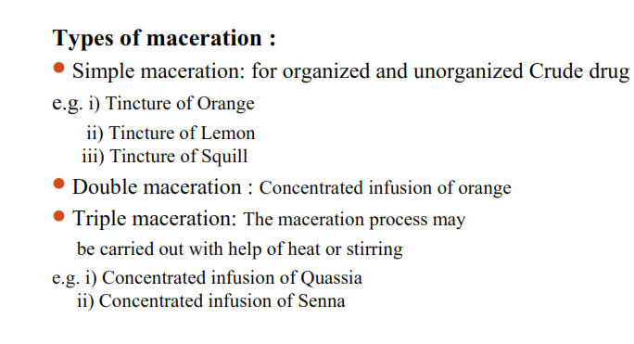

Slide 16
In organized drugs maceration the expressed liquid is mixed with strained liquid then filtered to make a clear liquid. The final volume is not adjusted.
E.g. tincture of orange, tincture of lemon,
In unorganized drugs filter the liquid and final volume is adjusted by adding remaining amount of menstruum.
E.g., Tincture of benzoin, Tincture of tolu.

Slide 17
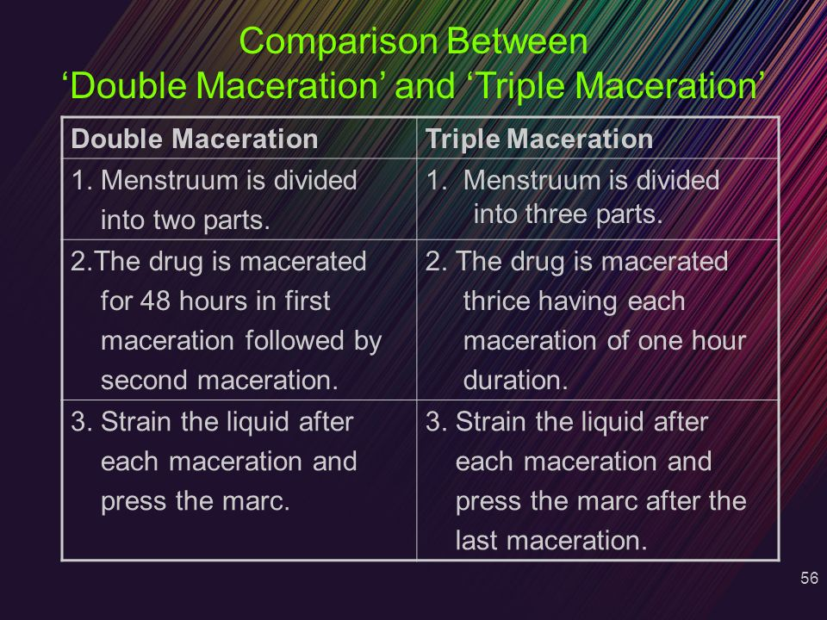
Multiple maceration

Slide 18
Triple maceration
The liquid obtained from 2nd and 3rd maceration is collected and evaporated to a specified concentration. This concentrated liquid is mixed with the liquid obtained from the 1st maceration .
Addition of alcohol then volume adjusted with water and allowed to stand for 14 days and then filtered.

Slide 19
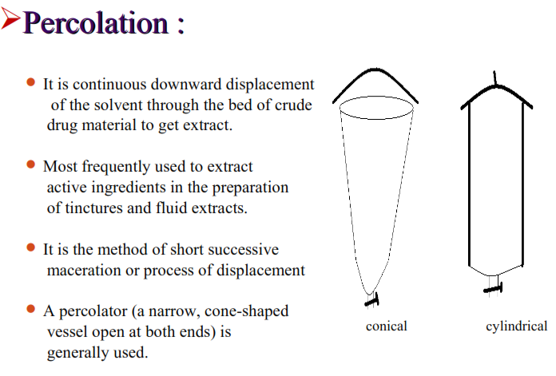

Slide 20
Types of Percolation Process
A. Simple percolation process
B. Percolation process for concentrated preparations
I) Reserved percolation
II) Modified percolation
C. Continuous hot percolation / Soxhlet Extraction
A. SIMPLE PERCOLATION
Apparatus:
Three types of apparatus are generally used,
i) Conical percolator
ii) Cylindrical percolator
iii) Steam jacketed percolator [for higher temperature extraction]

Slide 21
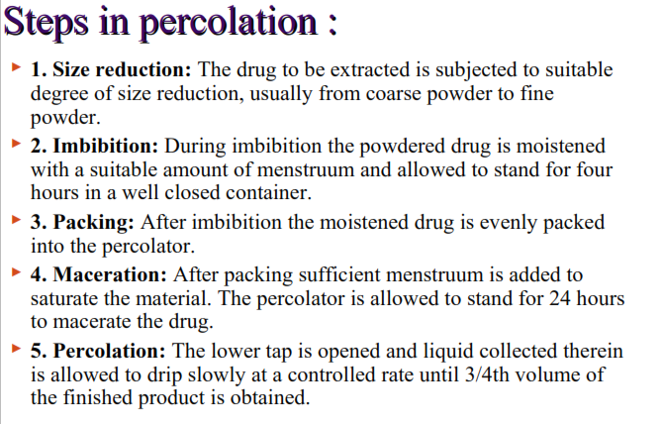

Slide 22
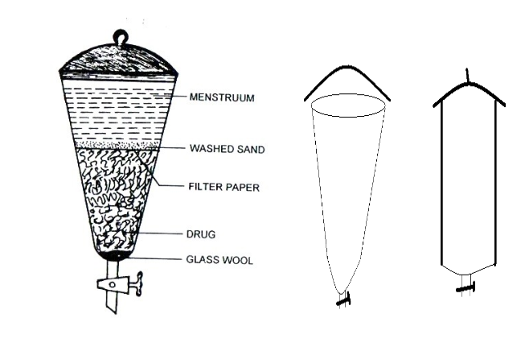

Slide 23
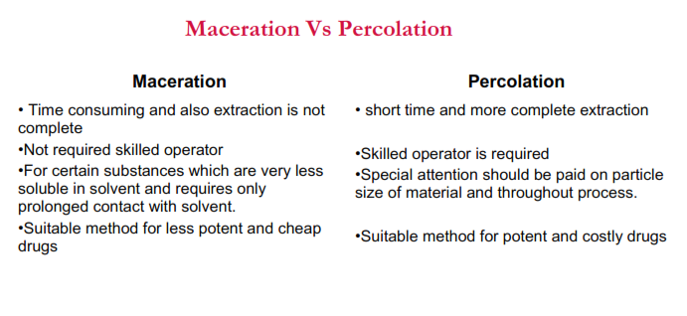

Slide 24
Reserve Percolation
In this process, the first portion (about 3/4 th of the final product) of the percolate which contains the maximum amount of active constituents is reserved. Subsequently, percolation is completed as usual until the drug is exhausted but the last part (about 1/4th of the final product) is collected separately.
The second dilute part is then evaporated to get a syrupy consistency which is then mixed with the
reserved first portion of the percolate.
Finally volume is adjusted by adding more menstrum.
Example:
Liquid extract of liquorice

Slide 25
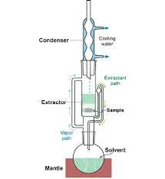
CONTINUOUS HOT PERCOLATION PROCESS / SOXHLET EXTRACTION
This process is used for those drugs
• where the penetration of the menstruum into the
cellular tissues is very slow and
• the solute is not readily soluble into the solvent and
• the quantity of the menstruum is very less.
Apparatus:
i) A flask in which the menstrum is boiled,
ii) an extraction chamber in which drug is filled, is
fitted with side tube and a siphon.
iii) a condenser

Slide 26
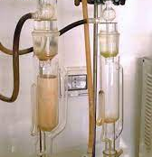
Continuous Hot Percolation
The drug to be extracted, is packed in a ‘thimble’ made of filter paper which is then placed into the wider part of the extractor.
Thimble is used to prevent choking of the lower part of the extractor.
Menstruum is placed in the flask and boiled. The vapor rises through the side tube to the condenser, where the vapor is condensed and fall on the packed drug, through which it percolates and extract out the active constituents.
As the volume of menstruum in the extractor increases, the level of liquid in the siphon also increases till it reaches the maximum point from where it is siphoned out into the flask.
On further heating the menstruum vaporizes while the dissolved active constituents remain behind in the flask.

Slide 27
889
Limitations of continuous hot percolation process:
1. Physical character of the drug: If the physical character of the drug is such that it would block the Soxhlet
apparatus then this method is not suitable. e.g opium, gum, resin, orange peel etc.
2. Solvent: Only pure solvents or constant boiling mixtures (like alcohol-water)can be used for this purpose.
3. Chemical constituents of the drug: The process is unsuitable for thermolabile active constituents, e.g. enzymes,
alkaloids, anthraquinone derivatives, esters etc.
Examples:
i) Extract cantharidins from cantharides with benzene
ii) Alkaloids from the seeds.

Slide 28
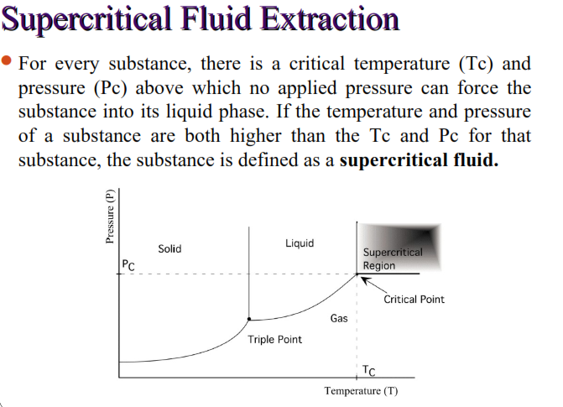

Slide 29
Cont.
Supercritical fluid extraction (SFE) is a method in which supercritical fluid as an extraction medium is added to substances and extraction is performed based on differences in solubility.

Slide 30
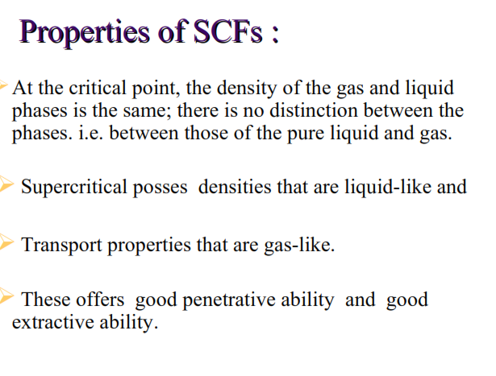

Slide 31
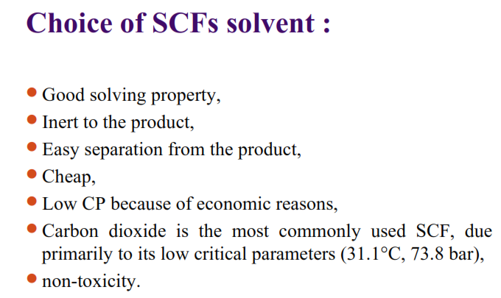

Slide 32
