Slide 1
PADAM SHRI AWARD
Started in 1954
This is the Fourth Highest Civilian Award After Bharat Ratan, Padma Vibhushan and Padma Bhushan.
It is Awarded irrespective citizenship to recognise their distinguished contribution in various spheres of activities including the Arts, Education, Industry, Literature, Science, Sports, Medicine, Social Service, and Public Affairs.
Presented by Government of India.
First Awarded: 1954
Last Awarded: 2021
Total Awarded: 3225

Slide 2
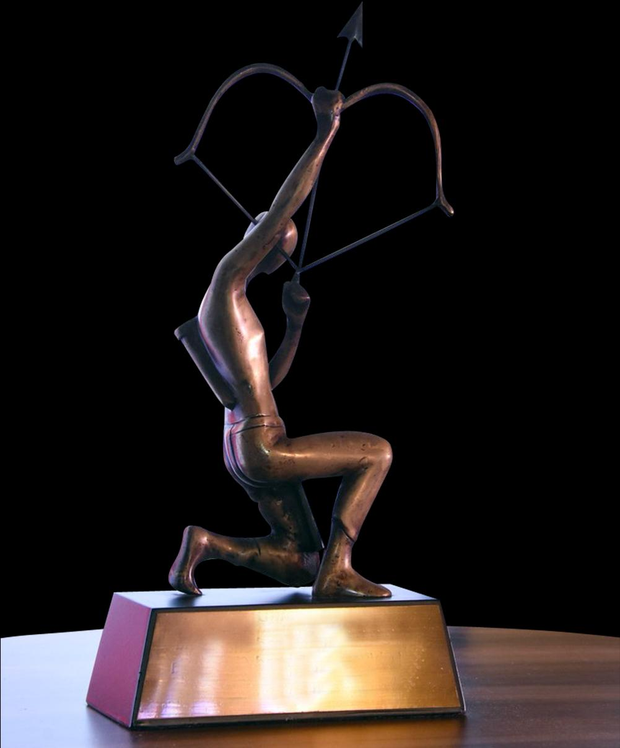
ARJUN AWARD
Started in 1961
Awarded to Sports Player to recognise their outstanding achievement in previous 1 year (Previous 3 years performance is also considered)
The second Highest Sporting honour of India, the Highest being the khel Ratan Award
Cash Prize:RS. 5 Lakh
The Award is Named after Arjuna, one of the central Character of the Sanskrit epic Mahabharat of ancient Indian
This Award are Given by the Ministry of Youth Affairs and Sports.

Slide 3
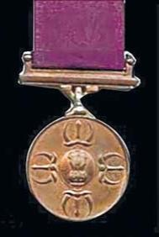
RAJIV GANDHI KHEL RATAN AWARD
Started in 1991-92
It is the Highest civilian award in India.
Awarded for spectacular and most outstanding performance over a period of four year international Level.
Cash Prize: RS. 7.5 Lakh
Sponsored by Government of India
First Recipient: Vishwanathan Anand
2019 Winners: (i) Deepa Malik & (ii) Bajrang Punia
Total Awarded = 57 Players.

Slide 4
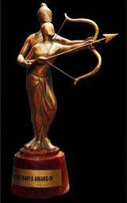
DRONACHARYA AWARD
Started in 1985
Awarded to coaches for their outstanding contribution in the field of sports Coaching and Training.
It is a Sports Coaching Honour in India.
The Award is Named after Drona, often referred as “Dronacharya” or “Guru Drona”, a character from the sanskrit epic Mahabharat of Ancient India.
First Recipient: (i) Bhalachandra Bhaskar Bhagwat (ii) Om Prakash Bharadwaj (iii) O.M. Nambiar
Total Awarded: 129 coaches

Slide 5
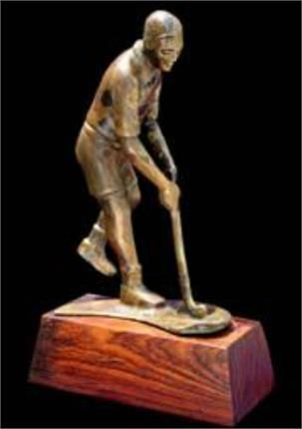
DHYAN CHAND AWARD
Started in 2002
Awarded for glorious contribution during active Sporting career and after retirement Also called Dhyan Chand Award for Lifetime Achievement in Sports and Games.
This award is named after Major Dhyanchand, an Indian hockey player who scored over 1000 goals during a career span of over 20 years.
Cash Prize: RS. 5 Lakh
First Recipient: (i) Shahuraj Birajdar (ii) Ashok Diwan (iii) Aparna Ghosh
Total Awarded: 80

Slide 6
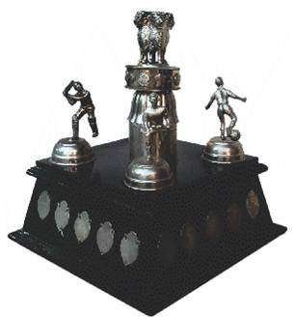
MAULANA ABUL KALAM AZAD TROPHY
Started in 1956-57
Also called MAKA Trophy
Awarded to overall top performing University in Inter- University Tournaments
It is a Running / Rolling Trophy
Cash Prize : Winner = RS. 15lakh. 1st Runner-up = 7.5 lakh. . 2ndRunner-up = 4.5 lakh
2019 Winner: (i) P.U. (Chandigarh) (ii) G.N.D.U. (Amritsar) and (iii) P.U. (patiala)

Slide 7
CAREER OPTION
INTRODUCTION: “Sports is one of the rewarding career options of the country with lots of job opportunities”.
Sports opened up many career opportunities for young talents in India. To become a sports person, having a talent in the chosen sport is very important. Along with talent, Strong determination and perseverance in needed. For every sports person, it is a dream to represent their nation at the international level. You can start your career in school and college level and start play at the State level, Regional level and then explores opportunities at national and international levels.

Slide 8
EDUCATION AND TRAINING FACILITIES
A number of government college also run full time courses in physical education right up to the doctodate level. A basic structure of sports education in india may look like as under
NIS Diploma
Bachelor in Physical Education (BPED)
Master in Physical Education (MPED)
M Phil Physical Education
Doctorate in Physical Education
Several institution offer various Diploma/ Degree /post graduate degree level course in the field of sports.

Slide 9
EMPLOYMENT OUTLOOK
Beside being active player, Sports person can avail to sports quota to acquire a job, although it is limited to admission in the clerical grade, in various Government and private Concerns. Among the organizations having sports quota are the central industrial security force (CISF), Border Security Force (BSF), the railways, Income tax department, custom and central excise Department, post and telecommunications Department, Police Department, the Army and some banks
SELF-EMPLOYMEMT OPPORTUNITIES
They may also open sports goods shops. They may start coaching classes in various fields e.g. Judo, Swiming, keep fit classes, Good and reputed sportsman may find suitable job opportunities in Health clubs of hostel on contract basis.
Sports events are shown on T.V. They cam also earn by writing articles on sports in various magazines and newspaper.

Slide 10
JOB PROFILE
Teacher Biomechanics Sport psychologist Sport journalist Sports Player Sports Coach & Instructor Commentator Sports Photographer Personal Trainer Professional Athlete Physical Education Teacher Health Advice Officer Health & Public Services Leader

Slide 11
Salary
“This field offers a handsome salary packages in both sectors”. The salary of the sports persons totally depends on the sport game that he has chosen. In the sports field, the number of years of experience is not merely matter, but also the sports person capability to deliver excellent performance consistently. Starting salary of the sports person is approx Rs. 3 Lac to Rs 5 Lac per year. When you become a star sportsman, you can earn in crores per annum. The salary is also depend on your job profile.

Slide 12
Thank you

