Slide 1
t-test
Priyanka Maurya,
Assistant Professor,
Department of Education, C.S.J.M. University, Kanpur
Email: priyanka@csjmu.ac.in

Slide 2
Introduction
The t-test was introduced by William Sealy Gosset.
His pen name was ‘student t’ that’s why this test is also called as student t test .
t-test is used to test the significant difference between two sample means.
T-ratio is the ratio of difference of two sample means and the standard error of this difference.

Slide 3
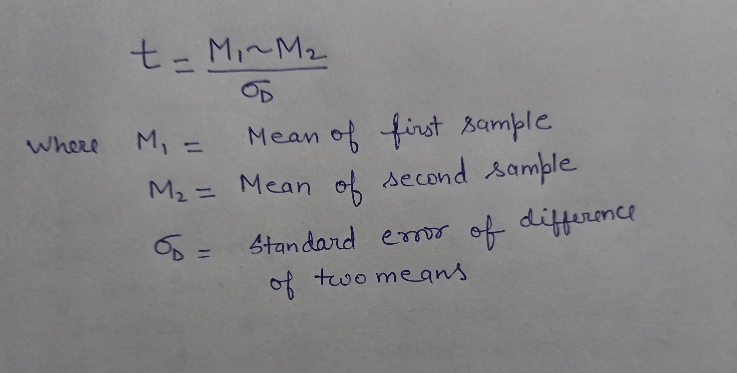
Yahan t test k formule ki pic lagani h

Slide 4
Assumptions :
Random observations.
The sample must be drawn from a normally distributed population.
The sample drawn from a population must have equal ( nearly equal) variances, this condition is known as homogeneity of variance i.e. there should not be significant difference among the variances of different samples.
The data must be expressed in interval or ratio scales.

Slide 5
Types:
There are two type of t-test:
1. Independent sample t-test: it compares two independent groups of observations or measurements on a single characteristics.
Example : To compare mean science achievement scores of male and female students of class ninth.
2. Dependent sample t-test: This test is used when the samples are dependent i.e. when there is only one sample that has been tested twice or when there are two samples that have been matched or paired as is usually done in experimental research.

Slide 6
Steps:
Step 1: state the null hypothesis.
Step2: decide the level of significance.
Step3: find the standard error of two sample means.

Slide 9
Step4: calculate mean and t-value
Step 5: find degree of freedom
Step6: test of significance
If calculated value of t >/= tabulated value of t. then t value is significant i.e. null hypothesis is rejected. In other words, both sample differ.
b. If calculated value of t <tabulated value of t. then t value is not-significant i.e. null hypothesis is retained. In other words, both sample do not differ.

Slide 10
Step 7: summary of t- value
Step 8: interpretation
Significant or not
Accept or retained null hypothesis
Both group are same or different.

Slide 11
THANK YOU

