Slide 1


The Evolution of Management Thoughts
Sub: PRINCIPLES OF MANAGEMENT
Dr Prabhat K. Dwivedi
Associate Professor
Deptt. of Business Management,
CSJM University, Kanpur, India

Slide 2
Evolution of Management Thought
Evolution of Management Thought can be classed into different parts like:
Pre-Scientific Management Period, before 1880
Classical Management Period (1880-1930)
Neo-Classical Management Period (1930-1950)
Modern Management Period (1950-onwards)

Slide 3
Three Types of Management Theories
Classical management theory: emerged from the Industrial Revolution and revolves around maximizing efficiency and production.
Behavioral management theory: started in the early 20th century and addresses the organization’s human and social elements.
Modern management theory: followed on the heels of World War II and combines mathematical principles with sociology to develop holistic approaches to management.

Slide 4
Management Theories & Approaches
Classical management theory
Scientific Management Theory by F.W. Taylor
Bureaucratic Management Theory by Max Weber
Administrative Management Theory by Henri Fayol
Behavioral Management Theory
Human Relations Theory (Elton Mayo)
Theory X and Theory Y (McGregor’s theory )
Modern Management Theory
Systems Management Theory (Ludwig Von Bertalanffy)
Contingency Management Theory (Fred Fiedler)

Slide 5
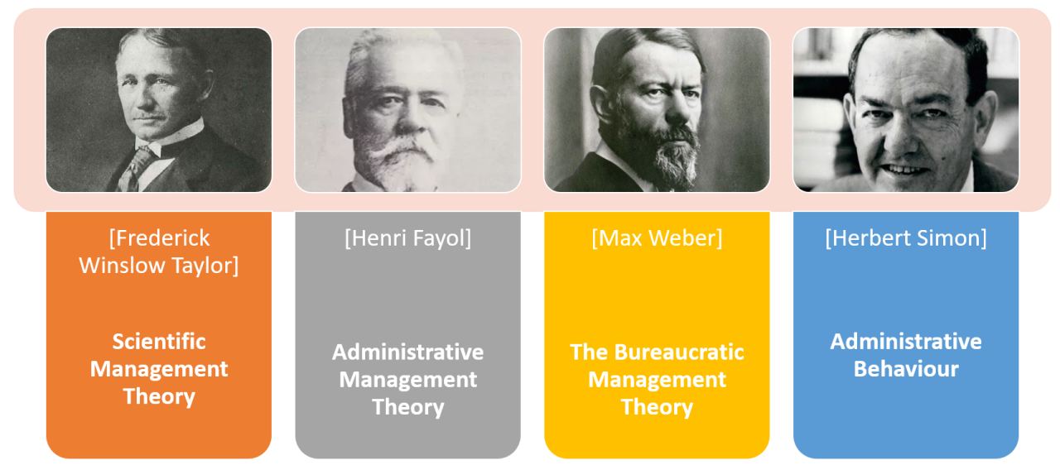
Classical management theory
Classical management theory prioritizes profit and assumes that personal gain motivates employees. It aims to streamline operations and increase productivity.
Major concepts include specialization, incentivization, and hierarchical structure. The first two contribute to employee efficiency and drive. Centralized leadership simplifies decision-making, and a meritocratic chain of commands provides order and oversight. At every level, standardization reduces waste and error.

Slide 6
Strengths & Shortcomings to classical management theory
Strengths:
It provides clarity for both the organization and its personnel, and specialization and sound hiring practices place employees in positions they can handle and even master.
Shortcomings :
The treatment of workers as machines without accounting for the role job satisfaction and workplace culture play in an organization’s success
The difficulty of applying some of its principles outside a limited manufacturing context
A top-down approach to communication that neglects employee input and prevents collaboration
Failure to provide for creativity and innovation, which rigid structures and hyper specialization can stifle

Slide 7
Scientific Management Theory
Scientific management theory is sometimes called Taylorism after its founder Frederick Winslow Taylor, a mechanical engineer. Taylor employed scientific methods to develop organizational principles that suited mass production needs. After creating and proving his theory as a manager and consultant, he wrote ” The Principles of Scientific Management” in 1911.
Taylor wanted to replace outdated, “rule-of-thumb” methods with more efficient processes. To this end, he identified four core principles of good management. The manager:
Develops a science consisting of best practices for all elements of their employees’ work
Selects and trains employees accordingly
Works with employees to ensure that the science is followed
Assumes half the responsibility for all work through process development, guidance, and maintenance

Slide 8
Bureaucratic Management Theory
Max Weber was one of the foremost scholars of the late 19th and early 20th century. He strongly influenced — and continues to influence — economic, religious, and political sociology. He explains bureaucratic management theory in “Economy and Society,” published posthumously in 1922.
Weber believed that standard rules and well-defined roles maximize the efficiency of an organization. Everyone should understand the responsibilities and expectations of their position, their place within a clear hierarchy and general corporate policies. Hiring decisions and the application of rules should be impersonal, guided only by reason and established codes.
Weber’s theory provides for orderly and scalable institutions. At least some element of bureaucracy informs most large organizations, whether they’re public, private, or profit driven.

Slide 9
Administrative Management Theory
Just as scientific management theory is sometimes called Taylorism, administrative management theory is sometimes called Fayolism.
Henri Fayol was a mining engineer who sought to codify the responsibilities of management and the principles of effective administration. He outlined these in “General and Industrial Management” in 1916.

Slide 10
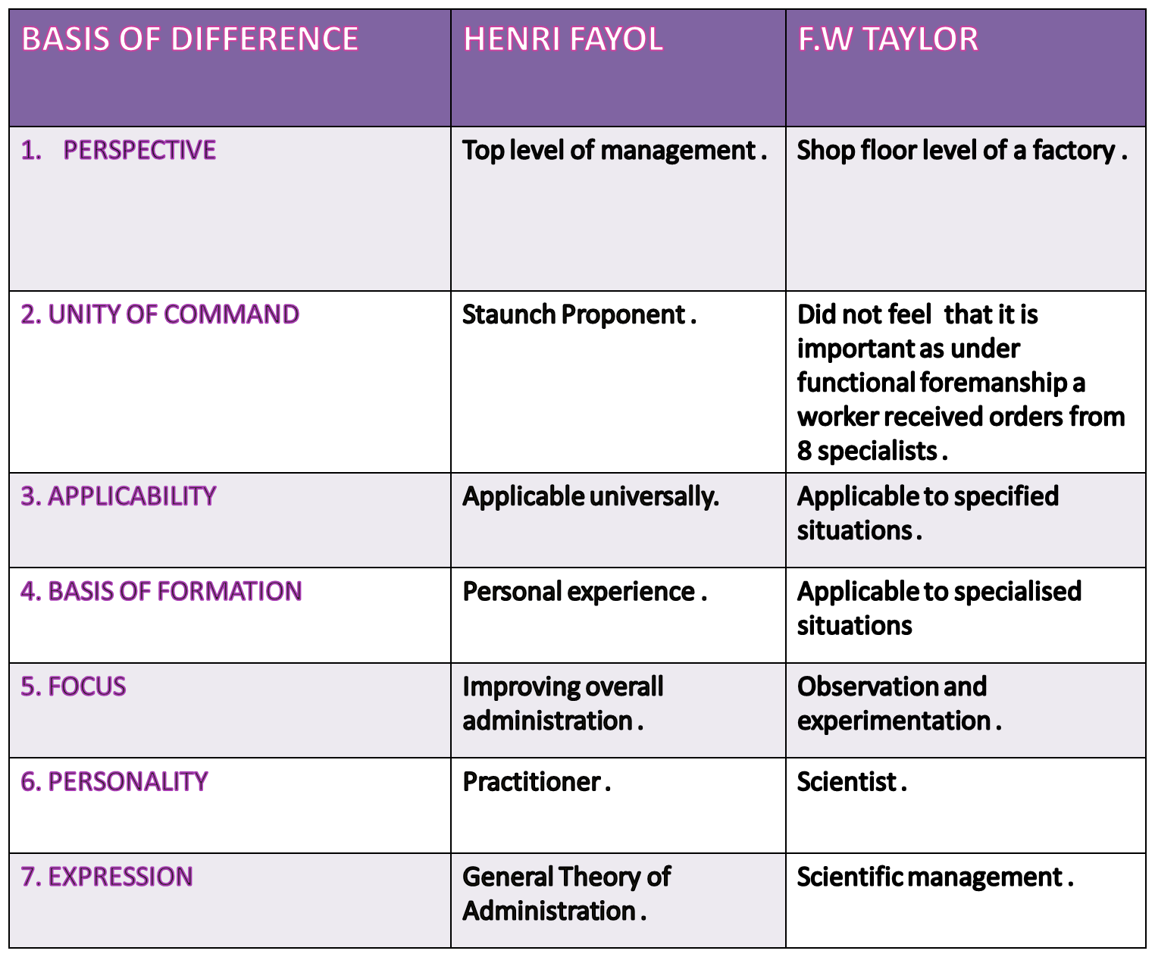

Slide 11
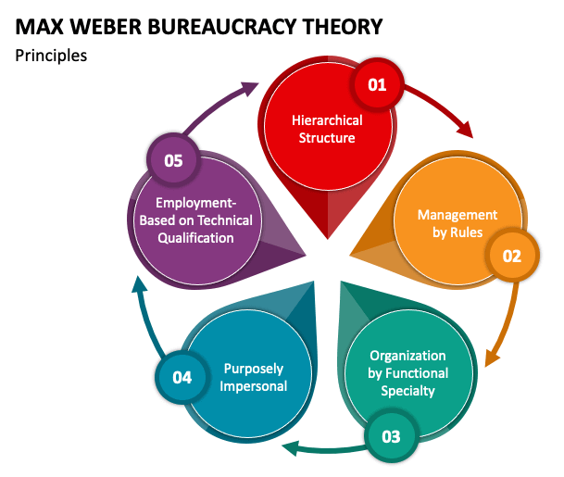

Slide 12
No Universally Accepted Theory of Management
There are several approaches to the theory and practice of management.
The universal process approach (Fayol’s)
The operational approach (Taylor’s)
The behavioral approach
The systems approach
The contingency approach

Slide 13
Henri Fayol’s
Universal Management Process
Fayol published “General and Industrial Management” in 1916.
He divided a manager’s job into five functions:
Planning
Organizing
Command
Coordination
Control
He developed 14 universal principles of management

Slide 14
Lessons from the Universal Process Approach
The management process can be separated into interdependent functions.
Management is a continuous process.
Management is a largely, though not an entirely, rational process.
The functional approach is useful because it specifies what managers should do.

Slide 15
The Operational Approach
The operational approach is a production-oriented field of management dedicated to improving efficiency and cutting waste.
Frederick W. Taylor’s published ” The Principles of Scientific Management” in 1911.
Developing performance standards on the basis of systematic observations and experimentation
Standardization
Time and task study
Systematic selection and training
Pay incentives

Slide 16
Lessons from the Operational Approach
A dedication to finding a better way is still important.
Using scientific management doesn’t dehumanize workers.
Quality advocates, inspired by the scientific approach, have been right all along about the importance of quality and continuous improvement.
The operational approach fostered the development of operations management.

Slide 17
The Behavioral Approach
The Human Relations Movement
An effort to make managers more sensitive to their employees’ needs
Arose out of the influences of
-The threat of unionization
-The Hawthorne studies
-The philosophy of industrial humanism

Slide 18
The Behavioral Approach…contd.
The Threat of Unionization
The Wagner Act of 1935 legalized union-management collective bargaining, promoting the growth of unions and union avoidance by firms.
The Hawthorne Studies (1924)
The study’s results that productivity was strongly affected by workers’ attitudes turned management toward the humanistic and realistic viewpoint of the “social man” model

Slide 19
Lessons from the Behavioral Approach
People are the key to productivity.
Success depends on motivated and skilled individuals committed to organizational objectives.
Managerial sensitivity to employees is necessary to foster the cooperation needed for high productivity.
Has been criticized as being vague and simplistic.

Slide 20
The Systems Approach
A system is a collection of parts operating interdependently to achieve a common purpose
In the systems approach:
The whole is greater than the sum of its parts
Use of Analytic (outside-in) thinking and synthetic (inside-out) thinking
Seeks to identify all parts of an organized activity and how they interact.

Slide 21
General Systems Theory
An interdisciplinary area of study based on the assumptions that everything is part of a larger, interdependent arrangement
Levels of systems
Identification of systems at various levels helps translate abstract systems theory into more concrete terms.
Each system is a subsystem of the system above it.
Closed Versus Open Systems
-Closed system: A self-sufficient entity
-Open system: Depends on its surrounding environment for survival
New Directions in Systems Thinking
Organizational learning and knowledge management –Organizations are living and thinking open systems that learn and engage in complex mental processes.
Chaos theory –Every complex system has a life of its own, with its own rule book.
Complex adaptive systems -Self-organizing

Slide 22
Lessons from the Systems Approach
Managers now have a greater appreciation for the importance of seeing the whole picture.
Manager should not become preoccupied with one aspect of organizational management while ignoring other internal and external realities.
The systems approach tries to integrate various management theories.
Criticism: Short on verifiable facts and practical advice

Slide 23
The Contingency Approach
A research effort to determine which managerial practices and techniques are appropriate in specific situations.
The term contingency refers to the choice of an alternative course of action.
Contingency management has become synonymous with situational management.
Application of various management tools and techniques must be appropriate for the particular situation.
Especially applicable in intercultural dealings.

Slide 24
The Contingency Approach (cont’d)
An open-system perspective
How subsystems combine to interact with outside systems
A practical research orientation
Translating research findings into tools and situational refinements for more effective management.
A multivariate approach
Many variables collectively account for variations in performance

Slide 25
Lessons from the Contingency Approach
Approach emphasizes situational appropriateness rather than rigid adherence to universal principles
Practical extension of the systems approach
Criticism: Creates the impression that an organization is captive to its environment.

Slide 27
What’s Next for Management Theory?
It’s time for a new category of management theory. The business world requires more than a single new idea, and it’s ripe for a constellation of new theories.
Ecology and technology continue to reshape our concerns, resources, and possibilities. Remote work physically distances coworkers, and worldwide health and climate concerns create fragile relationships with globalization. Equity is no longer “a nice idea” but an urgent imperative. Volatile conditions lead people to search for meaning at work and everywhere else.
No one truly knows what’s next. But it will likely build on and cherry-pick from the above management approaches, reorienting them around a new philosophical core. Familiarize yourself with predominant principles today and prepare yourself for a new movement tomorrow.

Slide 28
References
https://www.villanovau.com/resources/leadership/an-overview-of-management-theories/
https://www.academia.edu/37934774/Lecture_2_on_Evolution_of_Management_Thoughts

