Slide 1


MANAGEMENT:
An Introduction
Sub: PRINCIPLES OF MANAGEMENT
Dr Prabhat K. Dwivedi
Associate Professor
Deptt. of Business Management,
CSJM University, Kanpur, India

Slide 2
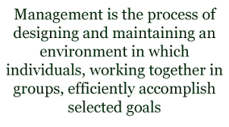
Management: meaning and concept

Slide 3
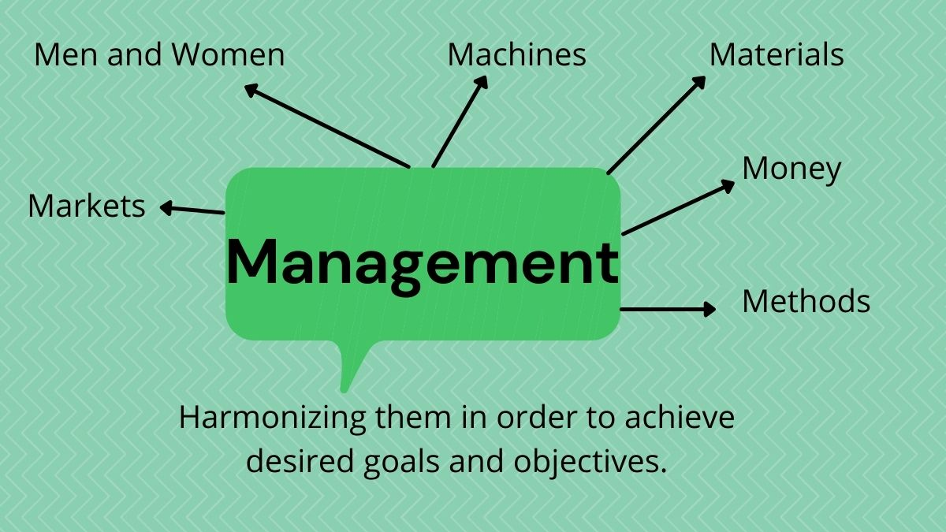

Slide 4
Management: Definitions
Mary Parker Follett defines, “The art of getting things done through people.”
Frederick Winslow Taylor states, “Management is the art of knowing what you want to do and then seeing that they do it in the best and the cheapest way.”
Harold Koontz defines, “Management is the art of getting things done through and with people in formally organized groups.”
George R Terry defines, “Management Is a distinct process consisting of planning, organizing, actuating and controlling; utilizing in each both science and art, and followed in order to accomplish pre-determined objectives.”
According to Peter Ferdinand Drucker, “Management is a multipurpose organ that manages a business and manages managers and manages workers and work.”

Slide 5
MANAGEMENT IS Science, Art and Profession
Science:- The basic principle of management is based on scientific experiments and observation. They apply to all types of organizations in today’s world. It deals with the people and their behavior. So, it is known as social science.
Art:- An artist has a foresight vision of the picture they are going to make. Similarly, managers need creativity, process, and foresight vision about the outcomes of what they are performing. For this purpose, managers have to play the role of artists.
Profession:–A profession defined as an occupation of specialized knowledge that provides services to the people by charging a short fee. Similarly, managers also have specialized knowledge about the principle of management. So, they can direct, suggest the employee perform their job assigned to them in an effective and efficient way.

Slide 6
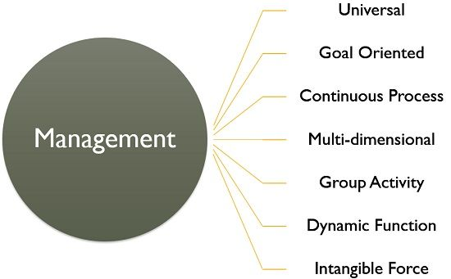
Features/ Characteristics

Slide 7
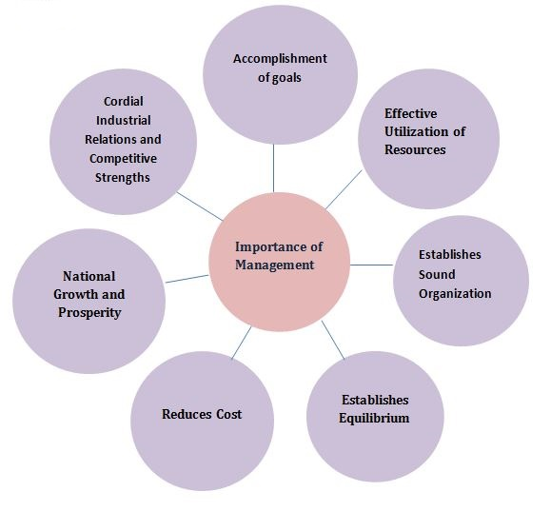

Slide 8
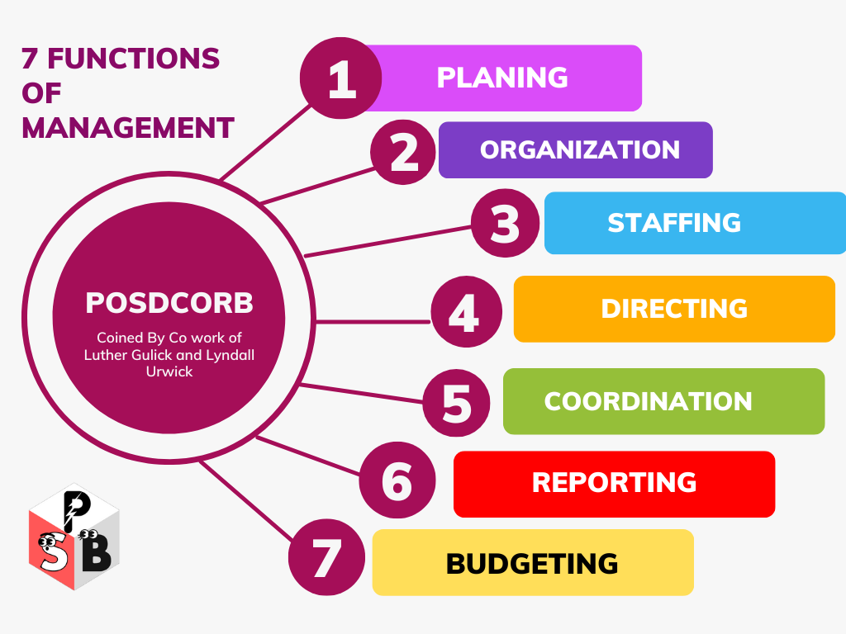
FUNCTIONS OF MANAGEMENT

Slide 9
Henri Fayol’s 14 principles of Management
Division of Work: This principle suggests that every employee should have a specific task to do so that he/she can give the best productivity.
Authority and Responsibility: It ensures employees should have sufficient authority to fulfill the responsibility, not too much or little, and so the responsibility.
Discipline: Discipline is the core value of all success. It is being disciplined in own self and with the organizational culture.
Unity of Command: By this, an employee should have a provision to get orders from a single manager at a time.
Unity of Direction: Here, unity of direction means all members of the team should have the same goal and are only directed by a single boss.
Subordination of Individual Interest To General Interest: Focusing on the group’s interest over a single employee for long-term goal achievement.
Remuneration: All the employees of the organization should be paid reasonable and fair rewards for their contributions.
Centralization and Decentralization: The concept of both centralization and decentralization should be implemented in the organization when needed.
Scalar Chain: It is the line of authority either from the bottom-up or top-to-bottom, which is unchanged.
Order: All the instruments of the organization should be ordered in proper form, whether it is materials or people.
Equity: Every employee of the organization should have the right to be equally treated and respected.
Stability of Tenure of Personnel: At the core of this principle, the manager should make believe his employees that their job is secure.
Initiative: The manager should let the employees take their own initiative while doing the job.
Espirit De Corps: At the core of this principle is that “Union is Strength” and “Team Spirit“.

Slide 10
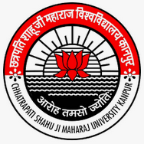
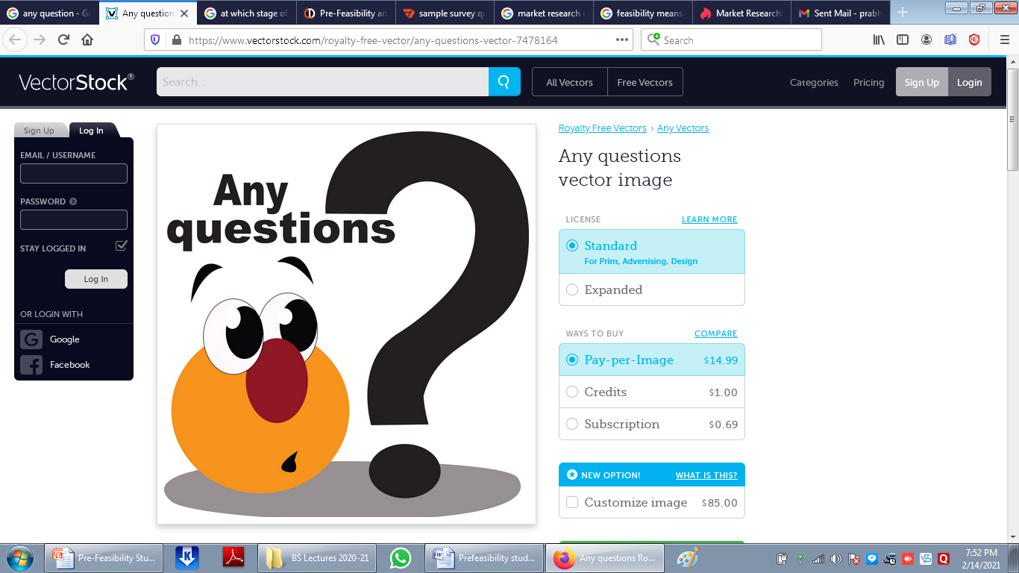

Slide 11


