Slide 1



MANAGEMENT THOUGHTS/ THEORIES
Lecture-3
Chhatrapati Shahu Ji Maharaj university, Kanpur, UP, India
Sub: PRINCIPLES OF MANAGEMENT
Program: BBA SEM: I
Dr Prabhat K. Dwivedi
Associate Professor
Deptt. of Business Management,
CSJM University, Kanpur, India

Slide 2
Evolution of Management Thought
Evolution of Management Thought can be classed into different parts like:
Pre-Scientific Management Period, before 1880
Classical Management Period (1880-1930)
Neo-Classical Management Period (1930-1950)
Modern Management Period (1950-onwards)

Slide 3
Three Types of Management Theories
Classical management theory: emerged from the Industrial Revolution and revolves around maximizing efficiency and production.
Behavioral management theory: started in the early 20th century and addresses the organization’s human and social elements.
Modern management theory: followed on the heels of World War II and combines mathematical principles with sociology to develop holistic approaches to management.

Slide 4
Management Theories & Approaches
Classical management theory
Scientific Management Theory by F.W. Taylor
Bureaucratic Management Theory by Max Weber
Administrative Management Theory by Henri Fayol
Behavioral Management Theory
Human Relations Theory (Elton Mayo)
Theory X and Theory Y (McGregor’s theory )
Modern Management Theory
Systems Management Theory (Ludwig Von Bertalanffy)
Contingency Management Theory (Fred Fiedler)

Slide 5
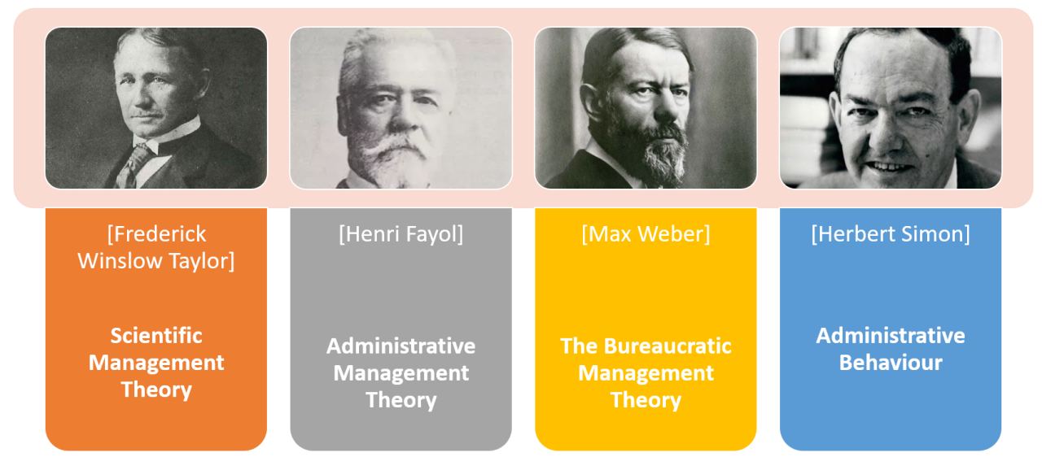
Classical management theory
Classical management theory prioritizes profit and assumes that personal gain motivates employees. It aims to streamline operations and increase productivity.
Major concepts include specialization, incentivization, and hierarchical structure. The first two contribute to employee efficiency and drive. Centralized leadership simplifies decision-making, and a meritocratic chain of commands provides order and oversight. At every level, standardization reduces waste and error.

Slide 6
Strengths & Shortcomings to classical management theory
Strengths:
It provides clarity for both the organization and its personnel, and specialization and sound hiring practices place employees in positions they can handle and even master.
Shortcomings :
The treatment of workers as machines without accounting for the role job satisfaction and workplace culture play in an organization’s success
The difficulty of applying some of its principles outside a limited manufacturing context
A top-down approach to communication that neglects employee input and prevents collaboration
Failure to provide for creativity and innovation, which rigid structures and hyper specialization can stifle

Slide 7
Scientific Management Theory
Scientific management theory is sometimes called Taylorism after its founder Frederick Winslow Taylor, a mechanical engineer. Taylor employed scientific methods to develop organizational principles that suited mass production needs. After creating and proving his theory as a manager and consultant, he wrote ” The Principles of Scientific Management” in 1911.
Taylor wanted to replace outdated, “rule-of-thumb” methods with more efficient processes. To this end, he identified four core principles of good management. The manager:
Develops a science consisting of best practices for all elements of their employees’ work
Selects and trains employees accordingly
Works with employees to ensure that the science is followed
Assumes half the responsibility for all work through process development, guidance, and maintenance

Slide 8
Bureaucratic Management Theory
Max Weber was one of the foremost scholars of the late 19th and early 20th century. He strongly influenced — and continues to influence — economic, religious, and political sociology. He explains bureaucratic management theory in “Economy and Society,” published posthumously in 1922.
Weber believed that standard rules and well-defined roles maximize the efficiency of an organization. Everyone should understand the responsibilities and expectations of their position, their place within a clear hierarchy and general corporate policies. Hiring decisions and the application of rules should be impersonal, guided only by reason and established codes.
Weber’s theory provides for orderly and scalable institutions. At least some element of bureaucracy informs most large organizations, whether they’re public, private, or profit driven.

Slide 9
Administrative Management Theory
Just as scientific management theory is sometimes called Taylorism, administrative management theory is sometimes called Fayolism.
Henri Fayol was a mining engineer who sought to codify the responsibilities of management and the principles of effective administration. He outlined these in “General and Industrial Management” in 1916.

Slide 10
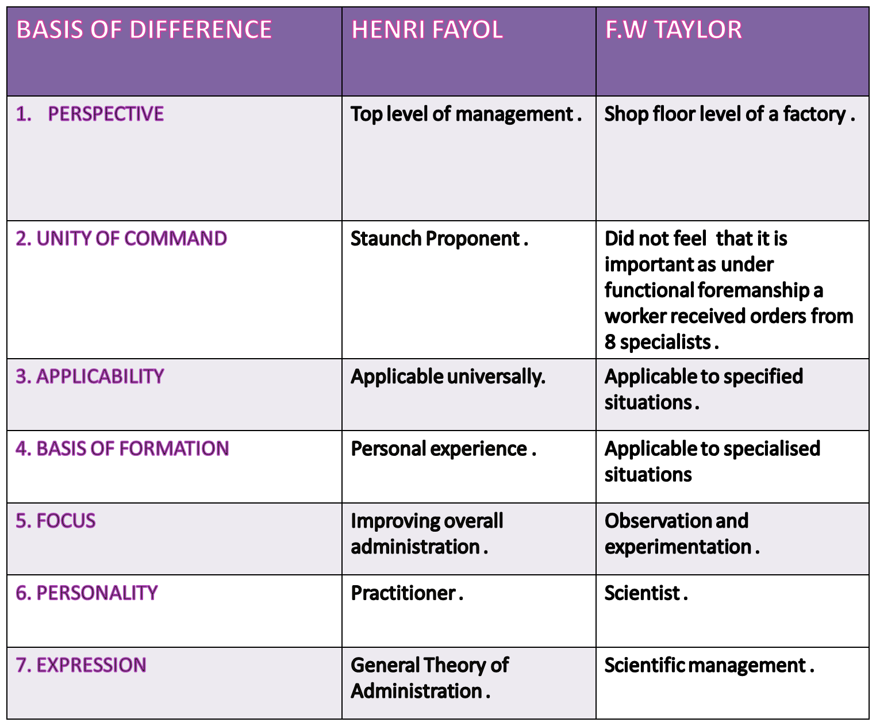

Slide 11
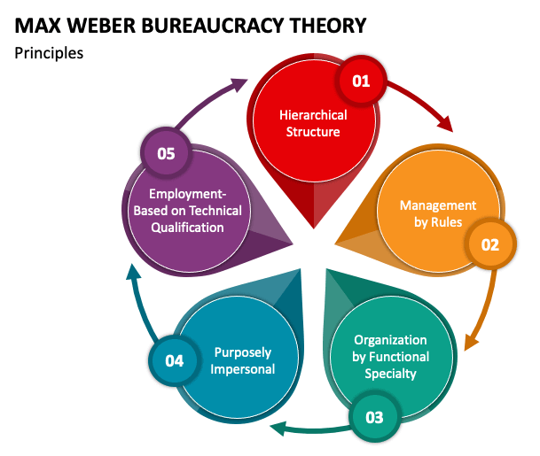

Slide 12


Slide 13


Slide 14
References
https://www.villanovau.com/resources/leadership/an-overview-of-management-theories/
https://www.academia.edu/37934774/Lecture_2_on_Evolution_of_Management_Thoughts

