Slide 1
PLANNING
Sub: PRINCIPLES OF MANAGEMENT
Dr Prabhat K. Dwivedi
Associate Professor
Deptt. of Business Management,
CSJM University, Kanpur, India

Slide 5
FEATURES OF PLANNING

Slide 10
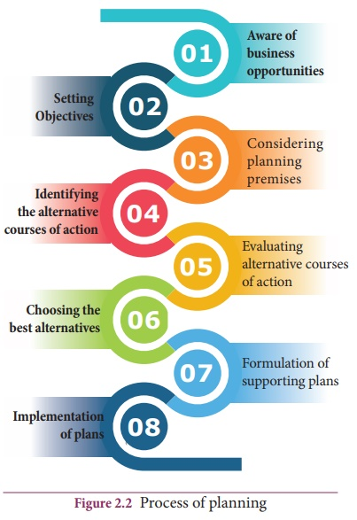
PLANNING PROCESS

Slide 11
Advantages of Planning
Gives an organization a sense of direction.
Focuses attention on objectives and results.
Establishes a basis for teamwork.
Helps anticipate problems and cope with change.
Provides guidelines for decision making.
Serves as a prerequisite to employing all other management functions.

