Slide 1
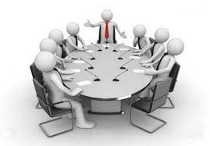
COMMUNICATION
Sub: PRINCIPLES OF MANAGEMENT
Dr Prabhat K. Dwivedi
Associate Professor
Deptt. of Business Management,
CSJM University, Kanpur, India

Slide 2
COMMUNICATION
Communication is the process of two or more people or groups exchanging information, ideas, thoughts, and feelings. It is a basic human activity that enables individuals to communicate with one another and exchange ideas, feelings, and experiences.

Slide 3
Communication Process

Slide 4
Types of Communication
Verbal Communication
Nonverbal Communication
Visual Communication
Interpersonal Communication
Communication Across Cultures
Mass Communications
Electronic communication

Slide 5
Barriers to Communication
Physical Barriers
Language Barriers
Cultural Barriers
Emotional Barriers
Cognitive Barriers
Perceptual Barriers
Technological Barriers
Noise Barriers

Slide 8
Reference
https://www.managementstudyguide.com/management_principles.htm
https://getuplearn.com/blog/motivation-in-hrm/
Porter, L. W. & Lawler, E. E. (1968). Managerial attitudes and performance. Dorsey Press.

