Slide 1
DIRECTING
Sub: PRINCIPLES OF MANAGEMENT
Dr Prabhat K. Dwivedi
Associate Professor
Deptt. of Business Management,
CSJM University, Kanpur, India

Slide 2
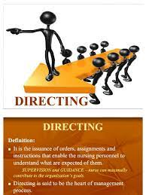
Meaning & Definitions
Directing refers to a process or technique of instructing, guiding, inspiring, counselling, overseeing and leading people towards the accomplishment of organizational goals. It is a continuous managerial process that goes on throughout the life of the organization.
Ernest Dale, “Direction is telling people what to do and seeing that they do it to the best of their ability”.
Theo Haimann, “Directing consists of the process and techniques utilised in issuing instructions and making certain that operations are carried on as originally planned”.

Slide 4
Main Elements of Directing

Slide 7
Importance of Directing
Directing Initiates action
Directing leads to integrated group activity
Directing attempts to get maximum out of individuals
Directing helps to implement changes
Directing provides stability and balance in the organisation

Slide 8
Directing Process
Define Objectives
Harmonise individual & Org. Goals
Make available necessary direction
Communication direction
Keep employees motivated
Maintain Close Watch
Review
Possess Effective Leaders

