Slide 1
Nutritional Classification of Micro-organisms
MIC 1001: GENERAL MICROBIOLOGY
MSc Microbiology Program
School of Life Science & Biotechnology

Slide 2
Microorganisms are grouped in relation to nutritional requirement into two groups;
Autotrophs: which can utilize inorganic nutrients or light as a source of energy. Ex: Nitrifying bacteria, algae etc.
II. Heterotrophs: Which requires organic compounds as a source of energy. Ex: Many bacteria, fungi and protozoa.

Slide 3
Microorganisms are grouped into four major groups based on the above parameters.
1. Photoautotrophs: which use light as energy source and CO2 as carbon source. Ex: Algae and many photosynthetic bacteria.
2. Photoheterotrophs: Which use light as energy source and reduced organic compounds as C source EX: purple non-sulphur bacteria.

Slide 4
3. Chemoautotrophs: Which use inorganic chemicals as energy source and CO2 as carbon source. Obtain their energy by the oxidation of reduced inorganic compounds such as NH3, NO2, H2, H2S, Fe2+. These organisms are also called as chemolithotrophs. Since these can grow in an inorganic medium in the absence of light.
4. Chemoheterotrophs: Which use organic compounds as an energy source as well as principal carbon source. The clear distinction between the energy source and the carbon source which is the characteristic of the above 3 groups is lost since this group can desire both carbon and energy from a single organic compound.

Slide 5
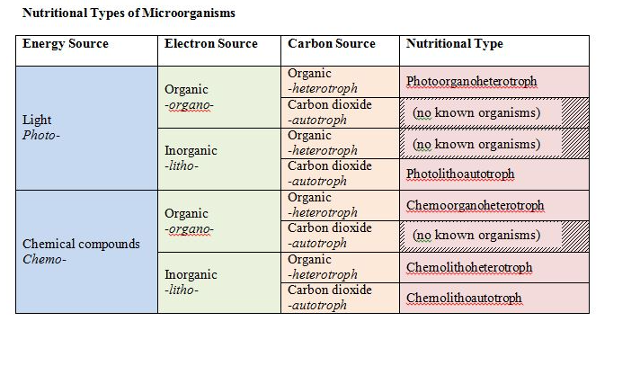
Nutritional Classification of Micro-organisms
https://open.oregonstate.education/generalmicrobiology/chapter/microbial-nutrition/

