Slide 1
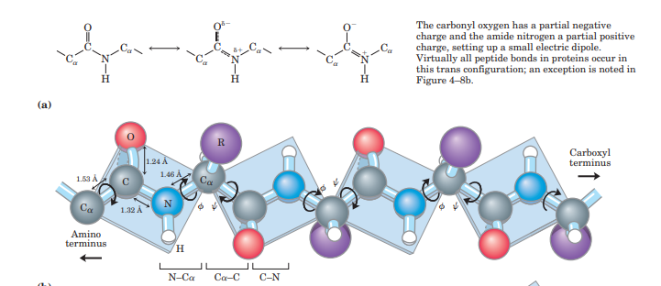
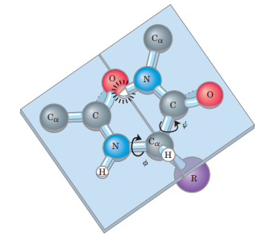

Slide 2
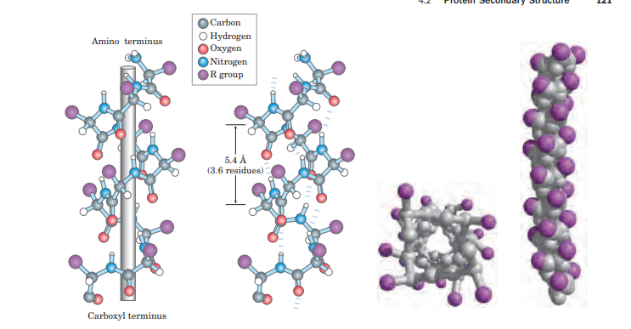
Four models of the helix, showing different aspects of its structure. (a) Formation of a right-handed α helix. The planes of the rigid peptide bonds are parallel to the long axis of the helix, depicted here as a vertical rod. (b) Ball-and-stick model of a right handed α helix, showing the intrachain hydrogen bonds. The repeat unit is a single turn of the helix, 3.6 residues. (c) The α helix as viewed from one end, looking down the longitudinal axis (derived from PDB ID 4TNC). Note the positions of the R groups, represented by purple spheres. This ball-and-stick model, used to emphasize the helical arrangement, gives the false impression that the helix is hollow, because the balls do not represent the van der Waals radii of the individual atoms. As the space-filling model (d) shows, the atoms in the center of the helix are in very close contact

Slide 3
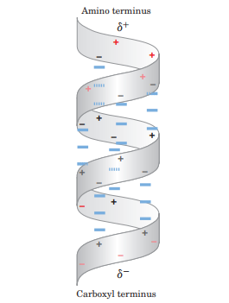
Helix dipole.

Slide 4
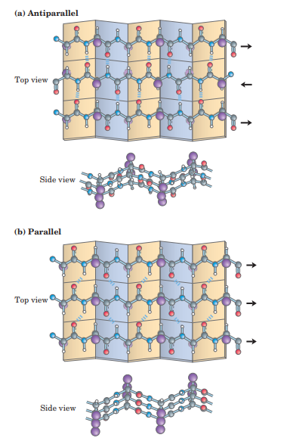
The β conformation of polypeptide chains

