Slide 2
Networking

Slide 3
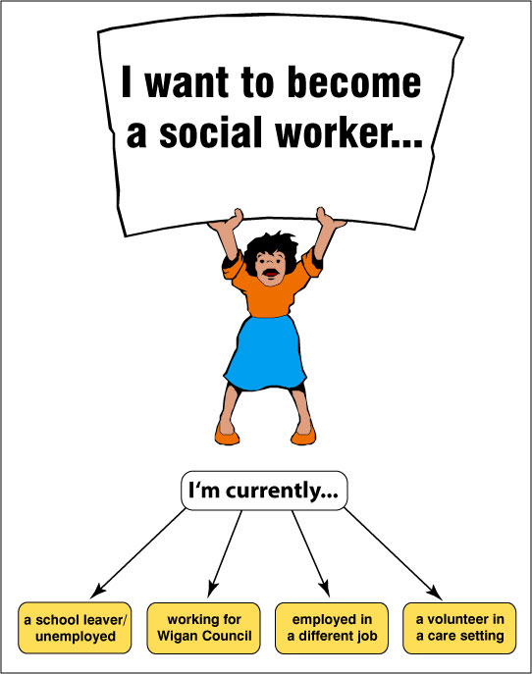

Slide 4
Concept of Social Case work
Component of Case work
Objective of Case Work
Principal of Case Work

Slide 5
Schools of Social Case Work
Diagnostic School of Social Case Work
Functional School of Social Case Work

Slide 6
Relationship between Client and Professional Worker
Subjective Relations
Conciseness relations

Slide 7
COP
C
COP = POLICE
SOCIAL WORKER
O
P

Slide 8
Social Case work ….
Mary Richmond (1915)
“Social case may be defined as the art of doing different things for and with different people by co-operating with them to achieve at one and the same time their own and society’s betterment.”
Perlman (1957)
“Social case work is a process used by certain human welfare agencies to help individuals with their problems in social functioning”

Slide 9
Component of Social case work
“A PERSON with a PROBLEM comes to a PLACE where social workers helps him through a well-defined PROCESS”
- Perlman.
PERSON – man, women, child, and aged, anyone with social emotional living.
PROBELM – arise from some need/obstacle/accumulation of frustrations or maladjustments which threaten the adequacy of the person’s living situations or the effectiveness of his efforts to deal with it.
PLACE - social service agency, social welfare department.
PROCESS – progressive transaction between case worker and client.

Slide 10
Objectives of Social case work
To understand and solve the internal problems of the individuals.
To strength his ego power.
Remediation of problems in social functioning.
Prevention of problem in social functioning.
Development of resources to enhance social functioning.

Slide 11
Principal of Social case work
Principal of individualization
“Individualization is the recognition and understanding of each client’s unique qualities and the differential use of principles and methods in assisting each toward a better adjustment.”
Individualization is based upon the right of human beings to be individuals.
And to be treated not just as human being but as a human being with his personal differences.
Client – Case Worker enter into a close relationship.
Problems may be similar but factors involved in their causation are entirely different from each other.

Slide 12
Principal of acceptance
“Acceptance is a principle of action where in the Case worker perceives and deals with the client as he really is, including his strengths and weakness, his congenial(agreeable) and uncongenial(disagreeable) qualities, his positive and negative feelings, his constructive and destructive attitude and behavior, maintaining all the while a sense of the client’s innate dignity and personal worth.”
Unconditional acceptance of the client.
Acceptance and approval.
Acceptance implies liking the client irrespective of his negative qualities and conduct.
An expression of goodwill towards the client.
Conveying deep concern and active understanding to the client who is liked by the worker in spite of his problem-behavior.

Slide 13
Principal of Non-judgmental attitude
“Non-judgmental attitude is the recognition that the case worker’s role is to understand and help the client rather than judge or condemn them.”
The principle is based on the conviction that the case work function excludes assigning guilt or innocence or degree of client responsibility for causation of the problems and needs.
But includes making evaluative judgments about the attitudes, standards or actions of the client.
E.g.: Criminal, though the society has already has already judged the criminal through its legal machinery, the social worker assumes a posture of anon-condemnatory acceptance and helpfulness, affirming the individual as a person worthy of attention.

Slide 14
Principal of purposeful expression of feelings
Purposeful expression of feelings is the recognition of the client’s need to express his feelings freely, especially his negative feelings. It is the client’s need for expression at a time when his problem is partially or predominantly emotional.”
Need to express feelings especially the negative feelings.
Frustration can result, if the basic psychological needs for expression are deprived.
Case worker listens purposefully neither discouragingly nor condemning.
Sometimes they can be actively stimulated.

Slide 15
Principal of controlled emotional involvement
“Controlled emotional involvement is the case worker’s sensitivity to the client’s feelings, an understanding of their meaning, and a purposeful and appropriate response to the client’s feelings.”
Need for communication – case worker should not be emotionally involved with the client during the case work process.
Response to the client on the feeling level is the most important psychological element in the case work relationship and most difficult of the case work skills.
Communication is a two-way process.
One person speaks directly and he expects response, need to maintain a certain degree of detachment.
Communication should be a combination of ideas and feelings.

Slide 16
Principal of Client Self-determination
“Client self-determination is the recognition of the right and need of the client to have freedom in making his own choice and decision in the case work process.”
Conviction that every individual has the innate ability to make his own choices, decisions under normal circumstances.
Any case worker who prevents a client from taking decisions is unethical and unprofessional.
Case worker is only an enabler who helps the client through his expertise, to take the best possible decision and action in the circumstances.

Slide 17
Principal of confidentiality
“Confidentiality is the preservation of secret information concerning the client which is disclosed in the professional relationship.”
It is basic right of the client.
Necessary for effective case work service.
Client must have a firm faith that the facts disclosed by him will remain confidential.
Information is shared with professionals within / outside agency with client’s permission.
Obligation binds all equally to preserve the information.

Slide 18
Mary Richmond (1915)
after 42years
Perlman (1957)
after 53years
Rahul (2010)
“Social case work profession, in which professionals access or identifying the problem of individual or group and then solve with the help of scientific tool and pre-researched techniques for society betterment. Now it is called social-psycho-scientific process.”

Slide 19
Thank You.

