Slide 1
EXCRETORY SYSTEM

Slide 2
The excretory system is a passive biological system that removes excess, unnecessary materials from the body fluids of an organism, so as to help maintain internal chemical homeostasis and prevent damage to the body. The dual function of excretory systems is the elimination of the waste products of metabolism and to drain the body of used up and broken down components in a liquid and gaseous state.
The excretory system in humans consists mainly of the kidneys and bladder. The kidneys filter urea and other waste products from the blood, which are then added to the urine within the bladder. Other organs, such as the liver, process toxins but put
their wastes back into the blood. It is
up to the kidneys to filter the
blood so that toxic substances do
not accumulate.

Slide 4
STRUCTURE OF KIDNEY
The kidney produce urine by removing toxic waste products and excess water from the body. Urine formed in each kidney passes through the ureter, flows into bladder before finally being excreted through the urethra.
People have two kidneys.
The kidneys are located at upper and back side of the abdomen, on either side of the spine (see diagram). They are protected from damage by the lower ribs.
The kidneys lie deep inside the abdomen so normally one cannot feel them.
The kidneys are a pair of bean shaped organs. In adults, a kidney is about 10 cm long, 6 cm wide and 4 cm thick. Each kidney weighs approximately 150-170 grams.
Urine formed in the kidneys flow down to urinary bladder through the ureters. Each ureter is about 25 cm long and is a hollow tube- like structure made up of special muscles.
The urinary bladder is a hollow organ made up of muscles, which lie in the lower and anterior part of the abdomen. It acts as a reservoir of urine.
The adult urinary bladder hold about 400-500 ml of urine; when filled to near capacity, a person feels the urge to pass urine.
The urine in the bladder is excreted through the urethra during the process of urination.

Slide 5
functions of the kidney
The primary function of the kidney is to make urine and purify the blood. Each kidney removes waste materials, and other chemicals which are not required by the body. Most important functions of the kidney are described below.
Removal of waste products
Purification of blood by removal of waste products is the most important function of the kidney.
Removal of excess fluid
The second most important function of the kidney is the regulation of fluid balance by excreting excess amount of water as urine while retaining the necessary amount of water in the body, that is essential for living .
Balance minerals and chemicals
The kidneys play another important role of regulating minerals and chemicals like sodium, potassium, hydrogen, calcium, phosphorus, magnesium and maintains normal composition of body fluid.
Red blood cells production
Erythropoietin is another hormone produced in the kidneys, it plays an important role in the production of red blood cells (RBC). During kidney failure, production of erythropoietin is decreased, which in turn leads to decreased production of RBC resulting in low hemoglobin (anemia.
The kidney convert vitamin D into its active form which is essential for the absorption of calcium from food, growth of the bones and teeth, and keep the bones strong and healthy.

Slide 6
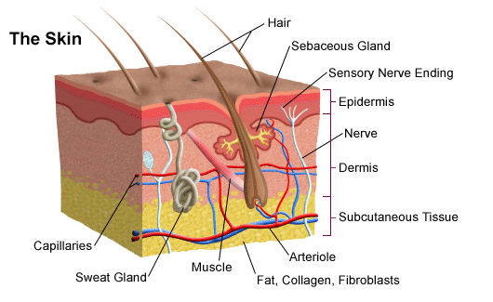
Skin structure

Slide 7
The skin is the largest organ of the body. It has three main layers, the epidermis, the dermis and the subcutaneous layer.
The epidermis is an elastic layer on the outside that is continually being regenerated. It includes the following:
Keratinocytes - the main cells of the epidermis formed by cell division at its base. New cells continually move towards the surface. As they move they gradually die and become flattened.
Corneocytes - the flattened dead keratinocytes that together make up the very outer layer of the epidermis is called the stratum corneum. This protective layer is continually worn away or shed.
Melanocytes – produce the pigment melanin that protects against UV radiation and gives skin its colour.
The dermis is the inner layer that includes the following:
Sweat glands – produce sweat that travels via sweat ducts to openings in the epidermis called pores. They play a role in temperature regulation.
Hair follicles – are pits in which hairs grow. Hairs also play a role in temperature regulation.
Sebaceous glands – produce sebum (an oil) to keep hairs free from dust and bacteria. Sebum and sweat make up the 'surface film'.
The subcutaneous layer under the dermis is made up of connective tissue and fat (a good insulator).

Slide 8
Functions of the skin
Provides a protective barrier against mechanical, thermal and physical injury and hazardous substances.
Prevents loss of moisture.
Reduces harmful effects of UV radiation.
Acts as a sensory organ (touch, detects temperature).
Helps regulate temperature.
An immune organ to detect infections etc.
Production of vitamin D.

Slide 9
endocrine system

Slide 10
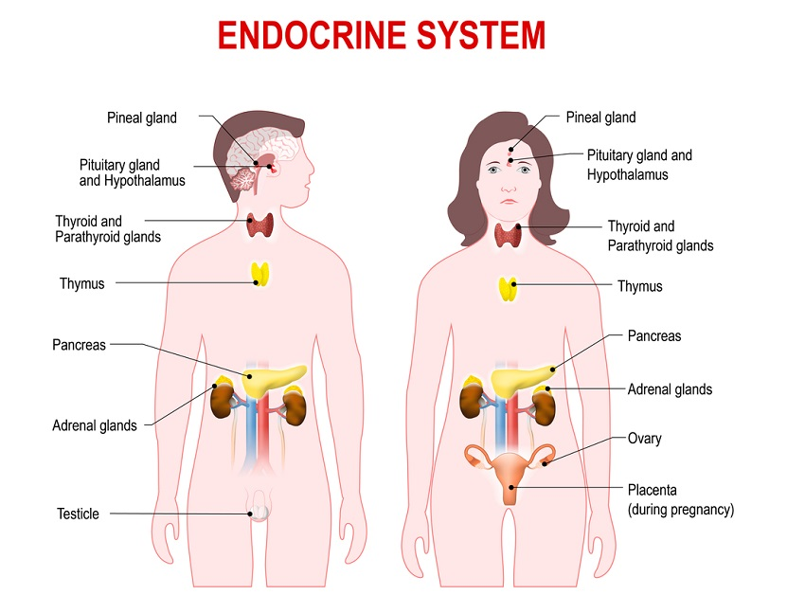

Slide 11
What is the endocrine system?
Your endocrine system is made up of several organs called glands. These glands, located all over your body, create and secrete (release) hormones.
Hormones are chemicals that coordinate different functions in your body by carrying messages through your blood to your organs, skin, muscles and other tissues. These signals tell your body what to do and when to do it.
What does the endocrine system do and how does it work?
Your endocrine system continuously monitors the amount of hormones in your blood. Hormones deliver their messages by locking into the cells they target so they can relay the message.
The pituitary gland senses when your hormone levels rise, and tells other glands to stop producing and releasing hormones. When hormone levels dip below a certain point, the pituitary gland can instruct other glands to produce and release more. This process, called homeostasis. Hormones affect nearly every process in your body, including:
Metabolism (the way you break down food and get energy from nutrients).
Growth and development.
Emotions and mood.
Fertility and sexual function.
Sleep.
Blood pressure.
Sometimes glands produce too much or not enough of a hormone. This imbalance can cause health problems, such as weight gain, high blood pressure and changes in sleep, mood and behavior. Many things can affect how your body creates and releases hormones. Illness, stress and certain medications can cause a hormone imbalance.

Slide 12
What are the parts of the endocrine system?
The endocrine system is made up of organs called glands. Glands produce and release different hormones that target specific things in the body. You have glands all over your body, including in your neck, brain and reproductive organs. Some glands are tiny, about the size of a grain of rice or a pea. The largest gland is the pancreas, which is about 6 inches long.
The main glands that produce hormones include:
Hypothalamus: This gland is located in your brain and controls your endocrine system. It uses information from your nervous system to determine when to tell other glands, including the pituitary gland, to produce hormones. The hypothalamus controls many processes in your body, including your mood, hunger and thirst, sleep patterns.
Pituitary: This little gland is only about the size of a pea, but it has a big role. It makes hormones that control several other glands such as the thyroid gland, adrenal glands, ovaries and testicles. The pituitary gland is in charge of many different functions, including how your body grows. It’s located at the base of your brain.
Thyroid: Your thyroid is a butterfly-shaped gland in the front of your neck. It’s responsible for your metabolism (how your body uses energy).
Parathyroid: These four tiny glands are no larger than a rice. They control the level of calcium in your body. For your heart, kidneys, bones and nervous system to work, you need the right amount of calcium.
Adrenal: You have two adrenal glands, one on top of each kidney. They control your metabolism, blood pressure, sexual development and response to stress.
Pineal: This gland manages your sleep cycle by releasing melatonin, a hormone that causes you to feel sleepy.
Pancreas: Your pancreas is part of your endocrine system, and it plays a significant role in your digestive system too. It makes a hormone called insulin that controls the level of sugar in your blood.
Ovaries: In women, the ovaries release hormones called estrogen and progesterone. Women have two ovaries in their lower abdomen, one on either side.
Testes: In men, the testes (testicles) make sperm and release the hormone testosterone. This hormone affects sperm production, muscle strength.

