Slide 1
UNIT – 2 RESPIRATORY SYSTEM
VISHAL KUMAR
ASSISTANT PROFESSOR
CSJMU

Slide 2
Respiratory System
Your respiratory system is the network of organs and tissues that help you breathe. This system helps your body absorb oxygen from the air so your organs can work. It also cleans waste gases, such as carbon dioxide, from your blood. It includes your airways, lungs and blood vessels. The muscles that power your lungs are also part of the respiratory system.

Slide 3
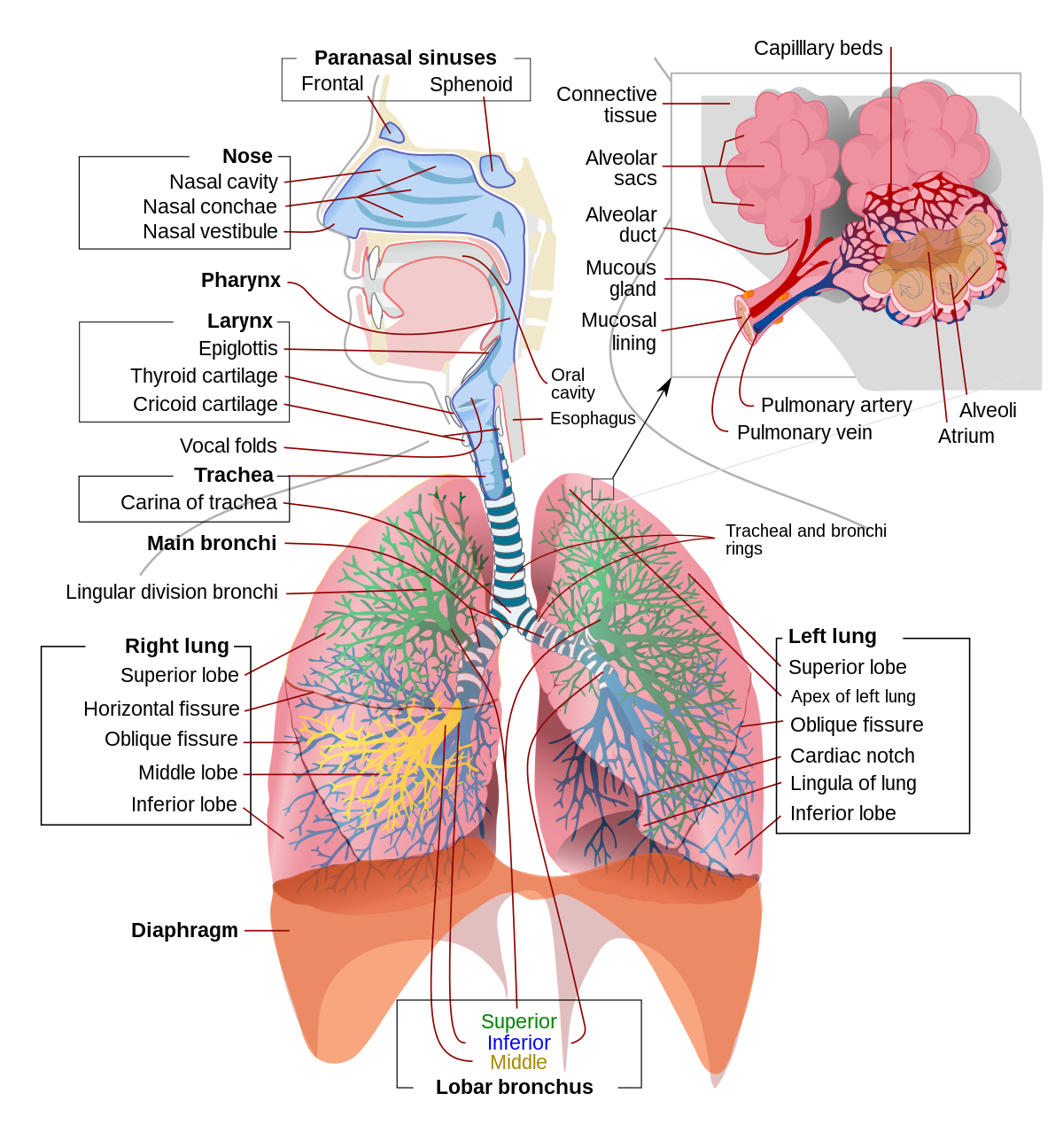

Slide 5
What are the parts of the respiratory system?
Mouth and nose: Openings that pull air from outside your body into your respiratory system.
Pharynx (throat): Tube that delivers air from your mouth and nose to the trachea (windpipe).
Larynx (voice box): Hollow organ that allows you to talk and make sounds when air moves in and out.
Trachea: Passage connecting your throat and lungs.
Bronchial tubes: Tubes at the bottom of your windpipe that connect into each lung.
Lungs: Two organs that remove oxygen from the air and pass it into your blood.
Diaphragm: Muscle that helps your lungs pull in air and push it out.
Ribs: Bones that surround and protect your lungs and heart.
Alveoli: Tiny air sacs in the lungs where the exchange of oxygen and carbon dioxide takes place.

Slide 6
Bronchioles: Small branches of the bronchial tubes that lead to the alveoli.
Lung lobes: Sections of the lungs — three lobes in the right lung and two in the left lung.
Pleura: Thin sacs that surround each lung lobe and separate your lungs from the chest wall.
Cilia: Tiny hairs that move in a wave-like motion to filter dust and other irritants out of your airways.
Epiglottis: Tissue flap at the entrance to the trachea that closes when you swallow to keep food and liquids out of your airway.

Slide 7
FUNCTIONS
Allows you to talk and to smell.
Warms air to match your body temperature and moisturizes it to the humidity level your body needs.
Delivers oxygen to the cells in your body.
Removes waste gases, including carbon dioxide, from the body when you exhale.
Protects your airways from harmful substances and irritants.

Slide 9
Inspiration
It takes place when the volume of thoracic cavity is increased and the air pressure is decreased.
Simultaneous contraction of the external intercostal muscles and the diaphragm expands the thorax.
As the diaphragm + external intercostals contracts the lung volume increases.
It involves following events
First of all, external intercoastal muscle contracts and internal intercoastal muscles relaxes.
Due to contraction of external intercoastal muscles, ribs is pulled upward, resulting in increase in thoracic cavity size
The thoracic cavity further enlarges due to contraction of diaphragm, lowering the diaphragm and increases the size of thoracic cavity.
With increase in size of thorax, lungs expand simultaneously.
As lungs expands, the air pressure is reduced inside, so equalize the pressure, atmospheric air rushes inside the lungs

Slide 10
Expiration
It takes place when the size of thoracic cavity is reduced and air pressure is increased.
Involves following events
The internal intercoastal muscle contracts and external intercoastal muscles relaxes.
Due to contraction of internal intercoastal muscle, ribs are pulled inward, resulting in decrease in size of thoracic cavity
Now the diaphragm is pushed upward due to its relaxation
With the decrease in size of thoracic cavity, lungs is compressed
As lungs is compressed, pressure increases, so the air is forced outside.

Slide 11
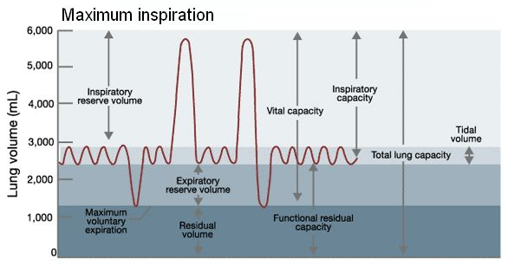

Slide 12
Average lung volumes in healthy adults[10]
Volume | Value (litres)
 | In men | In women
Inspiratory reserve volume (IRV) | 3.3 | 1.9
Tidal volume (TV) | 0.5 | 0.5
Expiratory reserve volume (ERV) | 1.1 | 0.7
Residual volume (RV) | 1.2 | 1.1
Lung capacities in healthy adults[10]
Volume | Average value (litres) |  | Derivation
 | In men | In women
Vital capacity | 4.8 | 3.1 | IRV + TV + ERV
Inspiratory capacity | 3.8 | 2.4 | IRV + TV
Functional residual capacity | 2.4 | 1.8 | ERV + RV
Total lung capacity | 6.0 | 4.2 | IRV + TV + ERV + RV

Slide 13
LUNG CAPACITY
Tidal Volume(TV) - It is the amount of air that can be inhaled or exhaled during one respiratory cycle.
The normal adult value is 10% of vital capacity (VC) but can increase up to 50% of VC on exercise
Inspiratory Reserve Volume(IRV) - It is the amount of air that can be forcibly inhaled after a normal tidal volume. IRV is usually kept in reserve, it is used during deep breathing.
Expiratory Reserve Volume(ERV) - It is the volume of air that can be exhaled forcibly after exhalation of normal tidal volume. ERV is reduced with obesity, ascites or after upper abdominal surgery.
Residual Volume(RV) - It is the volume of air remaining in the lungs after maximal exhalation.
Vital Capacity(VC) - It is the total amount of air exhaled after maximal inhalation. The value is about 4800mL and it varies according to age and body size. It is calculated by sum of tidal volume, inspiratory reserve volume, and expiratory reserve volume. VC = TV+IRV+ERV.
Total Lung Capacity(TLC) - It is the maximum volume of air the lungs can accommodate or sum of all volume compartments. TLC is calculated by summation of the four primary lung volumes (TV, IRV, ERV, RV). Among healthy adults, the average lung capacity is about 6 liters.

Slide 14
digestive system
What is the digestive system?
Your digestive system is made up of the gastrointestinal (GI) tract and your liver, pancreas and gallbladder. The GI tract is a series of hollow organs that are connected to each other from your mouth to your anus. The organs that make up your GI tract, in the order that they are connected, include your mouth, esophagus, stomach, small intestine, large intestine and anus.
What does the digestive system do?
Your digestive system is turning your food into the nutrients and energy you need to survive. And when it’s done with that, it packages your solid waste or stool, for disposal.
PHYSICAL ENERGY – CHEMICAL ENERGY – MECHANICAL ENERGY

Slide 15
Salivary amylase – carbs lingual amylase – fat stomach – HCL, pepsin – protein bile- fat colon – water

Slide 16
Mouth
The mouth is the beginning of the digestive tract. In fact, digestion starts before you even take a bite. Your salivary glands get active as you see and smell the food. After you start eating, you chew your food into pieces that are more easily digested. Your saliva mixes with the food to begin to break it down into a small pieces which is absorb and use. When you swallow, your tongue passes the food into your throat and your esophagus.
Esophagus
Located in your throat near your trachea (windpipe), the esophagus receives food from your mouth when you swallow. The epiglottis is a small flap that folds over your windpipe as you swallow to prevent you from choking. A series of muscular contractions within the esophagus called peristalsis delivers food to your stomach.
But first a ring-like muscle at the bottom of your esophagus called lower esophageal sphincter has to relax to let the food in. The sphincter then contracts and prevents the contents of the stomach from flowing back into the esophagus.

Slide 17
Stomach
The stomach is a hollow organ, or "container," that holds food while it is being mixed with stomach enzymes. These enzymes continue the process of breaking down food into a useable form. When the contents of the stomach are processed enough, they’re released into the small intestine.
Small intestine
Made up of three segments — the duodenum, jejunum, and ileum — the small intestine is a 22-foot long muscular tube that breaks down food using enzymes released by the pancreas and bile from the liver.
The duodenum is the first segment of the small intestine. It’s largely responsible for the continuous breaking-down process. The jejunum and ileum lower in the intestine are mainly responsible for the absorption of nutrients into the bloodstream.

Slide 18
Pancreas
The pancreas secretes digestive enzymes into the duodenum that break down protein, fats and carbohydrates. The pancreas also makes insulin, passing it directly into the bloodstream. Insulin is the chief hormone in your body for metabolizing sugar.
Liver
The liver has many functions, but its main job within the digestive system is to process the nutrients absorbed from the small intestine. Bile from the liver secreted into the small intestine also plays an important role in digesting fat and some vitamins.
The liver is your body's chemical "factory." It takes the raw materials absorbed by the intestine and makes all the various chemicals your body needs to function.
The liver also detoxifies harmful chemicals. It breaks down many drugs that can be toxic to your body.

Slide 19
Gallbladder
The gallbladder stores and concentrates bile from the liver, and then releases it into the duodenum in the small intestine to help absorb and digest fats.
Colon
The colon is responsible for processing waste so that emptying your bowels is easy and convenient. It’s a 6-foot long muscular tube that connects the small intestine to the rectum.
Stool, or waste left over from the digestive process, is passed through the colon by means of peristalsis, first in a liquid state and ultimately in a solid form.
Rectum
The rectum is a straight, 8-inch chamber that connects the colon to the anus. When anything (gas or stool) comes into the rectum, sensors send a message to the brain.
Anus
The anus is the last part of the digestive tract. It is a 2-inch long canal consisting of the pelvic floor muscles and the two anal sphincters (internal and external). The anus is surrounded by sphincter muscles that are important in allowing control of stool.

Slide 20
Function of the Digestive System
Ingestion is the process of eating.
Propulsion is the movement of food along the digestive tract. The major means of propulsion is peristalsis, a series of alternating contractions and relaxations of smooth muscle that lines the walls of the digestive organs and that forces food to move forward.
Secretion of digestive enzymes and other substances liquefies, adjusts the pH of, and chemically breaks down the food.
Mechanical digestion is the process of physically breaking down food into smaller pieces. This process begins with the chewing of food and continues with the muscular churning of the stomach.
Chemical digestion is the process of chemically breaking down food into simpler molecules. The process is carried out by enzymes in the stomach and small intestines.
Absorption is the movement of molecules from the digestive tract to adjacent blood and lymphatic vessels. Absorption is the entrance of the digested food (now called nutrients) into the body.
Defecation is the process of eliminating undigested material through the anus.

Slide 21
Metabolism: Converting food into energy
Metabolism is the process by which the body changes food and drink into energy. During this process, calories in food and drinks mix with oxygen to make the energy the body needs.
Even at rest, a body needs energy. This includes breathing, sending blood through the body, keeping hormone levels even, and growing and repairing cells. The number of calories a body at rest uses to do internal process is known as basal metabolic rate, also called basal metabolism.
Metabolic reactions may be categorized as catabolic – the breaking down of compounds (for example, of glucose to pyruvate by cellular respiration); or anabolic – the building up (synthesis) of compounds (such as proteins, carbohydrates, lipids, and nucleic acids). Usually, catabolism releases energy, and anabolism consumes energy.
CATABOLIC -the large molecules that make up the bulk of food materials are broken down into small constituent units: proteins are converted to the 20 or so different amino acids of which they are composed; carbohydrates (polysaccharides such as starch in plants and glycogen in animals) are degraded to sugars such as glucose; and fats (lipids) are broken down into fatty acids and glycerol.
BMR=66.4730 + 13.7516 x weight in kg + 5.0033 x height in cm – 6.7550 x age in years.
In women BMR=655.0955 + 9.5634 x weight in kg + 1.8496 x height in cm – 4.6756 x age in years.

