Slide 1
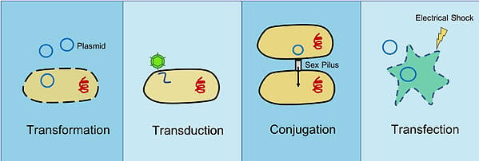
DNA introduction Concepts
Transformation is the uptake of genetic material from the environment by bacterial cells.
Transduction occurs when foreign DNA or RNA is introduced into bacterial or eukaryotic cells via a virus or viral vector.
During conjugation, genetic material is transferred from a donor bacterium to a recipient bacterium through direct contact.
Transfection is the process by which foreign DNA is deliberately introduced into a eukaryotic cell through non-viral methods including both chemical and physical methods in the lab.

Slide 2
What is the difference between Transformation and Transfection?
• Transformation is the introduction of a gene into a prokaryotic cell (bacterial and yeast), whereas transfection is usually called the introduction of a gene into a mammalian cell.
• Transformation results in heritable alteration, in genes, whereas transfection can result in either temporary expression or permanent changes in genes.
What is Cell Transfection?
Transfection is a method of introduction of a foreign gene, usually, into mammalian cells. There are two methods of transfection; namely, transient transfection and stable transfection.
In transient transfection, gene expression is available for a limited time; thus, the alteration of gene causes temporary expression. This transfection method is simple and fast; hence it can be used routinely. One drawback of transient transfection is the difficulty of applying for large scale protein synthesis systems.
During stable transfection, a target gene is integrated into the genome of the host cell, and thus the gene expression is permanent, unlike the transient transfection.

Slide 3
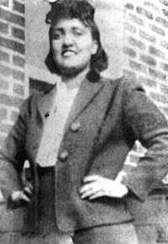
The main difference between monolayer and suspension culture is that monolayer culture is an anchorage-dependent culture whereas suspension culture is an anchorage-independent culture. Therefore, the cells of the monolayer culture grow attached to the surface of the flask while the cells of the suspension culture mainly grow floating in the medium.
Monolayer and suspension culture are two types of animal cell cultures classified based on the type of cell growth.
Attached Cell Lines
Name | Species and Tissue of Origin | Morphology
MRC-5 | Human Lung | Fibroblast
HeLa | Human Cervix | Epithelial
CHO | Chinese Hamster Ovary | Fibroblast
HEK-293 | Human Kidney | Epithelial
SH-SY5Y | Human Neuroblastoma | Neuronal
Suspension Cell Lines
Name | Species and Tissue of Origin | Morphology
NS0 | Mouse Myeloma | Lymphoblast
U937 | Human Hystiocytic Lymphoma | Lymphoblast
HL60 | Human Leukemia | Lymphoblast
WEHI231 | Mouse B-cell Lymphoma | Lymphoblast
Henrietta Lacks

Slide 4
Gene transfer to animal cells
Overview of gene-transfer strategies:
Transfection Strategies: Chemical and Physical Methods
Virus mediated transduction
Whichever route is chosen, the result is transformation, i.e. a change of the recipient cell’s genotype caused by the acquired foreign DNA, the transgene.
Chemical Transfection Strategies:
DNA/calcium phosphate coprecipitate method
Successful DNA transfer in such experiments is dependent on the formation of a
fine DNA/calcium phosphate coprecipitate, which first settles on to the cells and is then internalized. The precipitate must be formed freshly at the time of transfection. It is thought that small granules of calcium phosphate associated with DNA are taken up by endocytosis and transported to the nucleus.
However, since the precipitate must coat the cells, this method is suitable only for cells growing in monolayers, not those growing in suspension or as clumps.

Slide 6
b. Transfectiion with DEAE-Dextran
The calcium phosphate method is applicable to many cell types, but some cell lines are adversely affected by the coprecipitate due to its toxicity and are hence difficult to transfect.
Alternative chemical transfection methods have been developed to address this problem. One such method utilizes diethylaminoethyl dextran (DEAE-dextran), a soluble polycationic carbohydrate that promotes interactions between DNA and the endocytotic machinery of the cell.
Another polycationic chemical, the detergent Polybrene, has been used for the transfection of Chinese hamster ovary (CHO) cells, which are not amenable to calcium phosphate
Transfection.
c. Transfectiion with Liposomes & Lipofection:
Liposomes are vesicles that have an aqueous compartment enclosed by a phospholipid
Bilayers. DNA trapped in liposomes, fused with cells and deliver DNA directly to the cell.
However, initially transfection efficiency was found no better than calcium phosphate
method.

Slide 7
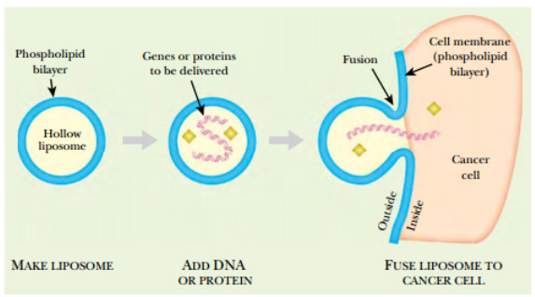
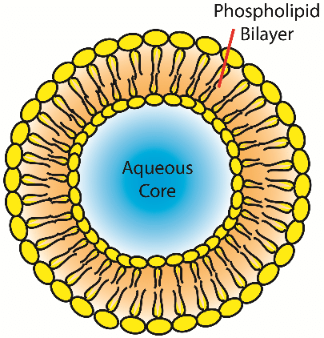

Slide 8
Lipofection:
The cationic/neutral lipid mixtures can spontaneously form stable complexes
with DNA that interact productively with the cell membrane, resulting in DNA uptake by endocytosis. This low-toxicity transfection method, commonly known as lipofection, is one of the simplest to perform and is applicable to many cell types that are difficult to transfect by other means, including cells growing in suspension.
This technique is suitable for transient and stable transformation. The efficiency is also much higher than that of chemical transfection methods – up to 90% of cells in a culture dish can be transfected.
A large number of different lipid mixtures is available, varying in efficiency for different cell lines. A unique benefit of liposome gene-delivery vehicles is their
ability to transform cells in live animals following injection into target tissues or even the bloodstream.

Slide 9
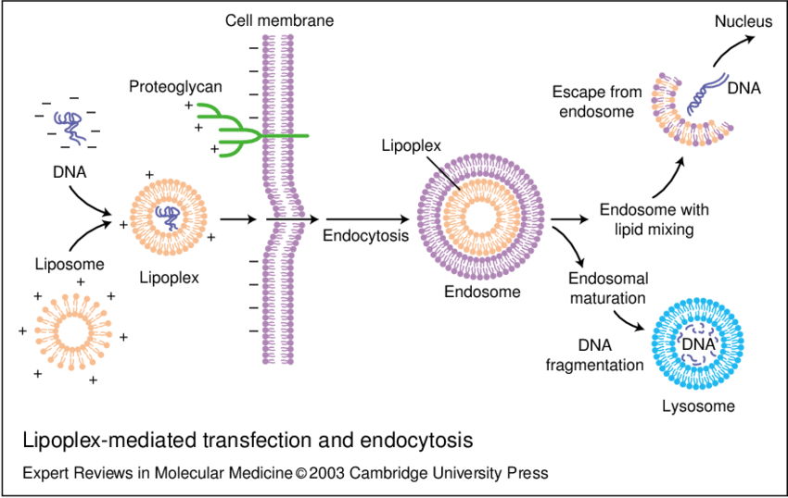
Lipoplexes are defined as the complexes among plasmid DNA and cationic lipids. The formation of the complex is due to the electrostatic interaction between the polar headgroups of cationic lipids and the phosphate groups of DNAs.

Slide 10
d. Transfection with cell or protoplast fusion
Certain chemicals (fusogens such as PEG) causes cell membranes to fuse together.
Bacterial cells were transformed with a suitable plasmid vector and then treated with chloramphenicol to amplify the plasmid copy number. Lysozyme was used to remove the cell walls, and the resulting protoplasts were gently centrifuged on to a monolayer of mammalian cells and induced to fuse with them, using polyethylene glycol.
e. Receptor-mediated Transfection
Receptor-mediated gene delivery capitalises on the presence of specific cell surface molecules for DNA uptake into cells and represents a particularly appealing approach for targeting vector DNA to specific cell types in vivo and in vitro. Various ligand/DNA and antibody/DNA transfer complexes were generated that, following binding to cells, are internalised and reach the endosomal compartment.

Slide 11
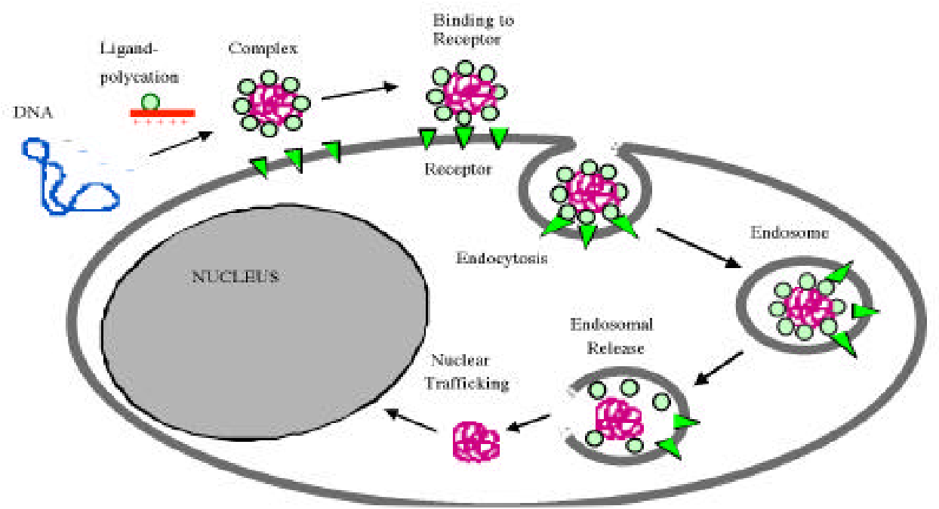

Slide 12
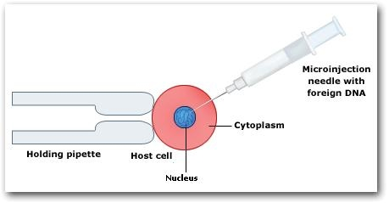
Physical Transfection Strategies:
Electroporation
Electroporation involves the generation of transient, nanometre-sized pores in the cell membrane, by exposing cells to a brief pulse of electricity. DNA enters the cell through these pores and is transported to the nucleus. This technique was first applied to animal cells by Wong and Neumann (1982), who successfully introduced plasmid DNA into mouse fibroblasts.
b. Microinjection
This technique successfully hits on target cells but that can
only be applied to a few cells in any one experiment.
This technique has been applied to cultured cells
that are recalcitrant to other transfection methods
, but its principal use is to introduce DNA and other
molecules into large cells, such as oocytes, eggs and
the cells of early embryos.

Slide 13
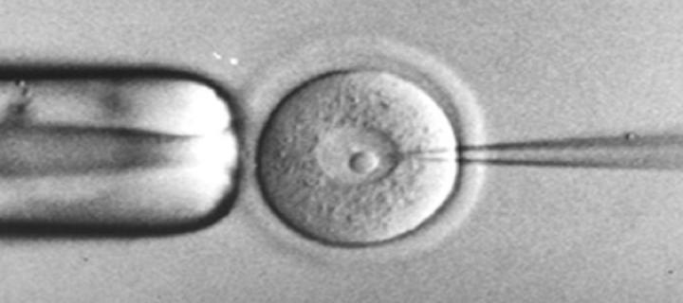

Slide 14
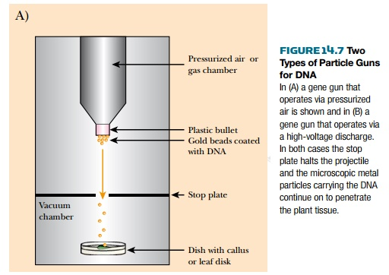
c. Particle bombardment
This involves coating small metal particles with DNA
And then accelerating them into target tissues using a
powerful force, such as a blast of high-pressure gas
or an electric discharge through a water droplet.
In animals, this technique is most often used to
transfect multiple cells in tissue slices rather than
cultured cells (e.g. Arnold et al. 1994, Lo et al. 1994).
It has also been used to transfer DNA into skin cells
in vivo (Haynes et al. 1996).
Target Cells

