Slide 1
UNIT 2
Basic biology of plasmid
and phage vectors

Slide 2
Plasmids are replicons which are stably inherited in
an extrachromosomal state. Most plasmids exist as
double-stranded circular DNA molecules. If both
strands of DNA are intact circles the molecules are
described as covalently closed circles or CCC DNA
(Fig. 4.1). If only one strand is intact, then the
molecules are described as open circles or OC DNA.
Not all plasmids exist as circular molecules.
Linear plasmids have been found in a variety of bacteria, e.g. Streptomyces sp. and
Borrelia burgdorferi.
To prevent nuclease digestion, the ends of linear
plasmids need to be protected and two general
mechanisms have evolved. Either there are repeated
sequences ending in a terminal DNA hairpin loop
(Borrelia) or the ends are protected by covalent
attachment of a protein (Streptomyces).
Old and Primrose
Chapter 4

Slide 3
Old and Primrose
Chapter 4

Slide 4
Plasmids can be categorized into one of two major
type – conjugative or non-conjugative – depending
upon whether or not they carry a set of transfer
genes, called the tra genes, which promote bacterial
conjugation.
Plasmids can also be categorized on the
basis of their being maintained as multiple copies per cell (relaxed plasmids) or as a limited number of
copies per cell (stringent plasmids). Generally, conjugative
plasmids are of relatively high molecular
weight and are present as one to three copies per
chromosome, whereas non-conjugative plasmids
are of low molecular weight and present as multiple
copies per chromosome

Slide 5
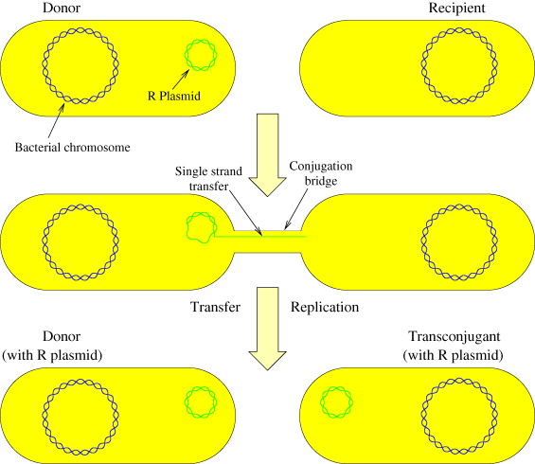

Slide 6
Table 4.1 Some phenotypic traits exhibited by
plasmid-carried genes.
Antibiotic resistance
Antibiotic production
Degradation of aromatic compounds
Haemolysin production
Sugar fermentation
Enterotoxin production
Heavy-metal resistance
Bacteriocin production
Induction of plant tumours
Hydrogen sulphide production
Host-controlled restriction and modification

Slide 7
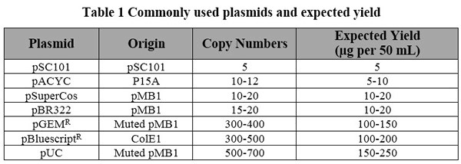
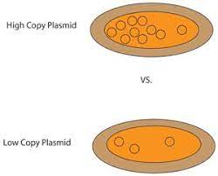
HIGH COPY NUMBER: 3-5 MICROGRAMS PER ML OF CULTURE
LOW COPY NUMBER: 0.2-1 MICROGRAM PER ML OF CULTURE

Slide 8
Partitioning and segregative
stability of plasmids
Plasmids are stably maintained because they contain
a partitioning function, par, which ensures that
they are stably maintained at each cell division.
Such par regions are essential for stability of low copy-
number plasmids.
Incompatibility of plasmids
Plasmid incompatibility is the inability of two different
plasmids to coexist in the same cell in the
absence of selection pressure.
Groups of plasmids which
are mutually incompatible are considered to belong
to the same incompatibility (Inc) group.

Slide 9
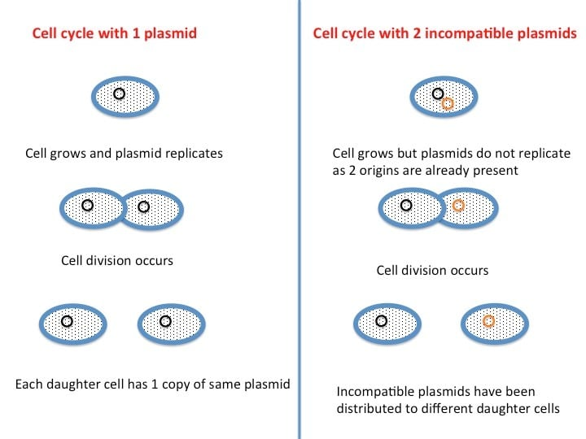
Plasmid incompatibility refers to the inability of two plasmids to coexist stably over a number of generations in the same bacterial cell line. Generally, closely related plasmids tend to be incompatible, while distantly related plasmids tend to be compatible.

Slide 10
Isolation of Plasmids
By isopycnic centrifugation in a CsCl – EtBr gradient
Alkaline lysis method
A method where the components of a sample (e.g. DNA) are separated on the basis of their density in a centrifuge according to the centrifugal force they experience.

Slide 11
This method involves isopycnic centrifugation of
cleared lysates in a solution of CsCl containing
ethidium bromide (EtBr). EtBr binds by intercalating
between the DNA base pairs, and in so doing causes
the DNA to unwind. A CCC DNA molecule, such as
a plasmid, has no free ends and can only unwind to
a limited extent, thus limiting the amount of EtBr
bound.
A linear DNA molecule, such as fragmented
chromosomal DNA, has no such topological constraints
and can therefore bind more of the EtBr
molecules. Because the density of the DNA–EtBr
complex decreases as more EtBr is bound, and
because more EtBr can be bound to a linear molecule
than to a covalent circle, the covalent circle has a
higher density at saturating concentrations of EtBr.
Thus covalent circles (i.e. plasmids) can be separated
from linear chromosomal DNA.

Slide 12
Old and Primrose
Chapter 4

Slide 13
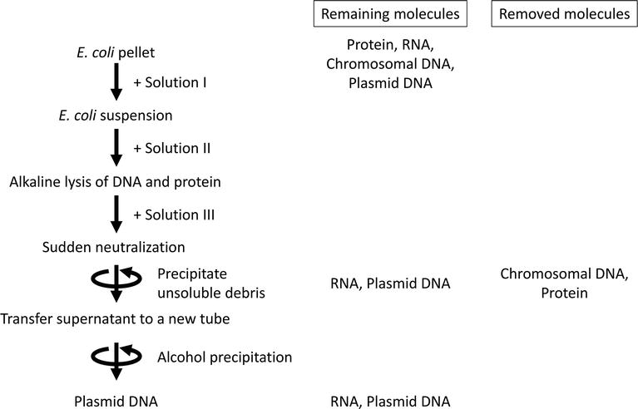
Alkaline Lysis Method

