Slide 1
Blotting Techniques
Blotting refers to immobilization of sample nucleic acids/proteins onto a solid support
It involves the transfer of nucleic acids or proteins from a gel strip to a blotting membrane
(nylon or nitrocellulose)
A Southern blot is a method used in molecular biology for detection of a specific DNA sequence in DNA samples. Southern blotting combines transfer of electrophoresis-separated DNA fragments to a filter membrane and subsequent fragment detection by probe hybridization.
E. M. SOUTHERN 1975
Step 1: DNA purification
Step 2: Fragmentation
Step 3: Gel Electrophoresis
Step 4: Denaturation
Step 5: Blotting
Step 6: Hybridization

Slide 2
Procedure
DNA fragments are denatured in strong alkali
Transfer to membrane
Fixing of DNA (immobilization)
Nitrocellulose paper: baking: 80 degree for 2 h
Nylon Membrane: 1 h 70 degree or UV irradiation
4. The membrane is placed in a solution of labeled (radioactive or non-radioactive) RNA, ssDNA or oligonucleotides which is complementary to sequence present in the target DNA.
5. Removal of excess probes
6. If probe is radioactive: Autoradiography
If probe is not radioactive: the membrane is treated with chemiluminescent substrate to detect the labeled probes, and the exposed to photographic films.
The probe will form band on the film at a position corresponding to the complementary
sequence on the membrane.

Slide 3
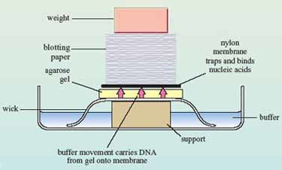
Blotting Apparatus

Slide 5
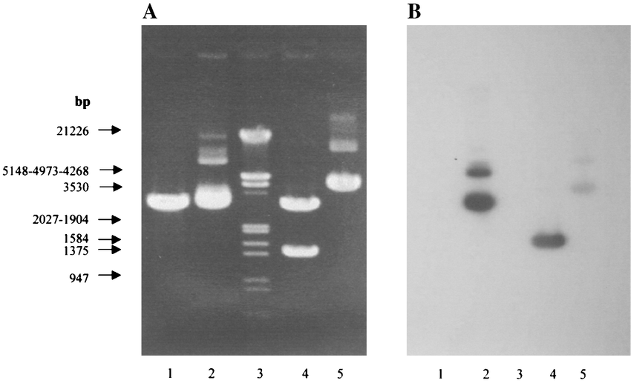
Examples

Slide 6
Transgene Number

Slide 7
Application of Southern blotting
Southern blotting technique is used to detect DNA in given sample.
DNA finger printing is an example of southern blotting
Used for paternity testing, criminal identification, victim identification
To isolate and identify desire gene of interest.
Used in restriction fragment length polymorphism
To identify mutation or gene rearrangement in the sequence of DNA
Used in diagnosis of disease caused by genetic defects
Used to identify infectious agents

Slide 8
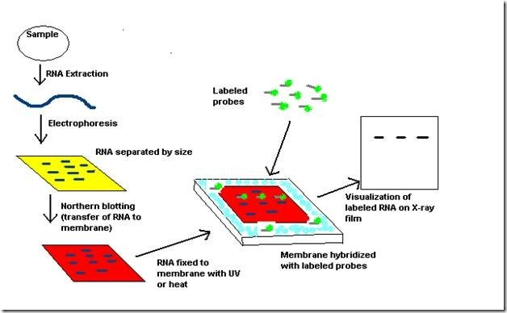
2. A northern blot is a laboratory method used to detect specific RNA molecules among a mixture of RNA. Northern blotting can be used to analyze a sample of RNA from a particular tissue or cell type in order to measure the RNA expression of particular genes.

Slide 9
Procedure
The first step in a northern blot is to denature, or separate, the RNA within the sample into single strands, which ensures that the strands are unfolded and that there is no bonding between strands.
The RNA molecules are then separated according to their sizes using a method called gel electrophoresis.
Following separation, the RNA is transferred from the gel onto a blotting membrane. (Although this step is what gives the technique the name "northern blotting," the term is typically used to describe the entire procedure.) Once the transfer is complete, the blotting membrane carries all of the RNA bands originally on the gel.
Next, the membrane is treated with a small piece of DNA or RNA called a probe, which has been designed to have a sequence that is complementary to a particular RNA sequence in the sample; this allows the probe to hybridize, or bind, to a specific RNA fragment on the membrane.
In addition, the probe has a label, which is typically a radioactive atom or a fluorescent dye. Thus, following hybridization, the probe permits the RNA molecule of interest to be detected from among the many different RNA molecules on the membrane.

Slide 10
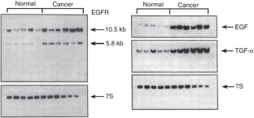
Northern blot analysis of EGFR, EGF and TGF-α in the normal pancreas and pancreatic cancer.
Streit, S., Michalski, C., Erkan, M. et al. Northern blot analysis for detection and quantification of RNA in pancreatic cancer cells and tissues. Nat Protoc 4, 37–43 (2009). https://doi.org/10.1038/nprot.2008.216

Slide 11
Applications of Northern Blot
The technique can be used for the identification and separation of RNA fragments collected from different biological sources.
Northern blotting is used as a sensitive test for the detection of transcription of DNA fragments that are to be used as a probe in Southern Blotting.
It also allows the detection and quantification of specific mRNAs from different tissues and different living organisms.
Northern blotting is used as a tool for gene expression studies related to overexpression of cancer-causing genes, and gene expression during transplant rejects.
Northern blotting has been used as a molecular tool for the diagnosis of diseases like Crohn’s disease.
The process is used as a method for the detection of viral microRNAs that play important roles in viral infection.

Slide 12
Northern blotting was employed as the primary technique for the analysis of RNA fragments for a long time; however, new, more convenient, and cost-effective techniques like RT-PCR have slowly replaced the technique.

Slide 13
3. Western blot is often used in research to separate and identify proteins. In this technique a mixture of proteins is separated based on molecular weight, and thus by type, through gel electrophoresis. These results are then transferred to a membrane producing a band for each protein.
Procedure
A. A western blot is a laboratory method used to detect specific protein molecules from among a mixture of proteins. This mixture can include all of the proteins associated with a particular tissue or cell type. Western blots can also be used to evaluate the size of a protein of interest, and to measure the amount of protein expression. This procedure was named for its similarity to the previously invented method known as the Southern blot.
B. The first step in a western blot is to prepare the protein sample by mixing it with a detergent called sodium dodecyl sulfate, which makes the proteins unfold into linear chains and coats then with a negative charge. Next, the protein molecules are separated according to their sizes using a method called gel electrophoresis. Following separation, the proteins are transferred from the gel onto a blotting membrane. Although this step is what gives the technique the name "western blotting," the term is typically used to describe the entire procedure.

Slide 14
C. Once the transfer is complete, the membrane carries all of the protein bands originally on the gel. Next, the membrane goes through a treatment called blocking, which prevents any nonspecific reactions from occurring. The membrane is then incubated with an antibody called the primary antibody, which specifically binds to the protein of interest. Following incubation, any unbound primary antibody is washed away, and the membrane is incubated yet again, but this time with a secondary antibody that specifically recognizes and binds to the primary antibody. The secondary antibody is linked to a reporter enzyme that produces color or light, which allows it to be easily detected and imaged. These steps permit a specific protein to be detected from among a mixture of proteins.

Slide 15
The 8 basic steps of the science of Western blotting have remained the same for the last 40 years.
1. First, sample preparation: lysing and denaturing the proteins. 2. Next, gel electrophoresis. 3. Then membrane transfer. 4. After that blocking. 5. Then incubating the primary antibody. 6. And, then incubating the secondary antibody. 7. Next detection. 8. And, finally analysis.

Slide 16
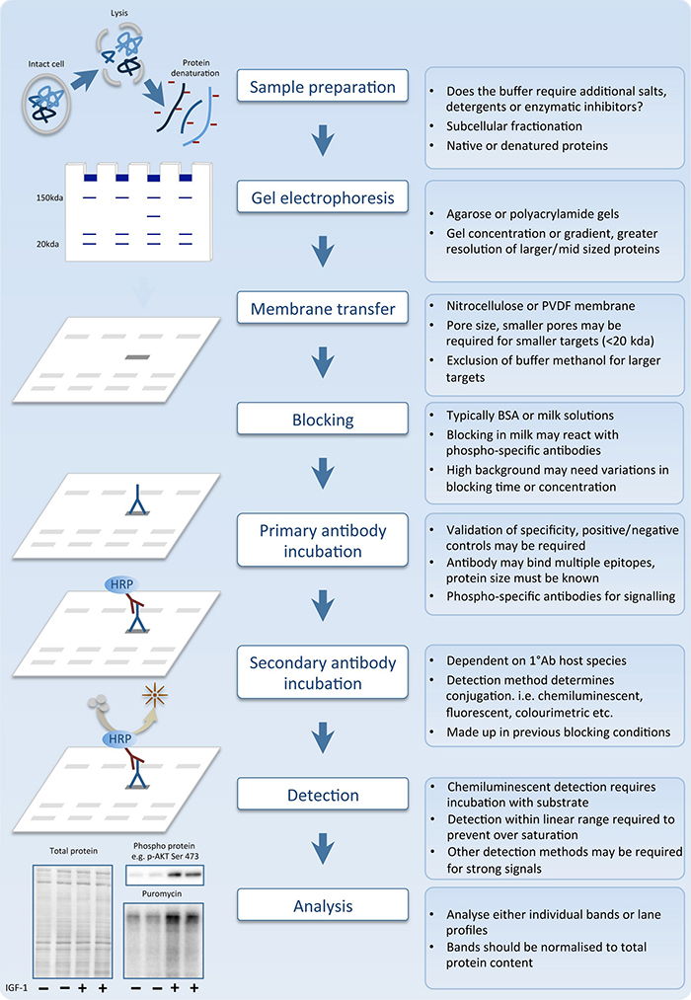

Slide 17
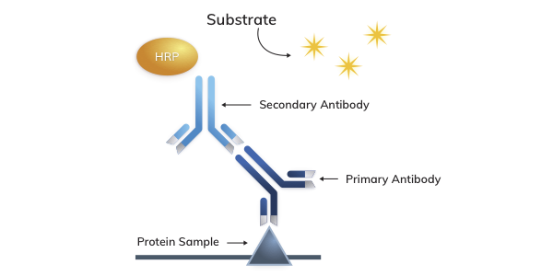
Horseradish Peroxidase (HRP) has a high turnover rate that allows HRP secondary antibodies to generate strong signal in a short time span. HRP secondary antibodies are commonly used in western blot (WB), immunohistochemistry (IHC) and ELISA.

Slide 18
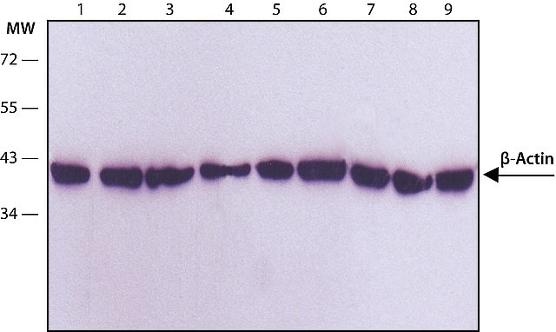
Western blot validation of a monoclonal antibody against β-actin

Slide 20
The northern blot technique was developed in 1977 by James Alwine, David Kemp, and George Stark at Stanford University. Northern blotting takes its name from its similarity to the first blotting technique, the Southern blot, named for biologist Edwin Southern.
The term "western blot" was given by W. Neal Burnette in 1981, although the method itself originated in 1979 in the laboratory of Harry Towbin at the Friedrich Miescher Institute in Basel, Switzerland.

Slide 21
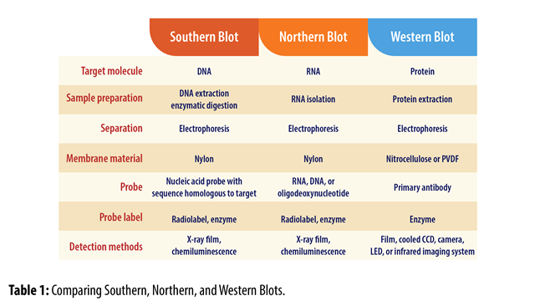

Slide 22
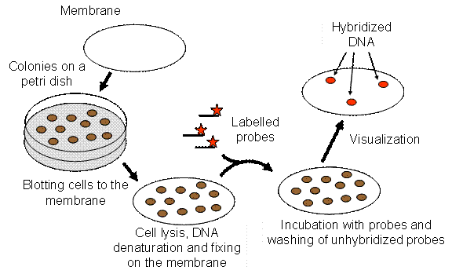
Colony Hybridization
Colonies of bacteria which contain specific DNA can be selected or identified by colony
Hybridization.

Slide 23
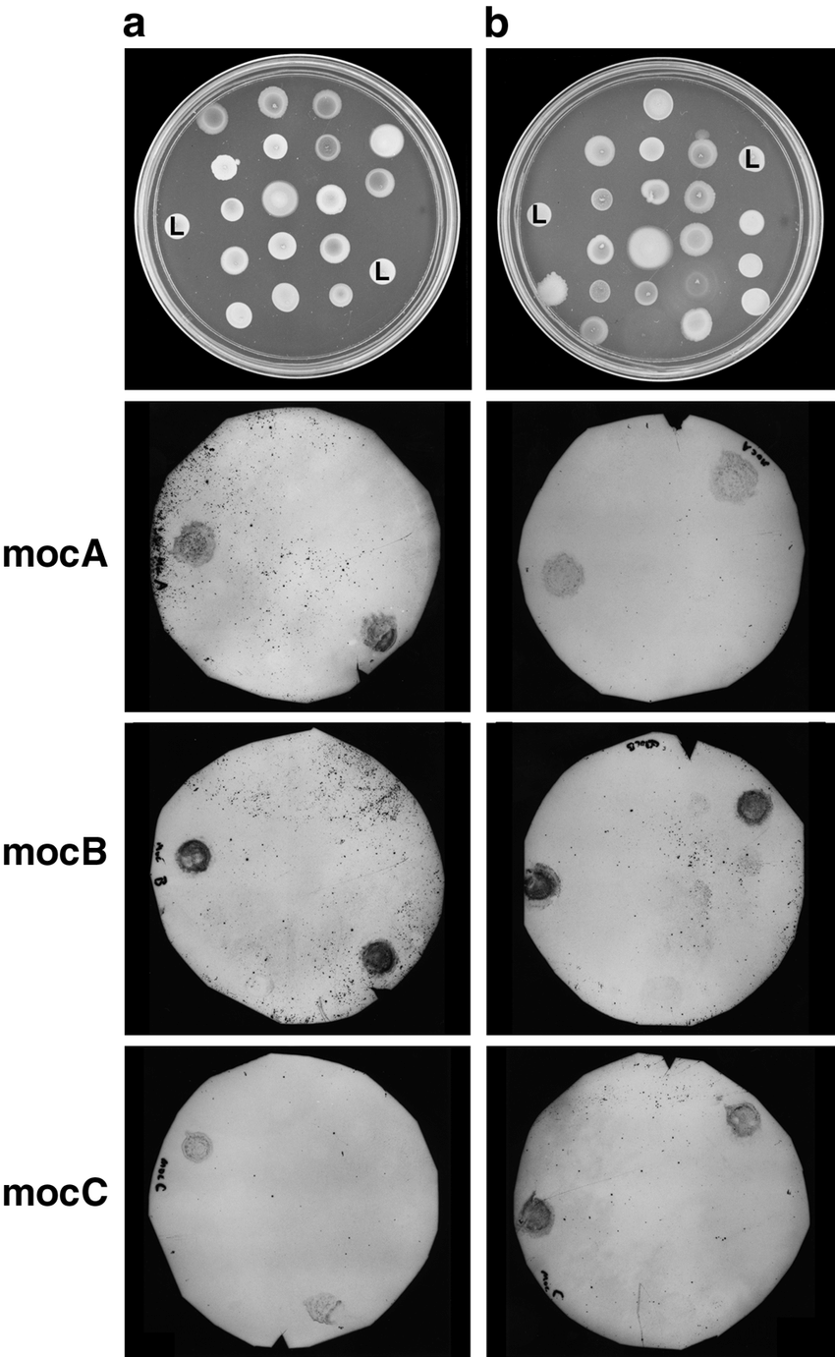
Digoxigenin labeled DNA probe

Slide 24
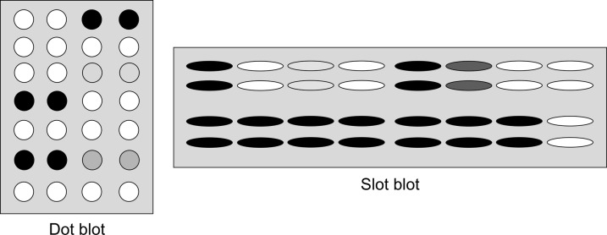
DOT BLOT ASSAY

Slide 26
Electrophoretic Mobility Shift Assay (EMSA)
The electrophoretic mobility shift assay (EMSA) is a rapid and sensitive method to detect protein-nucleic acid interactions.
It is based on the observation that the electrophoretic mobility of a protein-nucleic acid complex is typically less than that of the free nucleic acid.
Also referred as,
Gel shift assay
Gel mobility shift assay
Band shift assay
Gel retardation assay
Titration of a 214 bp lac promoter DNA fragment with E. coli CAP protein

Slide 27
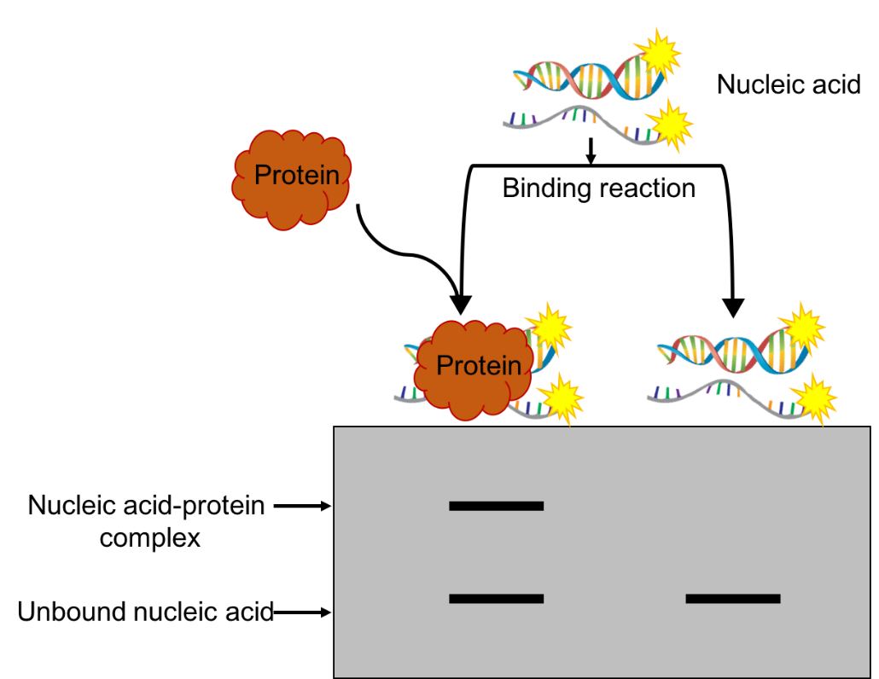

Slide 28
Once the length of the nucleotides is sufficient for the binding of two or more proteins, the protein–DNA complexes migrate as distinct bands, usually referred to as a super shift.

Slide 29
RNA electrophoretic mobility shift:
To get idea about the RNA binding protein
Limitation:
Electrophoretic mobility of a complex provides little direct information about the location of the nucleic acid sequences that are occupied by protein.

Slide 30
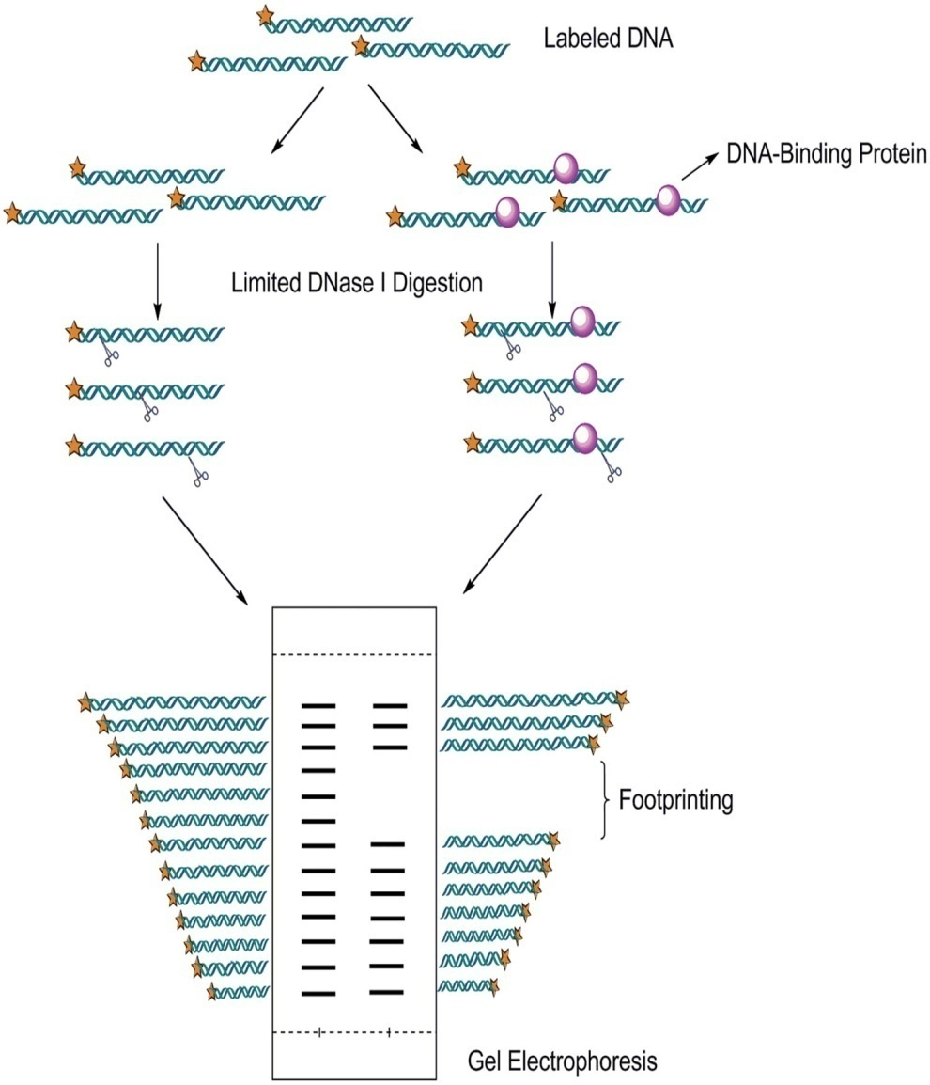
Footprinting Assay
This assay allows us to identify the sites, where protein binds.
DNase I footprinting assay: Identification of the DNA sequence to which protein binds.

Slide 31
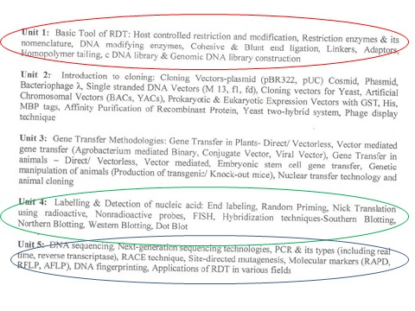

Slide 32
