Slide 1
DNA FINGERPRINTING

Slide 2
Division of forensic sciences
Crime scene investigation
(Forensic expert scientist)
Forensic biology
Pathology
Ballistics
Forensic Science
Entomology
Anthropology
Toxicology
Questioning and documentation
(Forensic linguistics)

Slide 3
History of DNA finger printing
1980 - Ray White describes first polymorphic RFLP marker
1985 - Alec Jeffreys discovers multilocus VNTR probes
1985 - First paper on PCR
1st use of DNA testing in forensic sciences came in 1986
2 young girls Lynda Mann and Dawn Ashworth raped and murdered in 1983 and 1986 respectively.
1988 - FBI starts DNA casework
1991 - First STR (short tandem repeats) paper
1995 – FSS (forensic science service) starts UK DNA database
1998 - FBI launches CODIS database

Slide 4
Continue…
DNA fingerprinting or DNA typing was first described in 1985 by an English geneticist named Alec Jeffreys.
The technique used by Dr. Jeffreys to examine the VNTRs was called restriction fragment length polymorphism (RFLP) because it involved the use of a restriction enzyme to cut the regions of DNA surrounding the VNTRs.
This RFLP method was first used to help in an English immigration case and shortly thereafter to solve a double homicide case.

Slide 5
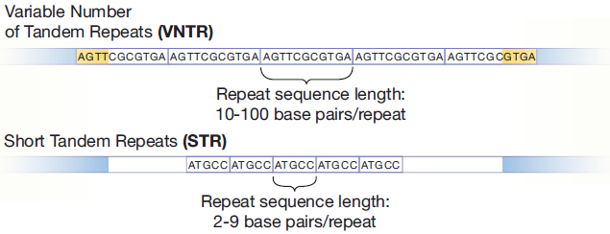
Principle behind DNA finger printing
The 99 % of the human genome is similar while it differ only at 1 % regions which are mainly non-coding and satellite regions.
DNA finger printing uses highly variable repeats sequences called VNTRs (variable number tandem repeats. Within a species the nucleotide sequence is highly conserved among all individuals but there is the differences in the number of repeats.
These VNTR regions are bordered by restriction endonucleases (RE) which can be cleaved and separated on the gel.
Minisatellite (VNTR)
Microsatellite (STR)

Slide 6
Although 99.9% of human DNA sequences are the same in every person, enough of the DNA is different that it is possible to distinguish one individual from another, unless they are monozygotic (identical) twins.
DNA profiling uses repetitive sequences that are highly variable, called variable number tandem repeats (VNTRs). VNTR loci are similar between closely related individuals, but are so variable that unrelated individuals are unlikely to have the same VNTRs.
A microsatellite is a tract of repetitive DNA in which certain DNA motifs (ranging in length from one to six or more base pairs) are repeated, typically 5–50 times. Microsatellites occur at thousands of locations within an organism's genome. They have a higher mutation rate than other areas of DNA leading to high genetic diversity. Microsatellites are often referred to as short tandem repeats (STRs) by forensic geneticists and in genetic genealogy, or as simple sequence repeats (SSRs) by plant geneticists.

Slide 7
Various methods of DNA finger printing
RFLP (Restriction fragment length polymorphism) Analysis: VNTR INVOLVED
Polymerase chain reaction (PCR) analysis: STR (Short tandem repeats) INVOLVED

Slide 8
Method 1

Slide 9
Technique or methodology
Isolation of genomic DNA
Restriction digestion of genomic DNA
Separation of the fragments on the gel electrophoresis
Transfer of DNA on nylon membrane
Hybridization of the probes
Autoradiography

Slide 10
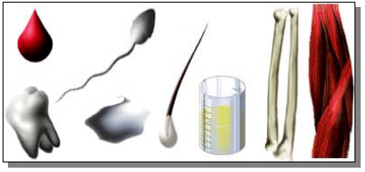
Sources of biological evidence
Blood
Semen
Saliva
Urine
Hair
Teeth
Bone
Tissue

Slide 11
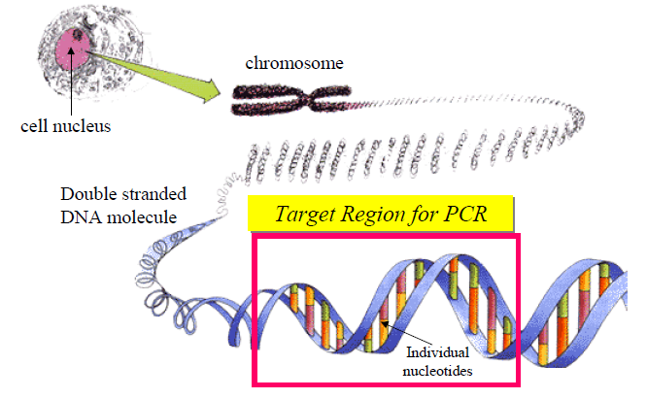
Isolation of genomic DNA
Target region

Slide 12
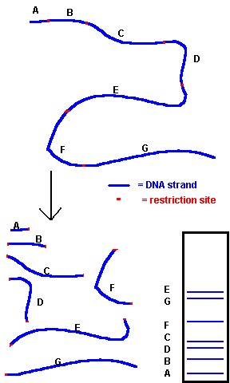
Restriction Enzyme Cut Sites

Slide 13
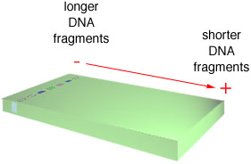
Electrophoresis of DNA Fragments

Slide 14
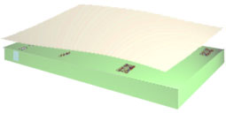
Transfer of DNA Fragments to a Nylon Membrane - “Southern Blotting”

Slide 15
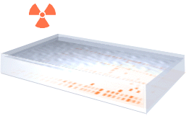
Probing of Membrane with Radioactive or Labeled DNA Probes

Slide 16
VNTRs
HaeIII
HaeIII
HaeIII
HaeIII
Size Separation on Gel
a
b
c
d
e
Probe
VNTR repeat region
c
Probe
b
a
b
e
d
c
d
a
e
Only DNA fragments containing a complementary sequence to the probe are detected.

Slide 17
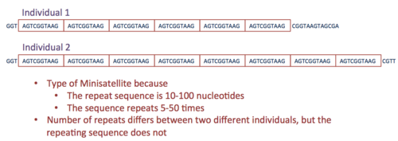
Schematic of a Variable Number of Tandem Repeats in 4 alleles.

Slide 18
DNA fingerprinting is a technique that shows the genetic makeup of living things. It is a method of finding the difference between the satellite DNA regions in the genome.”
DNA Fingerprinting Steps
Alec Jeffreys developed this technique in which he used satellite DNAs also called VNTRs (Variable Number of Tandem Repeats) as a probe because it showed the high level of polymorphism.
Following are the steps involved in DNA fingerprinting:
Isolating the DNA.
↓
Digesting the DNA with the help of restriction endonuclease enzymes.
↓
Separating the digested fragments as per the fragment size by the process of electrophoresis.
↓
Blotting the separated fragments onto synthetic membranes like nylon.
↓
Hybridizing the fragments using labeled VNTR probes.
↓
Analyzing the hybrid fragments using autoradiography.

Slide 19
Restriction Fragment Length Polymorphism (RFLP)
Restriction Fragment Length Polymorphism (R FLP) is a technique in which organisms may be differentiated by analysis of patterns derived from cleavage of their DNA. If two organisms differ in the distance between sites of cleavage of a particular restriction endonuclease, the length of the fragments produced will differ when the DNA is digested with a restriction enzyme. The similarity of the patterns generated can be used to differentiate species (and even strains) from one another.
Advantage
High power of discrimination
Reproducible
No prior sequence information required
Can differentiate between homozygotes and heterozygotes
Disadvantage
Time-consuming
Partial digests
Need at least 10-25 ng of DNA
Genetic mutations only identified at restriction cut sites
Not ideal for whole genome variation identification
Requires radioisotopes

Slide 20
RFLP

Slide 21
RFLP Method

Slide 22
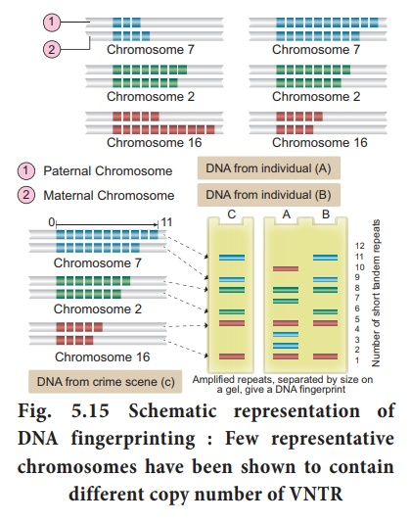

Slide 23
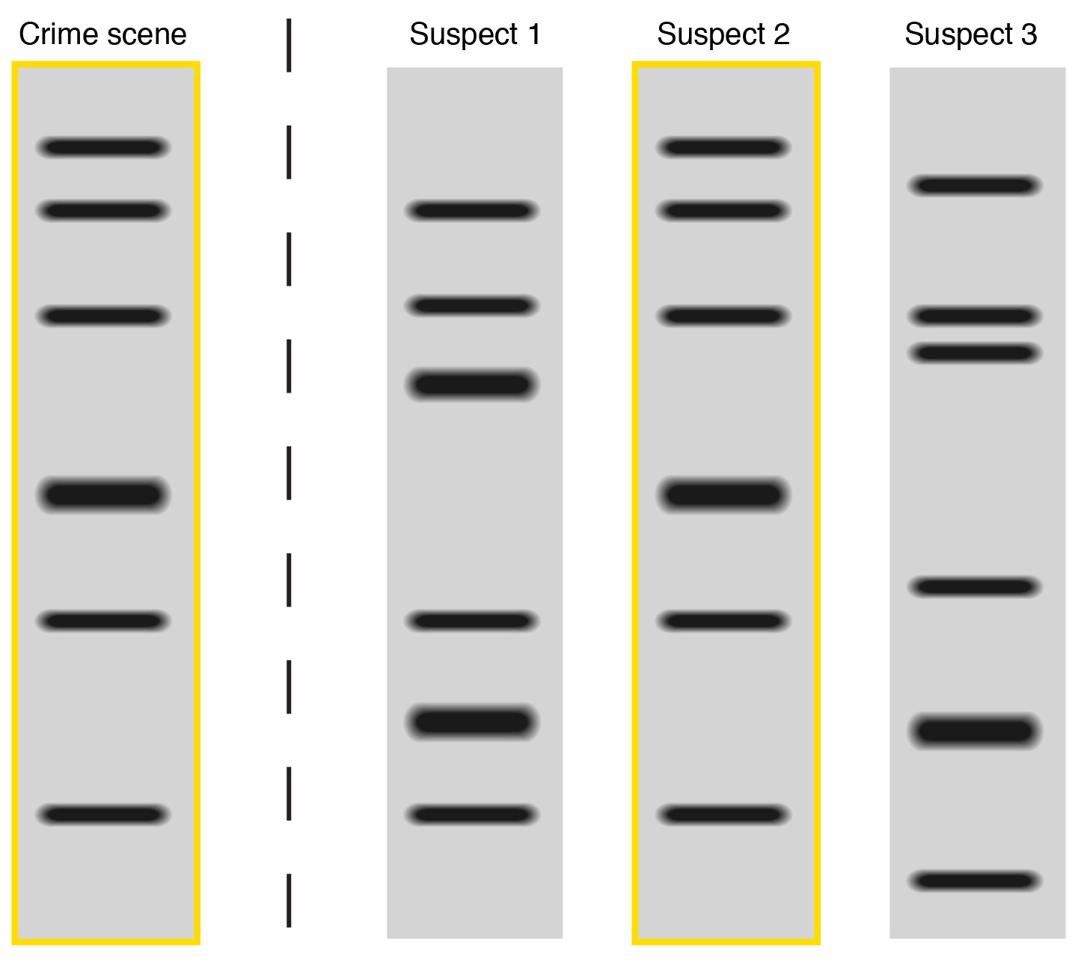
Case 1

Slide 24
2. Short Tandem Repeats (STRs)
AATG
7 repeats
8 repeats
the repeat region is variable between samples while the flanking regions where PCR primers bind are constant
Homozygote = both alleles are the same length (one PCR product)
Heterozygote = alleles differ and can be resolved from one another,
(2 PCR products.)
The system of DNA profiling used today is based on polymerase chain reaction (PCR) and uses simple sequences.

Slide 25
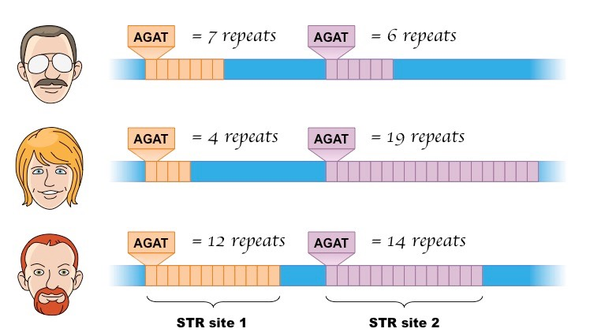

Slide 26
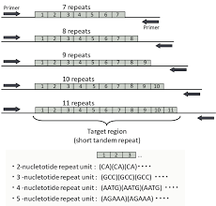

Slide 27
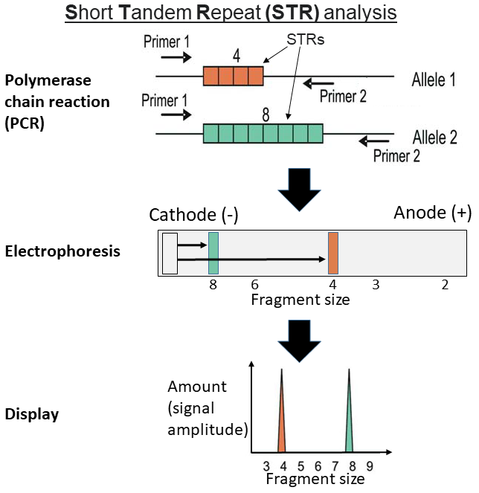

Slide 28
Continue…..
Advantages
Fast
Highly reproducible
High level of discrimination
Standardized across forensic laboratories
Uses low DNA amounts for amplification
Disadvantages
Challenges with highly degraded or low template DNA

Slide 29
Applications of DNA finger printing
Forensic analysis: It can be used in the identification of a (1) person involved in criminal activities, (2) for settling paternity or maternity disputes, and (3) in determining relationships for immigration purposes.
Pedigree analysis: It can be used for inheritance pattern of genes through generations and for detecting inherited diseases such as Cystic Fibrosis, Haemophilia, Huntington’s Disease, Sickle Cell Anaemia etc.
Personal Identification: DNA fingerprints can be used as a genetic bar code to identify individuals.
Anthropological studies: It is useful in determining the origin and migration of human populations and genetic diversities.
DNA Barcoding: A technique for specifying the organisms’ species using a short sequence of DNA situated in the genome is termed DNA bar-coding. The barcode DNA sequences are too short in respect to the complete genome and hence cheaper.

Slide 30
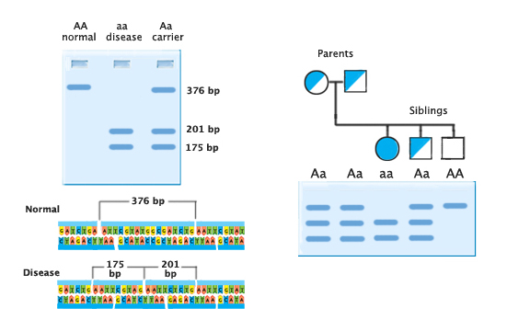
Diagnosing Disease
Sickle cell anemia: A single point mutation that causes the amino acid valine to replace glutamic acid in the amino acid chain. This mutation also creates an additional recognition site for the restriction enzyme DdeI.

Slide 31
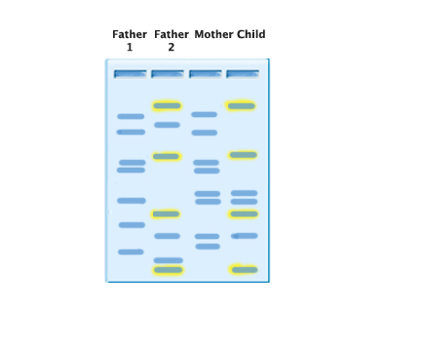
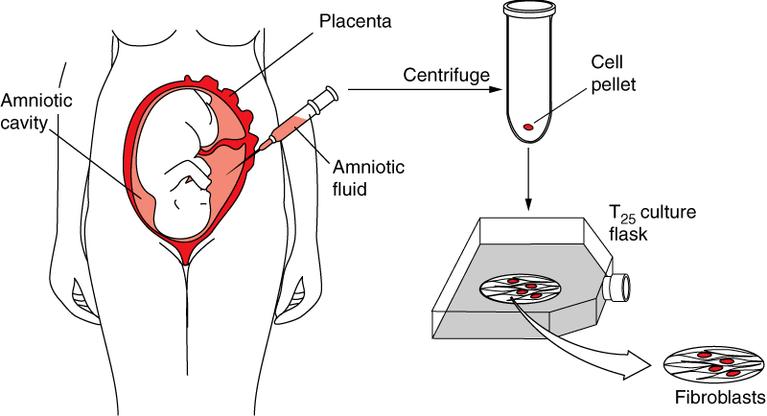
Paternity Testing
Children receive their DNA only from their mother or father that means that any bands a child has must also be represented by one parent or the other.

Slide 32
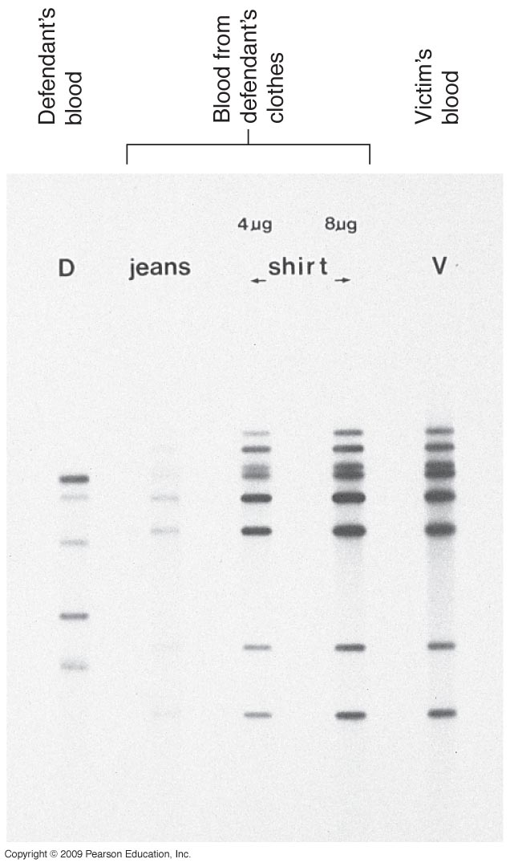
Solving cases like murdered/rape etc…

Slide 33
DNA Fingerprinting in India
Pioneering work was done by Dr. Lalji Singh at the Centre for Cellular and Molecular Biology (CCMB), Hyderabad
Centre for DNA Fingerprinting & Diagnostics (Hyderabad)
Central Forensic Science Laboratory, Kolkata
National Bureau of Plant Genetic Resource (NBPGR), New Delhi
National Institute of Plant and Genetic Research (NIPGR), New Delhi

Slide 34
